Slide 2

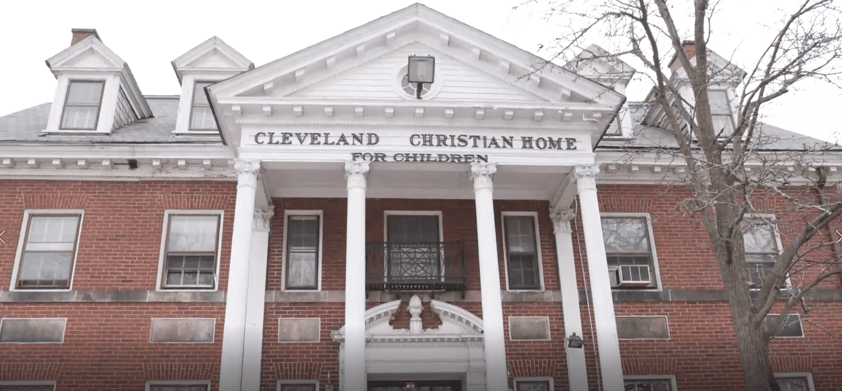
Cleveland Christian Home Today
The Centers’ H.O.P.E. Campus, formerly the Cleveland Christian Home (CCH) is a behavioral health service facility that exists to be a haven of hope and healing for children, youth, and families. As a program of The Centers, CCH’s mission is to fight for equity by healing, teaching, and inspiring individuals and families to reach their full potential. Throughout its 124-year history, CCH has evolved to meet the emerging needs of Cuyahoga County youth as a secular organization. It remains a trusted resource for youth and families dealing with mental illness, abuse, and neglect.
In 2022, CCH formally affiliated with The Centers. CCH is now better positioned to utilize The Centers’ multi-service approach that connects families with the comprehensive resources they need to build brighter futures.

Slide 3
Youth Residential Program
The Centers and Cleveland Christian Home (CCH) joined together in 2022, enabling The Centers to expand access to the full continuum of behavioral health services for children and adolescents.
Residential Care & Treatment for Youth
  24/7 care and support for youth in the custody of the Cuyahoga County Department of Children & Family Services (CCDCFS), including nursing, psychiatry, therapeutic, enrichment and educational services for youth who have experienced severe trauma or abuse and/or who may have significant emotional or behavioral health challenges.

Slide 4
Youth Residential Crisis
Today, we face a situation where the safety and well-being of children are at risk because the systems designed to protect them are overwhelmed.
For years, our community has faced a severe shortage of appropriate placements for children in county custody. The lack of sufficient beds and/or foster families has been a persistent issue, leading to increasingly desperate situations for our most vulnerable youth. Children with the most acute needs are often funneled into systems that were never designed to address their complex challenges. And the lack of local available placement options has led to the tragic reality of children being placed even temporarily in office buildings or sent out of state, far from their families and communities, in search of adequate care.
When children are sent out of state, they are not only removed from their familiar surroundings but also lose vital connections to their families and their community. This dislocation makes it significantly more difficult to reunify these children with their families, prolonging their time in the system and increasing their trauma. The systems in place, both locally and out of state, are often ill-equipped to address the acute needs of these children, further complicating their path to healing and stability.

Slide 5
The Centers' Solution
The Centers is partnering with Cuyahoga County on an ambitious capital campaign in 2024 to create lasting solutions for vulnerable youth. The new HOPE Campus, which will be built at the current Cleveland Christian Home (CCH) site on Lorain Avenue on Cleveland’s west side, demonstrates The Centers’ and the County’s commitment to ensuring that youth in County custody have a safe and therapeutic place to stay – especially those who have been turned away from other options. The campus transformation will promote a comprehensive model for assisting with rapid reunification and kinship diversion for children in county custody, while providing a safe location where youth awaiting placement can be assessed and receive treatment.
This joint effort will make meaningful progress toward providing a solution for area youth in need of placement outside of their homes. We believe keeping local youth in Cuyahoga County is our moral obligation and critical to family reunification and engagement. Over time, this program will reduce the number of nights any youth spends without adequate housing and help keep Cuyahoga County youth close to home. In one central location, Centers and County staff, along with other child-serving nonprofits, can work in lockstep to get children who have faced some of life’s harshest realities into their best placement as quickly as possible.
The campus will also provide residential treatment, short-term emergency placement, and other support for youth and families. With approximately 50 specialized beds in a comfortable, trauma-informed environment, youth will have seamless step-down and step-up options as they receive treatment close to home and work toward a path back to their families.

Slide 6
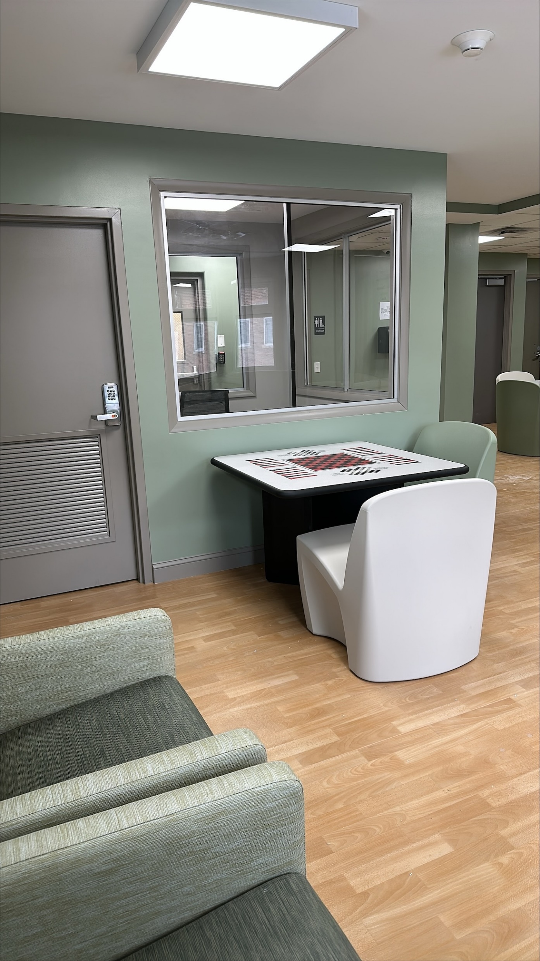
Core Components
24/7 Youth Residential Services (current)
Emergency Childcare Beds
Emergency Treatment Beds
Intensive Treatment Beds
Open Residential
Staffed Group Homes (future)
Two off-campus group homes reserved for youth who may not do well in a congregate setting, youth stepping down and preparing for foster home placement, or youth who are aging out.

Slide 7
Core Components
24/7 CHILD WELLNESS WELCOME CENTER
A centralized hub co-operated by The Centers’ H.O.P.E. Campus and Cuyahoga County Department of Children and Family Services, designed to provide immediate safety, stabilization, and support for children and families. Whether a child arrives through police, a parent, or walk-in,
Onsite community partners may include, but not limited to healthcare, crisis stabilization, child advocacy, and trauma support.
CCDCFS assessment and determination of custody, linkage to immediate supports as needed.
Return to home, kinship placement, rapid reunification response team, mobile response and stabilization services (MRSS), emergency childcare, emergency treatment.

Slide 8
Core Components
RAPID REUNIFICATION TEAM
To address dependency causes of custody (behavior management, parent mental health, etc.).
Available 7 days a week, 9am to 9pm.
Staffed by social workers and case managers with close collaboration with CCDCFS.
Provide intensive intervention to reunite or prevent custody within 72 hours, handoff and linkage to ongoing support and treatment.

Slide 9
Data
January 2023 – March 2025
  159 – unique admissions
  123 – unique individuals served
  30.8 – average length of stay for the 159 unique admissions (Median LOS = 15)
Measure | Jan-Dec 2023 | Jan-Dec 2024
Total served | 48 T-Suites unique 28 Residential unique | 88 unique youth; 96 admissions
T-Suites served since inception | 48 unique youth | Jan 2023 thru Dec 2025: 105 unique youth; 132 admissions
T-Suites served | 48 unique youth | 72 unique youth; 80 admissions
T-Suites bed days | N/A | Nearly 2500 nights
T-Suites average length of stay | 43 days | Since the inception of T-Suites, we have been able to increase the number of youth served while decreasing the average length of stay: average length of stay in 2023: 43; average length of stay in 2024: 29. Note: Median in 2024 is 16 days.
Focus group statement | N/A | T-Suites and Residential youth reported feeling connected with and supported by staff

Slide 10
Stakeholders
Cuyahoga County Executive Chris Ronayne
David Merriman, Director, Cuyahoga County Department of Health and Human Services
Jacqueline Fletcher, Director, Cuyahoga County DCFS
State Representative Bride Rose Sweeney
State Representative Tom Patton
State Representative Terrence Upchurch
State Senator Matt Dolan
State Senator Jerry Cirino
State Senator Nickie Antonio
State Senator Kent Smith
Cleveland Mayor Justin Bibb

Slide 11
Partners
Cuyahoga County Department of Children and Family Services
Cuyahoga County Juvenile Court
Cuyahoga County Board of Developmental Disabilities
Alcohol, Drug, Addiction, and Mental Health Services Board of Cuyahoga County
A Place 4 Me
Bellfaire JCB
Bluestone
Boundless
Cleveland Clinic
Cleveland Metropolitan School District
Cleveland Rape Crisis Center
Collaborative to End Human Trafficking
CWRU
FrontLine Service
KinnectOhio
MetroHealth
OhioGuidestone
Positive Education Program
The Achievement Centers
The Canopy Child Advocacy Center
University Hospitals
Wingspan Care Group
YWCA of Greater Cleveland

Slide 12
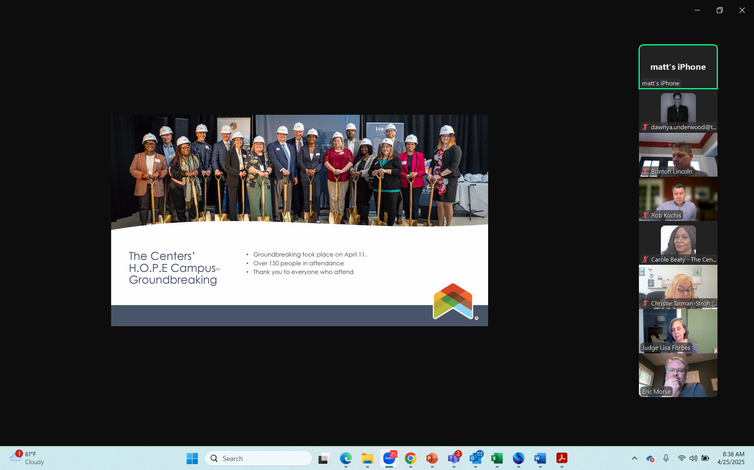

Slide 13


Slide 14
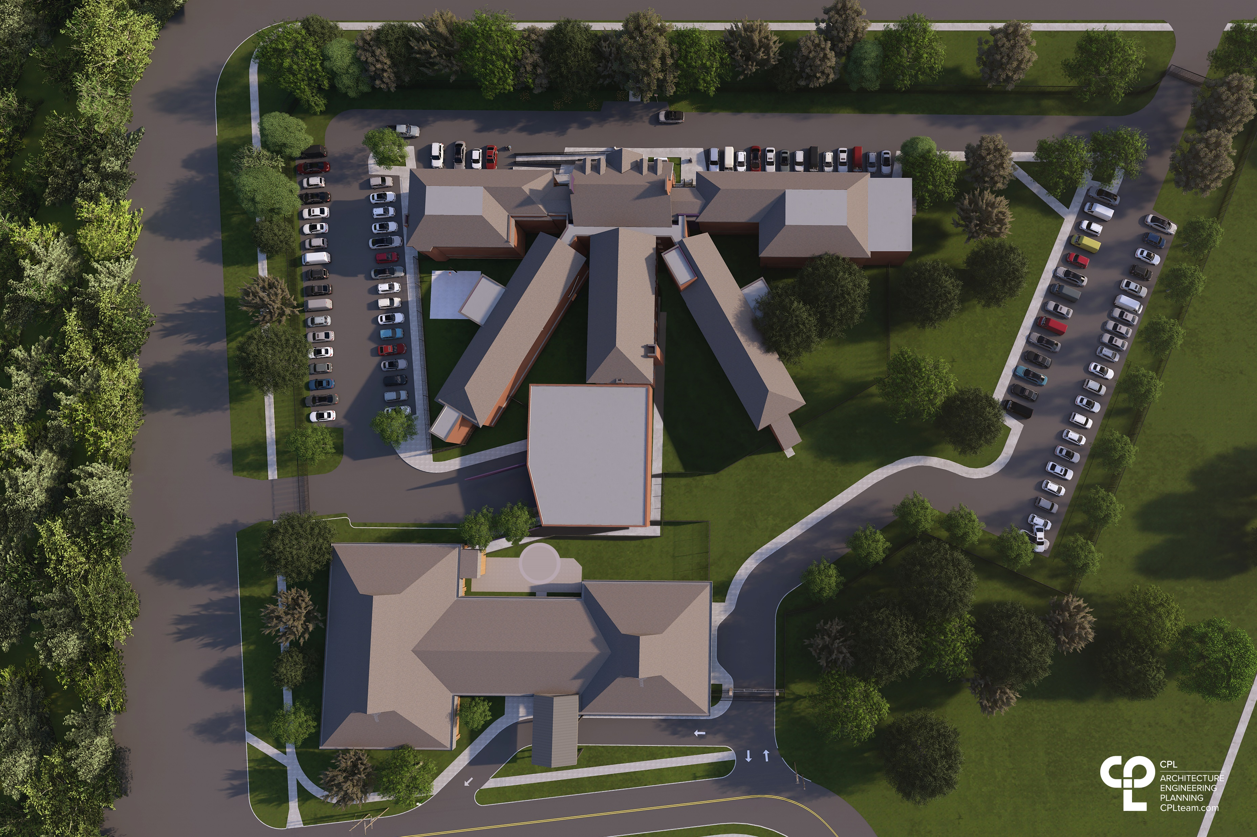

Slide 15
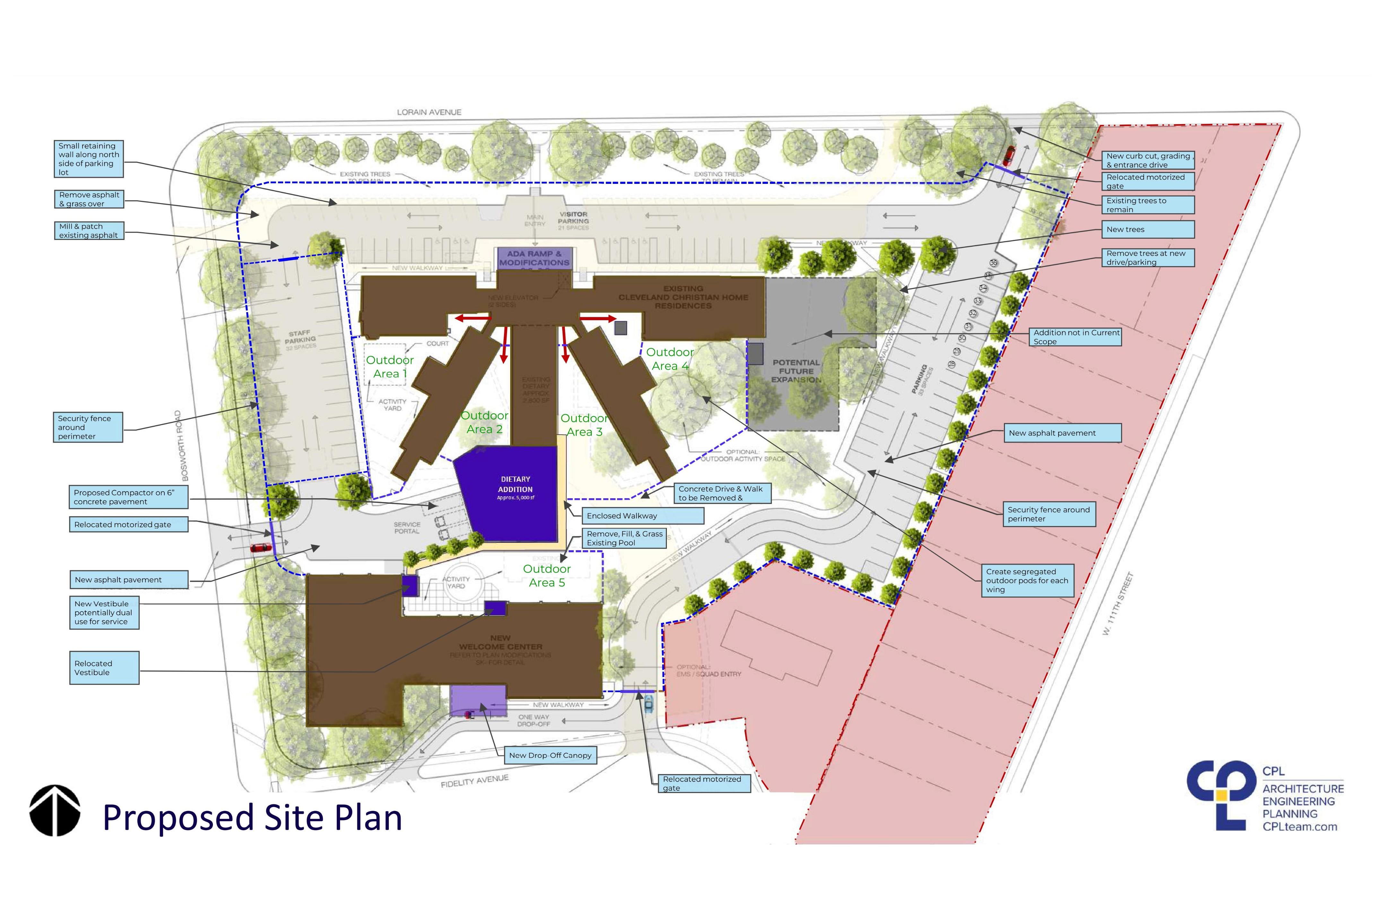

Slide 17
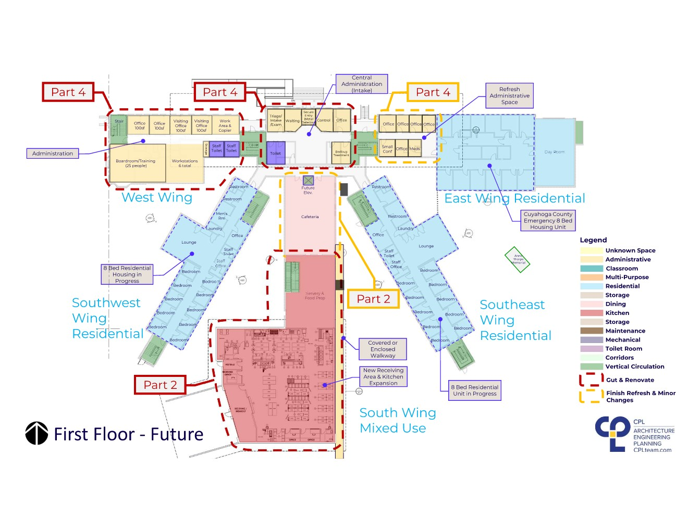

Slide 18
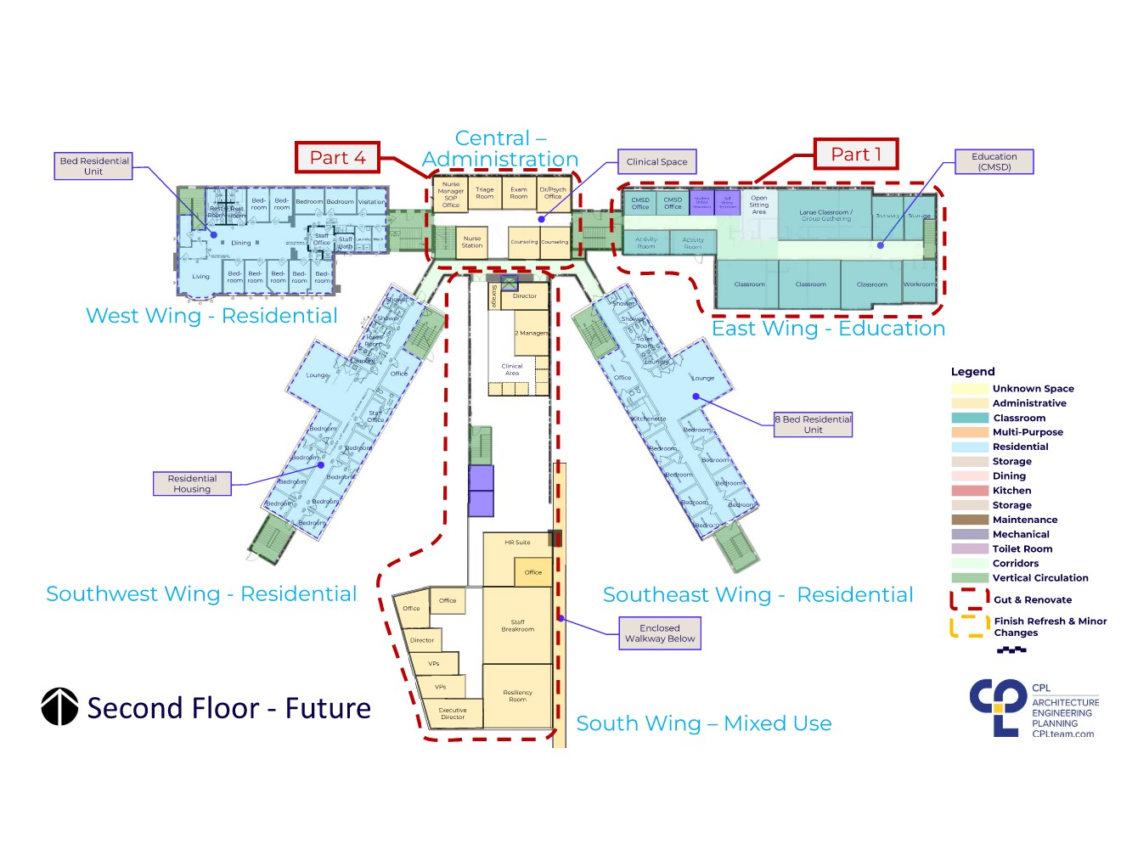

Slide 19
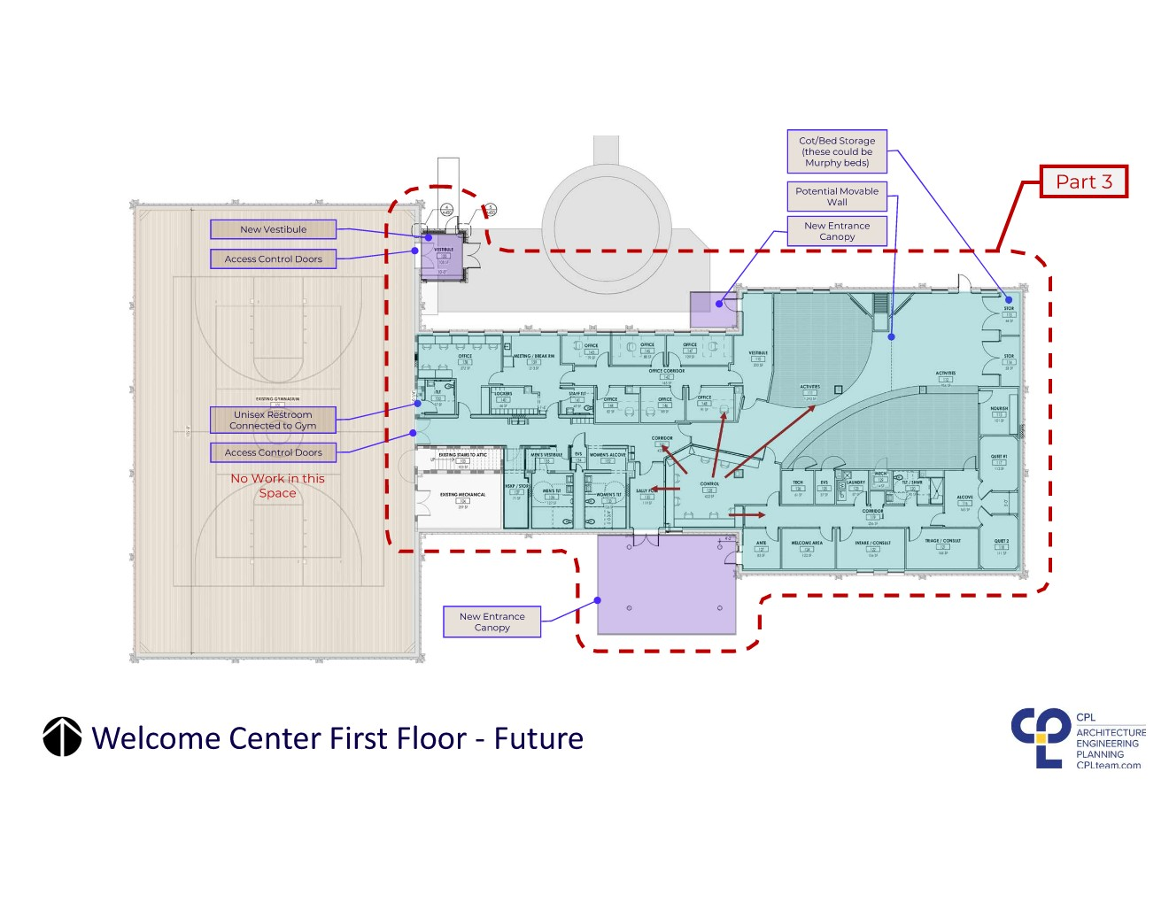

Slide 20
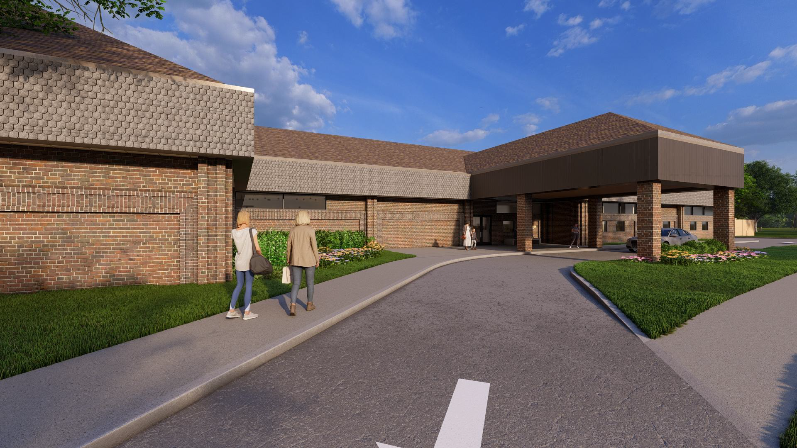

Slide 21
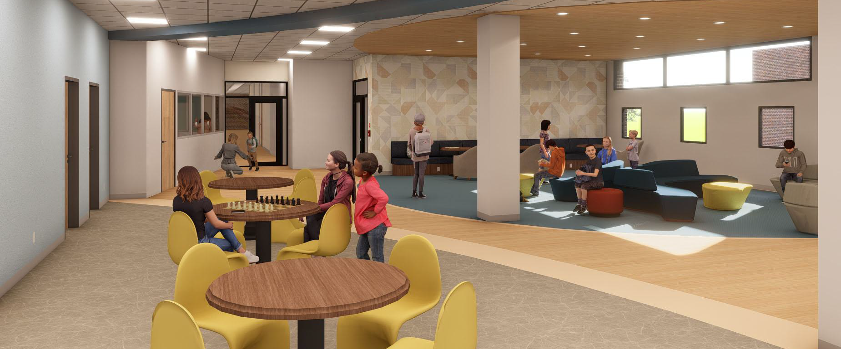

Slide 22
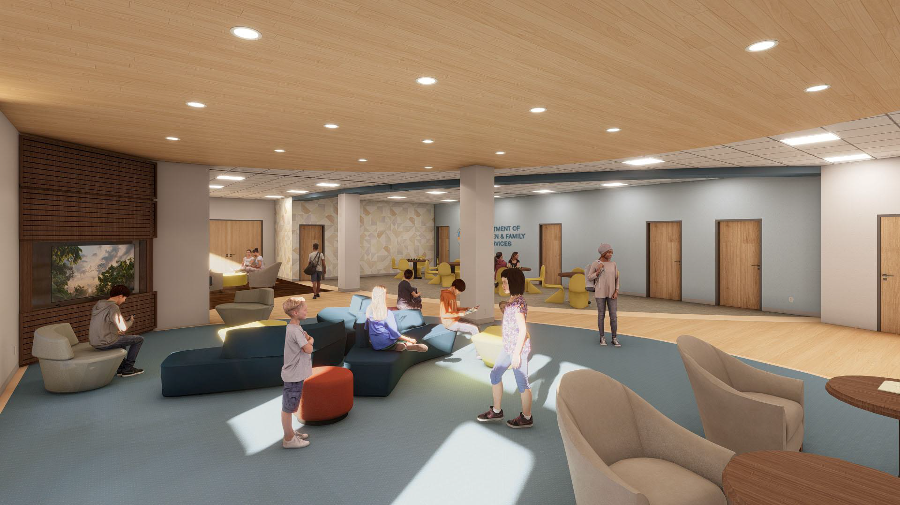

Slide 23





CONNECT WITH US
@THECENTERSHOPE
@THECENTERSHOPECAMPUS
https://thecentersohio.org/youth-residential-services/the-centers-hope-campus/
Connect With Us
@TheCentersOhio

