Slide 1
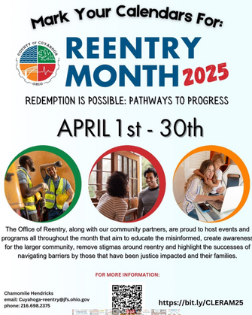
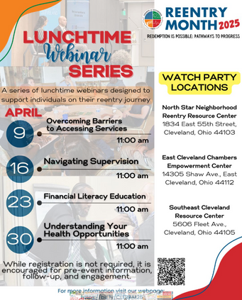





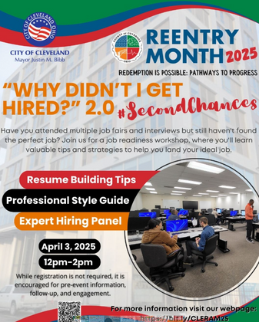
Reentry Awareness Month
Redemption is Possible: Pathways to Progress
APRIL 2025

Slide 2
Reentry Awareness Month 2025 Partners
Case Western Reserve University Second Chance Reentry Clinic
Center for Employment Opportunities (CEO)
Cleveland City Council
Cleveland Neighborhood Progress
Cleveland Public Library
Cleveland State University College of Law
Cleveland Votes
Cuyahoga Community College
Cuyahoga County Council
Cuyahoga County Office of the Public Defender
Cuyahoga County Public Library
East Cleveland City Schools
EDEN CLE
EDWINS Leadership & Restaurant Institute
Enterprise Community Partners
Fairfax Renaissance Development Corporation
Famicos Foundation
Floods Urban Seafood
Frontline Services
Greater Cleveland Food Bank
Heights Library
Jefferson-Puritas West Park CDC
Legal Aid Society of Cleveland
Lutheran Metropolitan Ministry
MetroHealth
Molina Health Care
NE Ohio Coalition for Homeless (NEOCH)
No Fork Restaurant
Northern Ohio Recovery Association (NORA)
North Star Neighborhood Reentry Resource Center
NuPoint CDC
Ohio Department of Rehabilitation and Correction (ODRC)
Ohio Department of Transportation (ODOT)
Ohio Dept of Job and Family Services (ODJFS)
Ohio Guidestone
Oriana House Inc.
Passages
Project LIFT
Reach Success, Inc.
Relink
Say Yes Mentor
Southeast Resource Center
That Brown Girl Spice
The City Mission
The City of Cleveland
Towards Employment
University Settlement
West Side Catholic Center

Slide 3
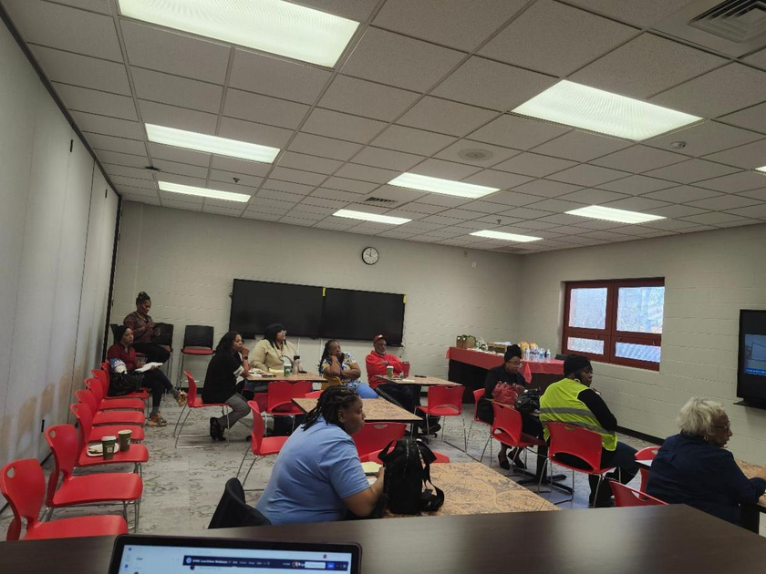
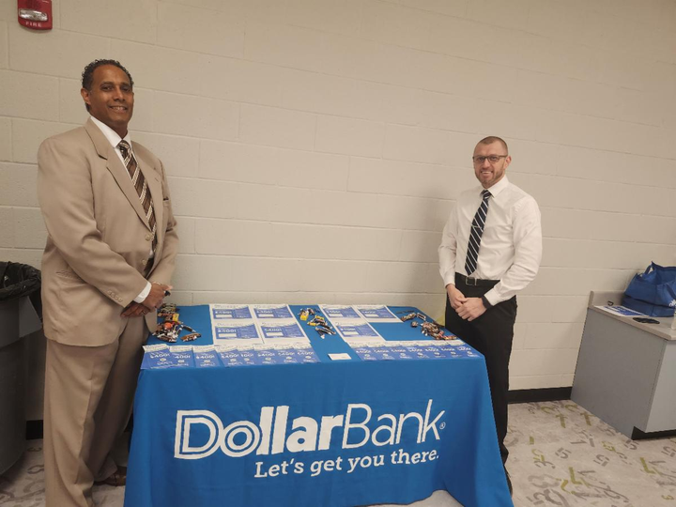
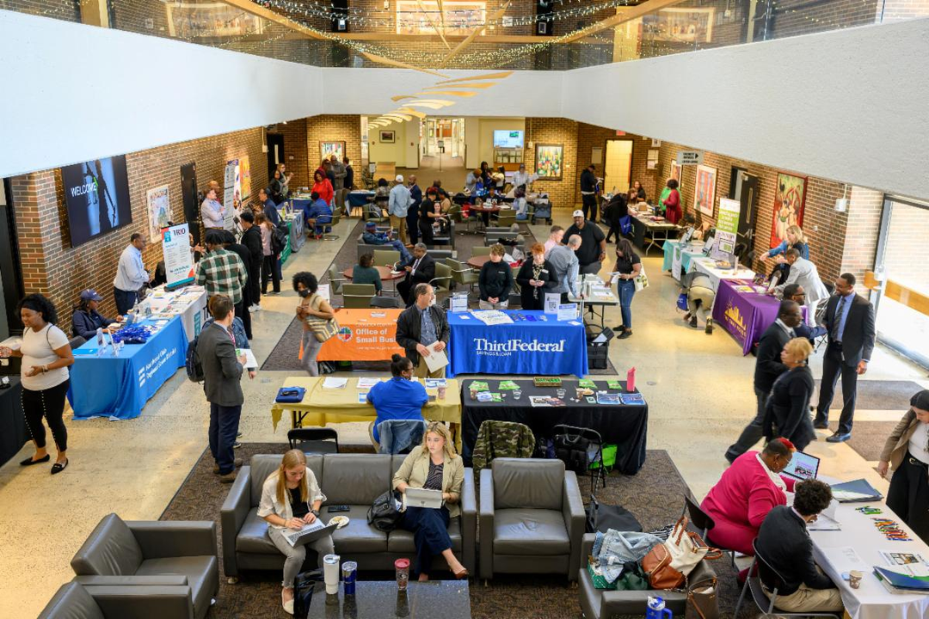
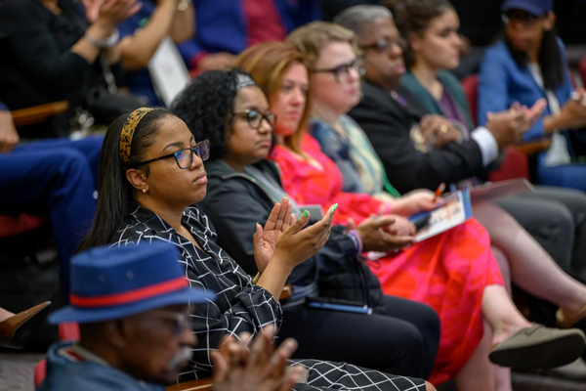
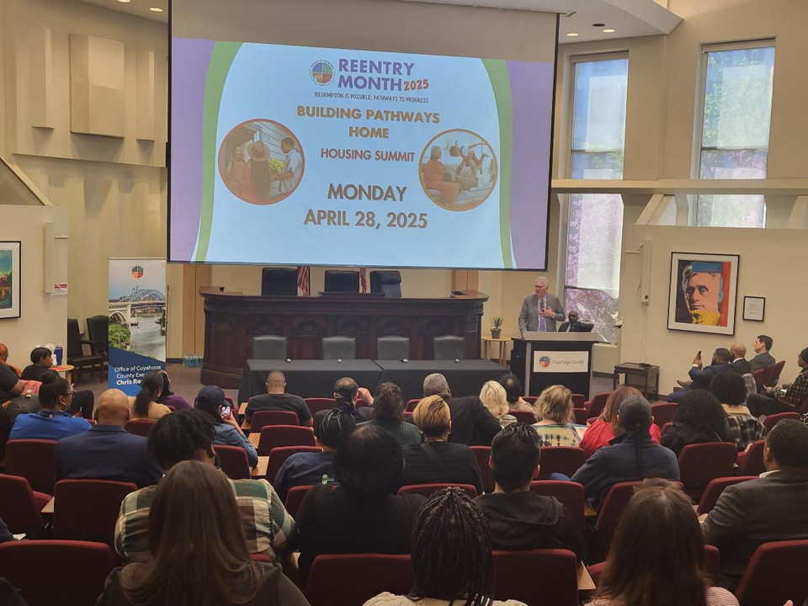
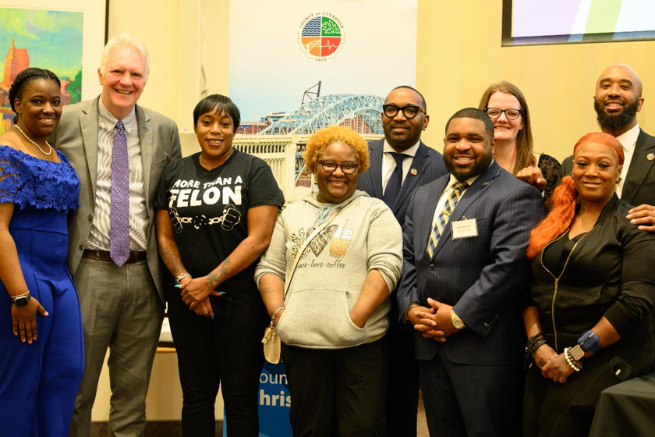
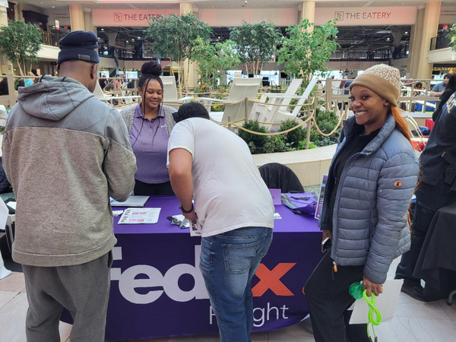
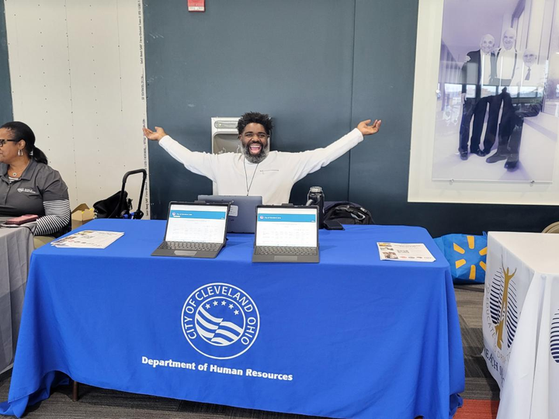
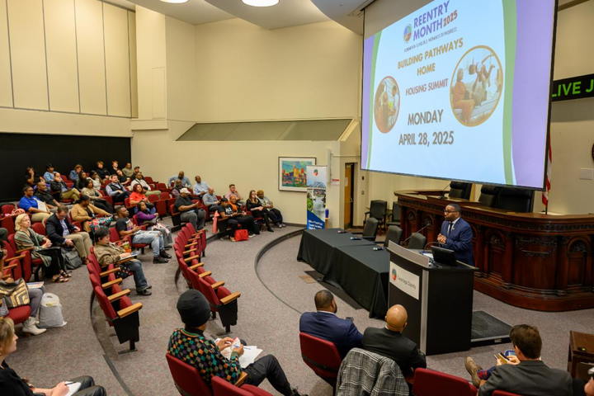
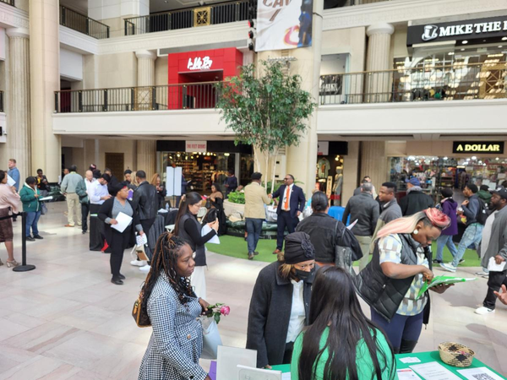
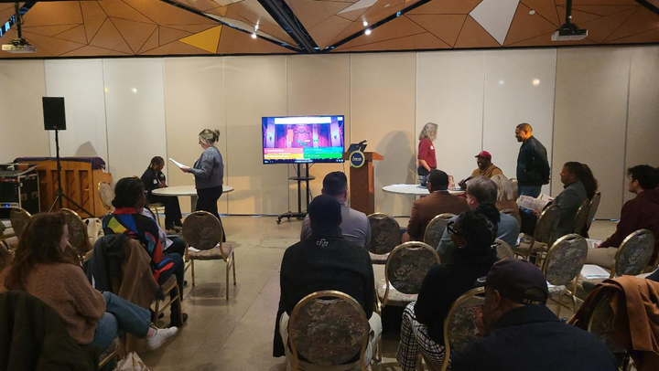
30 DAYS
20 EVENTS
1,000 +
RESIDENTS TOUCHED

Slide 4
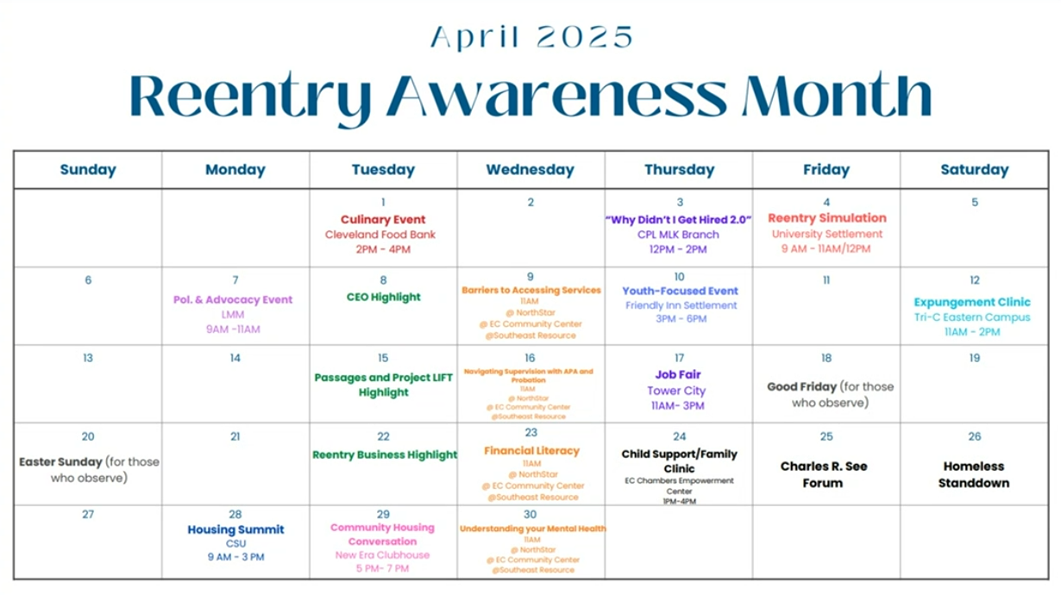

Slide 5
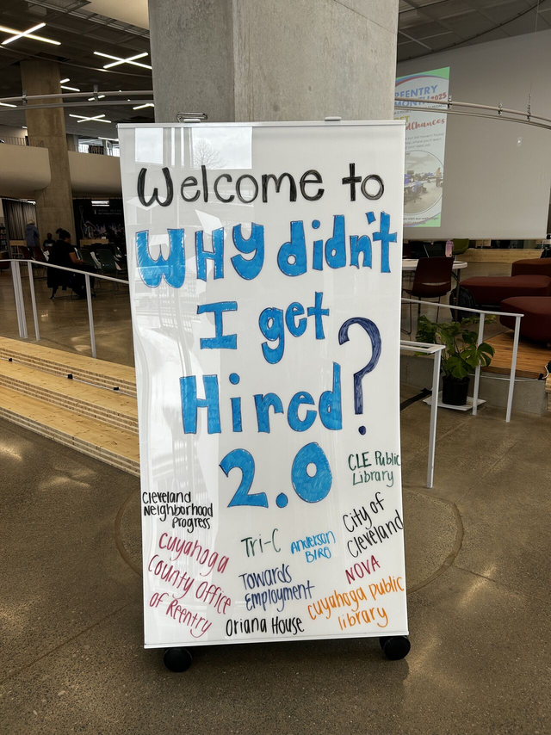
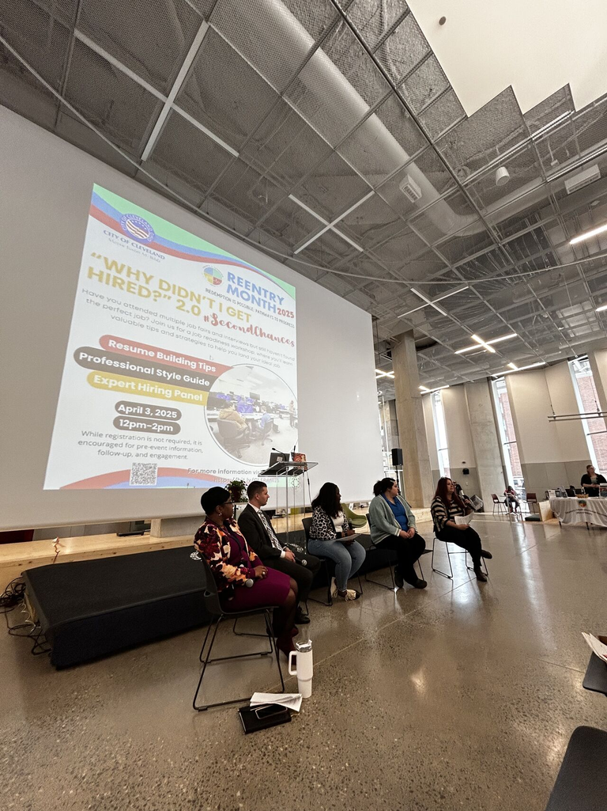
“Why Didn’t I Get Hired?” 2.0
#secondchances
Cleveland Public Library, MLK Branch
April 3rd, 2025
  Resume Building Tips
    Felicia Barker, Career Service Specialist at Tri-C
  Interview Tips
    Jessica Murphy, Staffing Leader at Anderson | Biro Staffing
  LinkedIn Presence
    Miranda Sharpnack, Director of Human Resources at Sharp HR
  Professional Attire
    Brenda Brown, Senior Employment Service Consultant at Towards Employment
  Expert Hiring Panel
    Commissioner Toi Porch, City of Cleveland
    Tracy Kurinksy, HR Director at Amotec Inc.
    Jason Peskar, HR Director at Northeast Ohio Sewer District
    Rebecca Francen, HR Manager at Oriana House
Event Collaborators
Cleveland Public Library
City of Cleveland
Tri-C
NOVA
Cuyahoga Public Library
Cleveland Neighborhood Progress
Anderson BIRO
Towards Employment
Cuyahoga County Office of Reentry

Slide 6
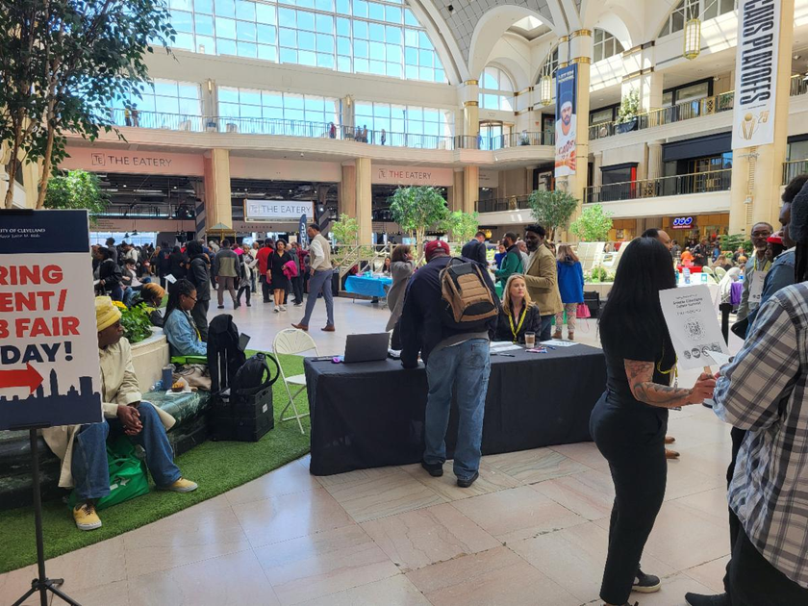
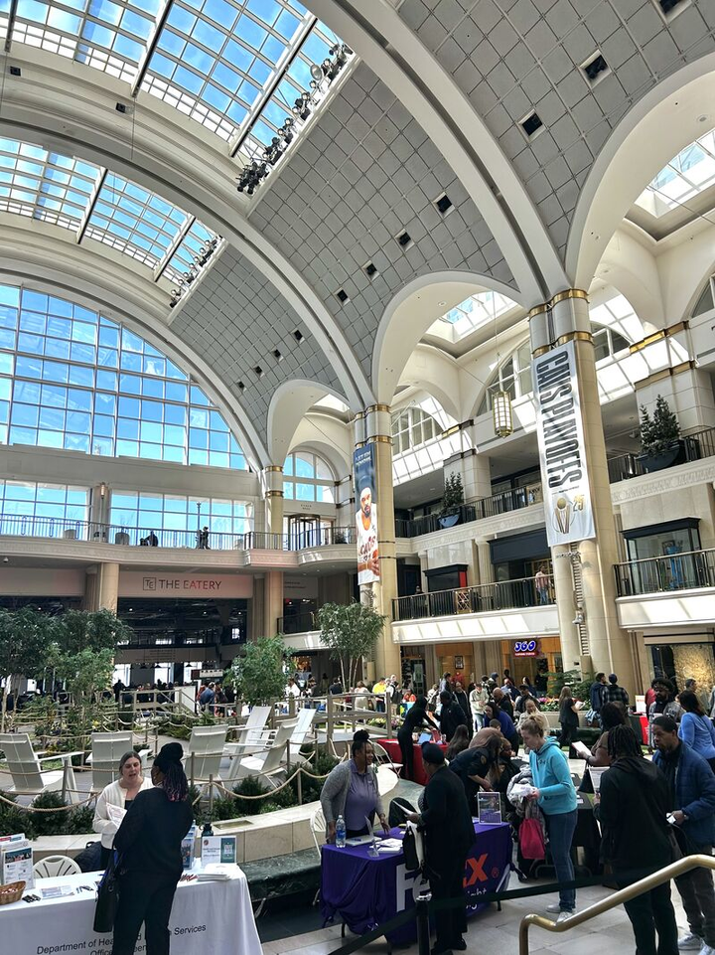
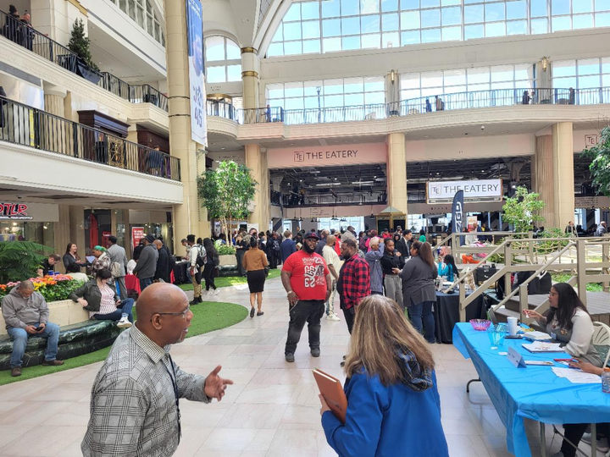
Spring Into Workforce
Greater Cleveland Career Summit
April 17th, 2025
  First-Ever Spring Into Workforce Career Summit
  Two weeks after WDIGH? for prep!
  475 job seekers and 45 top employers and workforce development resources
DJ Vibes
free parking!
on-the-spot
interviews!
raffle every half-hour

Slide 7
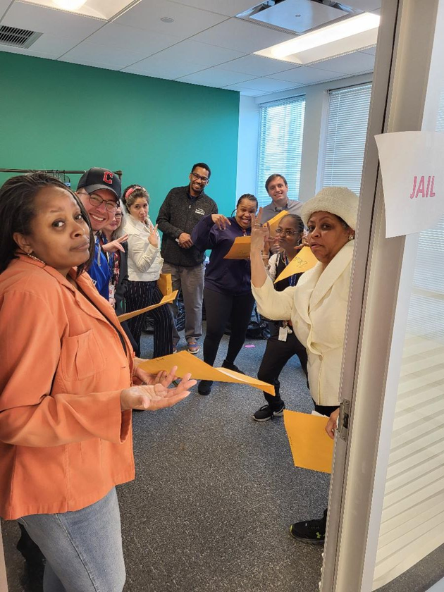
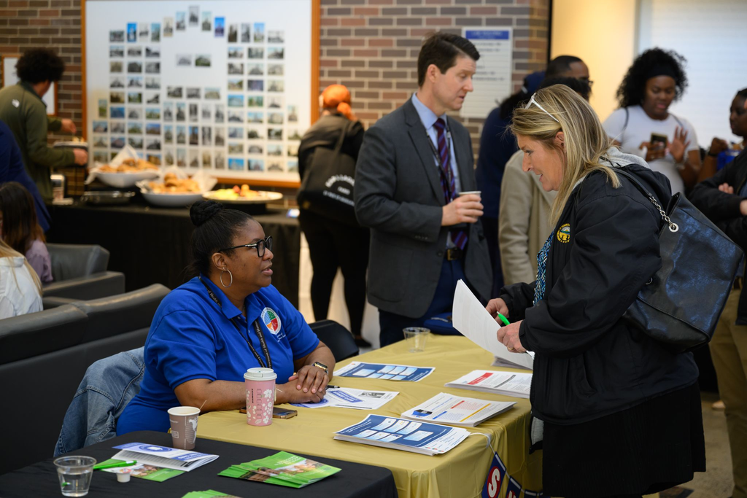
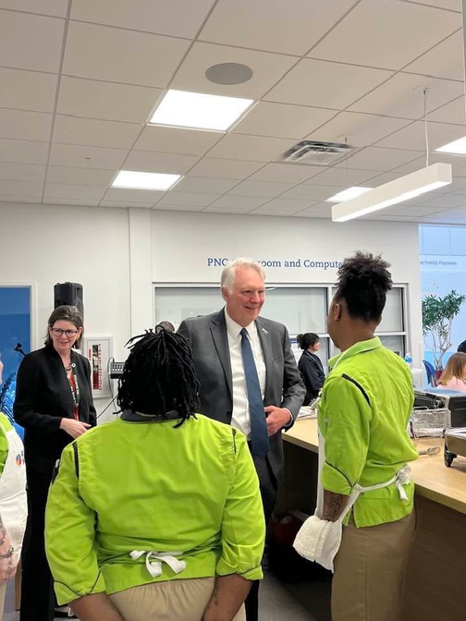
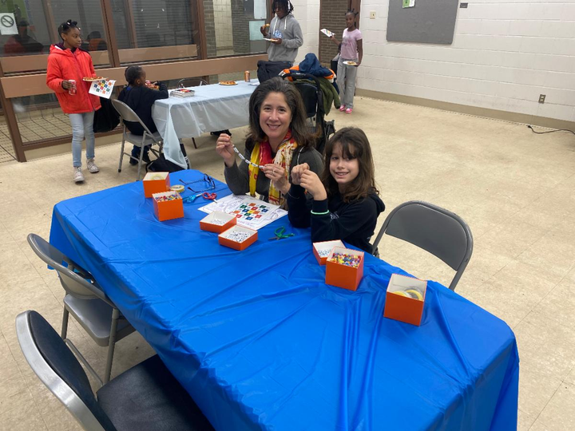
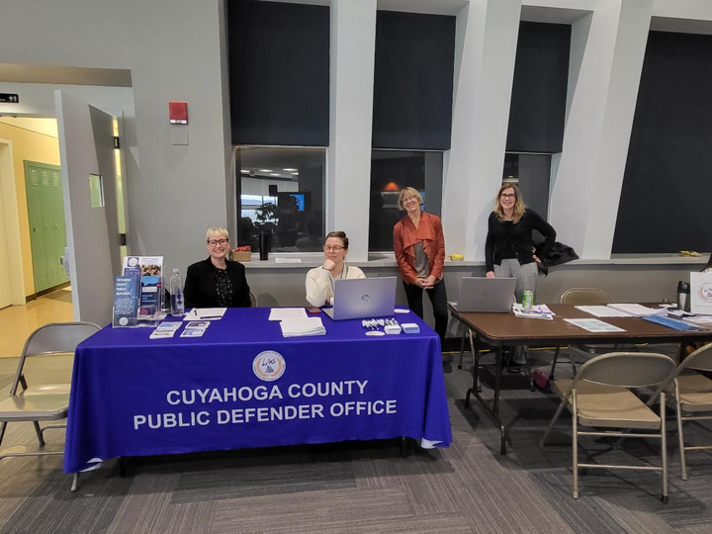
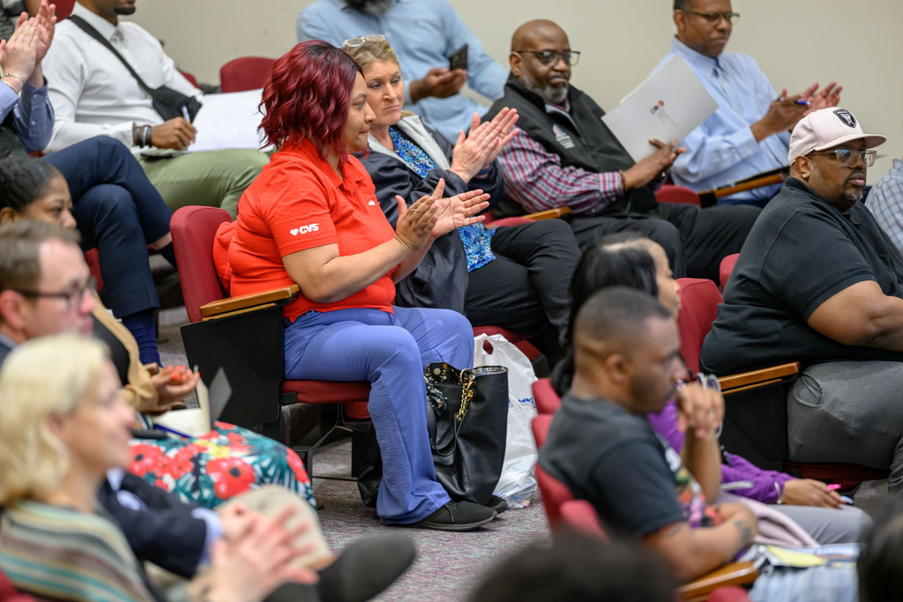
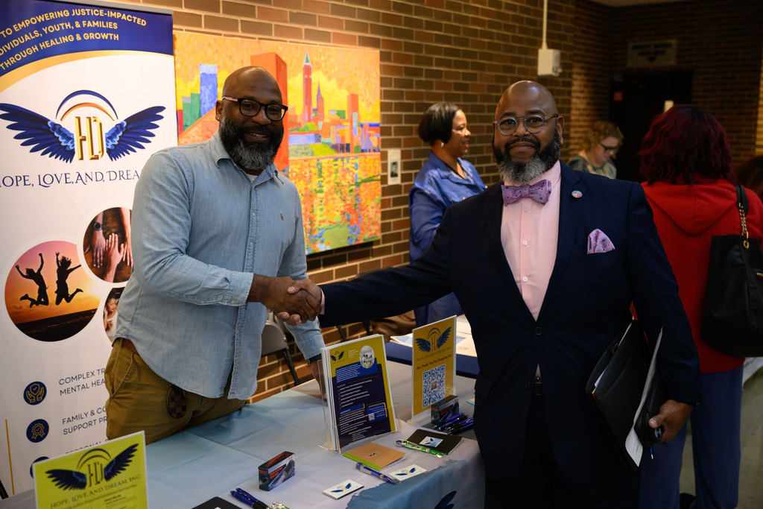
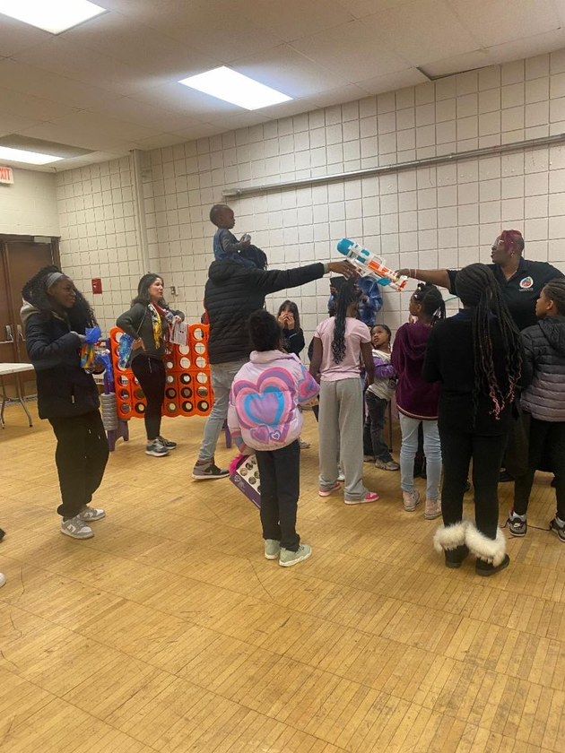
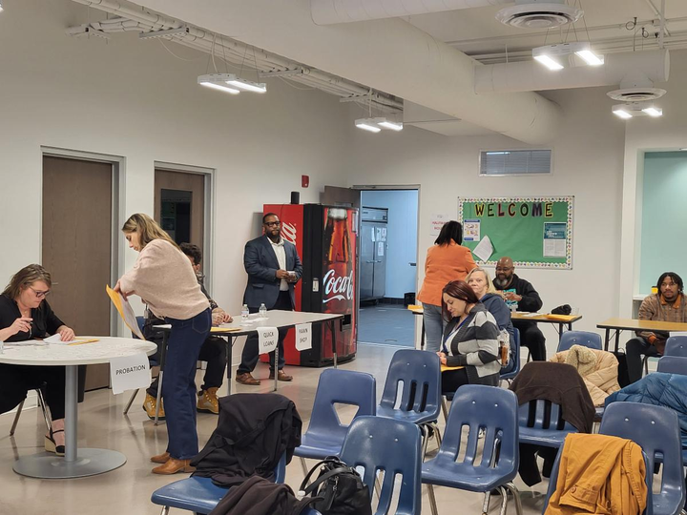
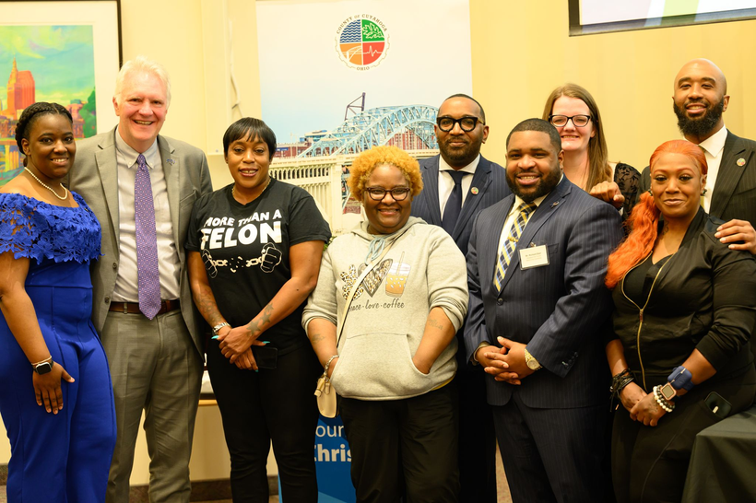
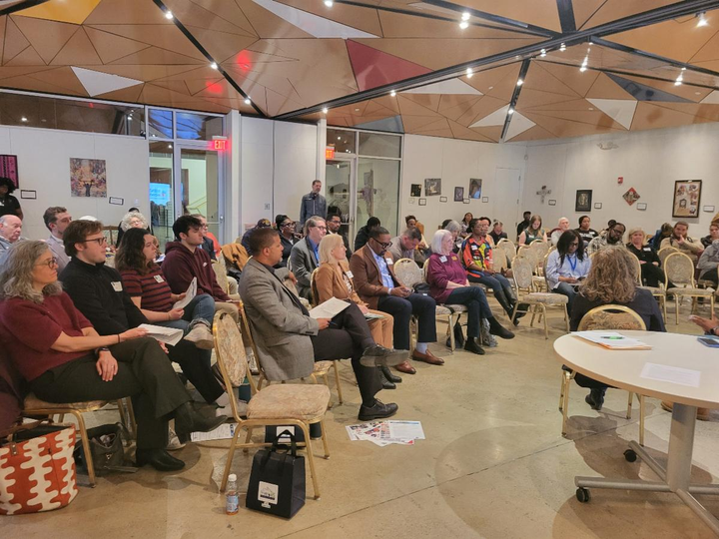
Thank you!

