Slide 1
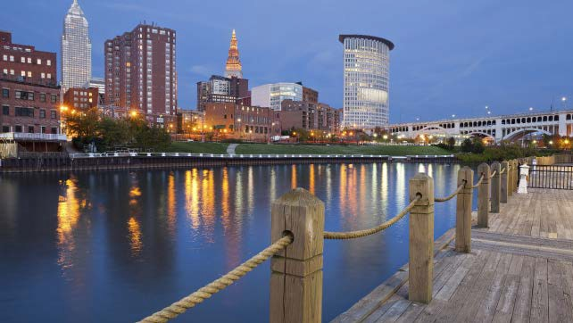
Cuyahoga County Family and Children First Council
Department of Health
and Human Services
David Merriman
Director
dmerriman@cuyahogacounty.us
Robin R. Martin
October 23, 2023

Slide 2
Family and Children First Council
County Library
Children and
Family Services
Developmental Disabilities
Job and Family
Services/Ohio Means Jobs
Council Office
Juvenile Court /
Ohio Dept of Youth Services
Early Childhood –
Bright Beginnings
Starting Point/
Step Forward
(Head Start)
Boards of Health
(City of Cleveland and Cuyahoga County)
Alcohol Drug Addiction and Mental Health
City of Cleveland and Cleveland Metropolitan Schools
Educational Service Center of Northeast Ohio
The Ohio State Extension
Three parents who have received services from at lease one of these agencies
2

Slide 3
Family and Children First Council Office
R=Robin R. Martin
Director
Stephanie Graham
Fiscal Specialist
(Shared Services)
Raquel Encalada
Senior Administrative Assistant
Youth Development
Kathleen Stewart
Assistant Director
Service Coordination
Tamara Barkley
Youth Development Program Coordinator
Amber Hunter
Service Coordinator
CANS Assessor
Angela Wilson
Service Coordinator Intake
Denise Hudson
Youth Development Program Coordinator
Myrtis Rander-Walker
Service Coordinator
CANS Assessor
Robert Pruitt
Service Coordinator Ongoing
Marcus Roddy
Youth Development Program Coordinator
Nathaniel Martin
Service Coordinator
CANS Assessor
Tamara Smith
Service Coordinator Ongoing
Clarrise Willis
Service Coordinator
CANS Assessor
3

Slide 4
FCFC – Budget
2024-2025 budget $5,519,544
Service Coordination $783,174 (68% state/32% levy)
Needs & Strengths Assessments (revenue generating)
Youth Development $4,031,996 (100% levy)
4

Slide 5
2024-2025 Strategic Considerations
Service Coordination
OhioRISE and other State changes
Family Centered and Supports funding
Ohio Department of Children and Youth Services
Teen Suicide Prevention
Re-establish the Crisis Bed
Shared FCFC Council issues (ex. Child Wellness Campus)
Assessments for DCFS
Continue to implement and enhance the process
Youth Development
Continued support for 9 contracts for 15 youth serving organizations
Rebuild capacity to pre-COVID numbers
5

Slide 6
Questions
6

