Slide 1






Understanding the Role of the
CASA Volunteer
Court Appointed Special Advocates

Slide 2
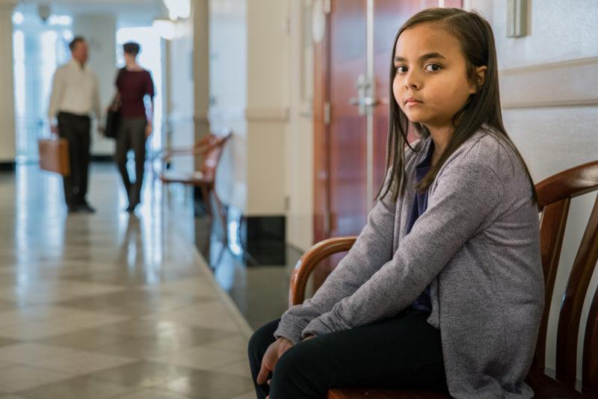
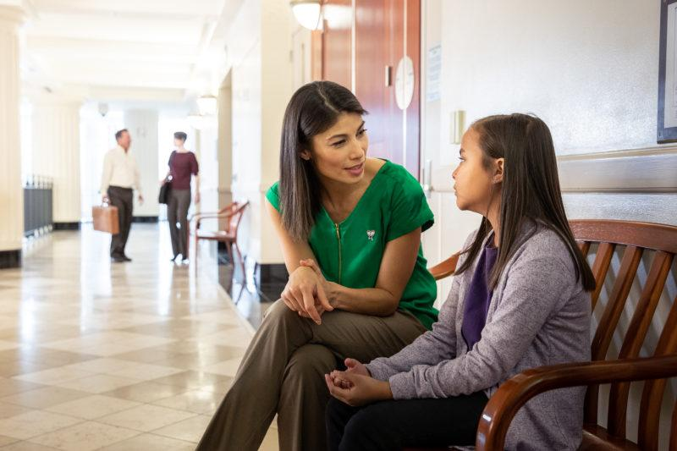
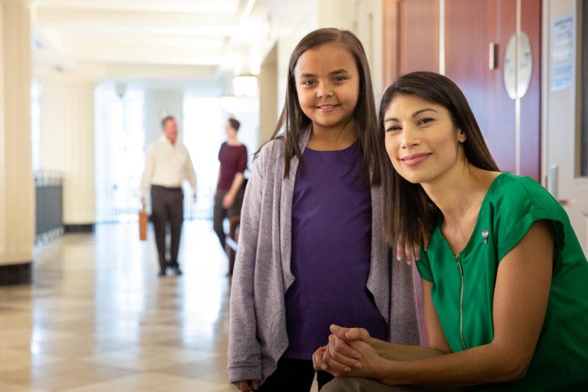
Objectives
Child Welfare History and Statistics
History on Child Advocacy in Cuyahoga County and National CASA
Who are CASA Volunteers and How do CASAs Serve Youth?
Requirements to Become a CASA Volunteer
Ways You Can Help

Slide 3
Mary Ellen’s Story
Organized child welfare in the United States began with the New York Children’s Aid Society, which was founded in 1853 to "place" orphan children in families.
In 1874, child abuse entered the national consciousness with the case of Mary Ellen Wilson, a young girl who in 1874 was harshly abused by her guardians.
At this point there was no such thing as child protective services, so Mary Ellen’s rescuer had to turn to the American Society for the Prevention of Cruelty to Animals to form a case to save Mary Ellen.
In response to this situation, in 1875 the New York Society for the Prevention of Cruelty to Children was formed, the first organization devoted solely to child protection.
At this point, child welfare remained charitable, and was not connected to the government; in 1912, the Federal Children’s Bureau was formed, bringing federal policies to bear on child welfare.

Slide 4
Child Abuse & Neglect Statistics
Currently, there are 7.5 million calls yearly to US agencies regarding child abuse and neglect
600,000 American children experience substantiated maltreatment each year, usually from parents
Approximately 500,000 US children are in foster care at any given time, with 20% “aging out”
Approximately 2,000 child deaths a year occur from child abuse and neglect
Nearly half of US children will experience an ACE/traumatic event
The most likely people to report child abuse are police/1st responders, followed by teachers and other professionals (pediatrician, etc)
Notes:
Stats updated 3/12/24

Slide 5
History of Child Advocacy in Cuyahoga County
  The federal Child Abuse Prevention and Treatment Act of 1974 requires states to appoint a Guardian ad Litem (GAL) for children in abuse and neglect proceedings.
  Cuyahoga County Juvenile Court Local Rule 15 requires the Guardian ad Litem to be an Ohio licensed attorney. The County had a strong attorney GAL program for nearly 40 years under the Cleveland Metropolitan Bar Association (CMBA).
  CASA was formed in Cuyahoga County in 2016 to provide additional support to children and families.
  Our Mission: To make a difference for every child served through advocacy, education, and collaborative alliances.
  Our Vision: Every child is seen, heard, and engaged, leading to permanency and hope.

Slide 6



National CASA/GAL Association
Inspiration came to Seattle Juvenile Court Judge David W. Soukup in 1976; Judge Soukup had insufficient information to make a life-changing decision for a 3-year-old girl who had suffered from child abuse.
Judge Soukup recommended that these children, who had experienced abuse or neglect, needed trained volunteers speaking up in the courtroom for their best interests.
In 1977, the first CASA program was formed in Seattle (King County), Washington. Now, there are over 1,000 CASA programs nationwide.

Slide 7
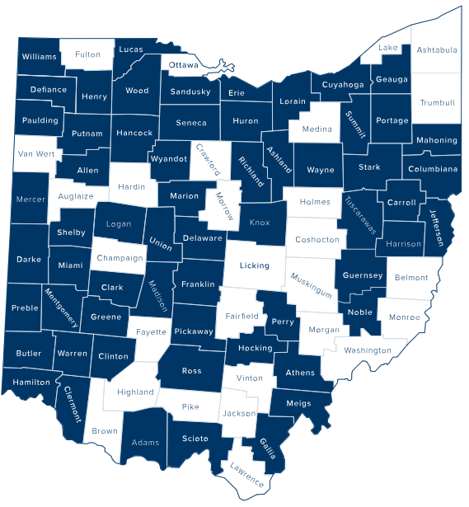
Ohio’s 48 CASA Programs
Notes:
Currently, there are 48 local CASA programs in Ohio serving children in 60 counties.
Lucas County was the first CASA program in Ohio and was established in 1980

Slide 8


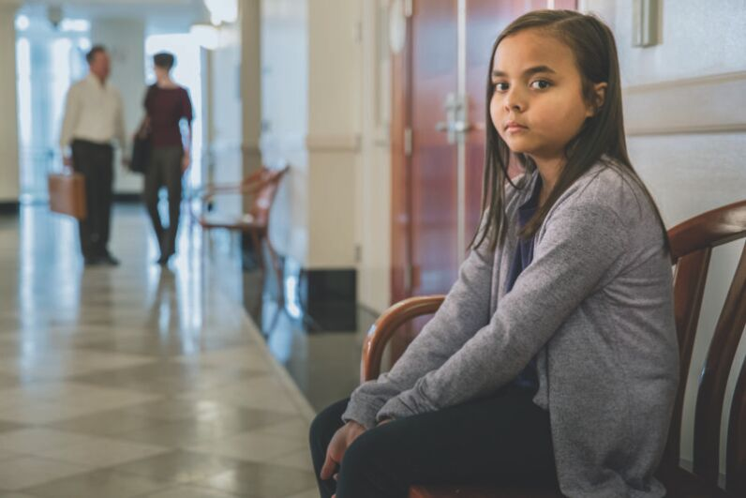
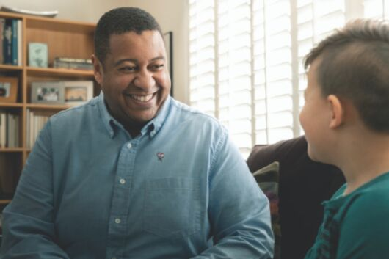

Local Impact of CASA
257
Number of CASAs Trained since 2015
83
Number of CASAs Currently available
875
Number of Children Served by CASA since 2016
1,508
Number of CASA-Eligible Children in Cuyahoga County
Who Need an Advocate
Notes:
# of trained volunteers since 2015-
Reports tab
Run a Mix and Match report
At the top of the screen, Enter the Start Date: 1/1/2015, Enter the End Date: 9/10/24 (this would be the current date of running the report)
Click Advocates/Volunteers
On the left hand side of the screen, under “Date Fields”, put cursor in the “Done/AOK” row and type in exactly 1/1/2015…9/10/2014 (this would be the current date of running the report)
Click Perform
# of CASAs trained will appear at the top of the screen
# of CASAs currently available-
Volunteers tab
Click magnifying glass on left hand side of the screen
Click it again
Misc. Fields tab
Type in Yes next to Compliance
Click Perform
Look for # of current CASAs at the bottom of the screen (it will state “Record 1 of 79”)
# of Children Served by a CASA since 2016-
Reports tab
On the left hand side of the screen, Enter a Date Range column, Enter the Start Date: 1/1/2015, Enter the End Date: 9/10/24 (this would be the current date of running the report)
Click Set Counts
Look for # of children served on the left hand side of the screen
# of CASA-Eligible Children- From weekly DCFS report, add up COPS + EC + PPLA + TC cases

Slide 9
Who are CASA Volunteers?
CASA- COURT APPOINTED SPECIAL ADVOCATE
CASAs are everyday people who have undergone screening and training and volunteer their time to advocate for children at risk of abuse, neglect, dependency, and aging out of the foster care system. No special background or education is required to become a CASA. We encourage people from all cultures, professions, and of all ethic and educational backgrounds to apply.
CASAs are often the one, consistent adult in the child’s life during the course of their case.

Slide 10

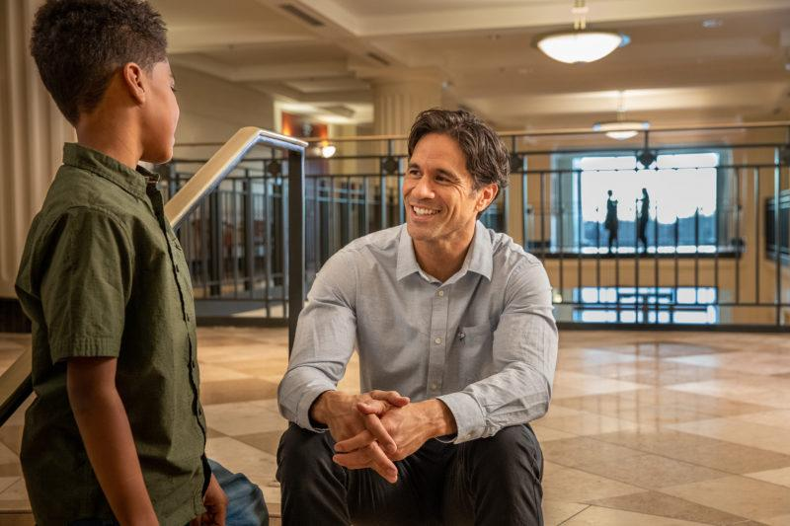
Roles and Responsibilities of a CASA Volunteer
INVESTIGATE
CASA ROLE
MONITOR
ADVOCATE
FACILITATE

Slide 11
Key Components of the CASA Role
  Investigate- Information gathering
      Meet with and get to know the child
      Observe the child in his or her natural environments
      Conduct interviews with the child, parents, caregivers, and professionals to obtain important facts and history
      Review records (court pleadings and motions, school, medical, and case plans)
  Advocate
      Attends all Court hearings
      Be prepared to advocate for the best interests of the child
      Informs the Court of important developments in the case
      Make fact-based recommendations to the Court in a written Court report
      Participates in case conferences
Notes:
Investigate- After case assignment, the Jurist will sign an appointment order for the CASA volunteer. This is the CASA’s golden ticket and states that the CASA has the right to review all records pertaining to the child (i.e., school & medical records).
Important to note- CASAs cannot not share any records with anyone unless a formal request is filed with the Court. CASAs should put any relevant information they want to share in their report to the Court.

Slide 12
Key Components of the CASA Role
  Facilitate
      Identify resources and needed services for the child
      Collaborate with case parties (i.e., Child Protection Specialist, attorney GAL, attorneys) to help ensure resources and services are provided
  Monitor
      Monitor the orders of the court and ensure the DCFS case plan is being carried out
      Monitor the child’s safety throughout the case
      Document all activities, accurately taking note of any concerns, progress or lack thereof
      Remains actively involved until the case is closed (average length is 2 years)

Slide 13
CASA Volunteers DO NOT:
Give legal advice or therapeutic counseling
Make placement arrangements for the child
Give money, gift cards, or purchase gifts for the child or the child’s family or caregiver
Transport any child, family member or other person on the case
Socialize with the child or the child’s family or caregiver outside of home visits, Court hearings, and case-related meetings

Slide 14


Focus of a CASA Volunteer
The child is seen, heard, and engaged by the child-welfare system
To help ensure the child’s needs are met
The child finds a safe and permanent home as soon as possible
The child’s case is not lingering in the system unnecessarily

Slide 15


Why CASA?
  CASA enhances the quality of advocacy
  Assigned to NO more than 1 or 2 cases at a time
  More frequent contact with child
    Visit child twice a month for the first 6 months of case
    Visit child once a month after, until case is closed
  CASAs come from various backgrounds and experiences
  Volunteer Coordinators monitor volunteer performance at all times and provide guidance and support as needed

Slide 16
Case Assignments
CASAs are appointed by the Court to abuse,
neglect, and dependency cases (A/N/D).
Court Ordered Protective Supervision (COPS) Cases – Court cases where the children remain in the home with supervision. The goal is to coordinate efforts to provide more oversight and needed services for families, allowing children to remain safely at home.
Permanent Custody (PC) Cases – An order which terminates parental rights and vests permanent custody of a child to the Division of Children and Family Services for the purposes of achieving permanency.

Slide 17
Case Assignments
Temporary Cases (TC) Cases – When a child is temporarily removed from their parent’s home and placed with a suitable relative or in foster care. The parent(s) must demonstrate to the Court they have remedied the factors that led to the removal.
Planned Permanent Living Arrangement (PPLA) Cases – The Division of Children and Family Services maintains care and custody of the youth and arranges a living situation in which the youth is expected to remain until adulthood. PPLA is a permanency option only when other options such as reunification, relative placement, adoption or legal guardianship have been ruled out.
Private Custody Cases- Seeking a determination of custody, parenting time, shared parenting time, and/or companionship time of a child.

Slide 18
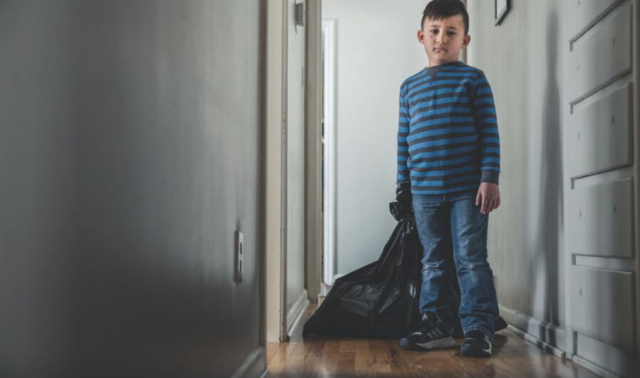
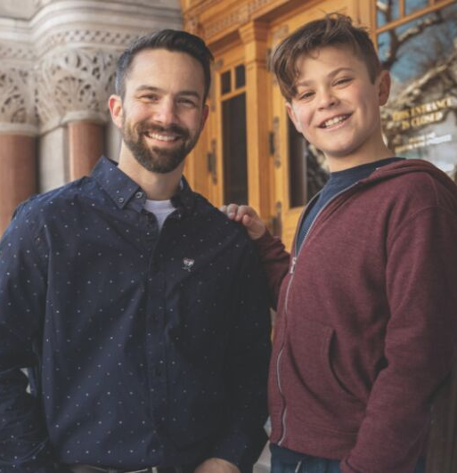
Case Assignment Process
Children served range in age from infant to 20
CASAs can accept cases based on timing, distance, life circumstances
CASAs can take up to 2 cases at a time
Volunteer Coordinators are professional staff who monitor performance at all times and provide guidance and support as needed
CASA could serve on a case for up to 2 years
Cases conclude when a child achieves permanency or ages out of the system
Notes:
When assigning a CASA to a particular child/case, program staff will take into consideration the strengths and limitations of each available CASA and their preferences and make a determination as to which individuals would best serve the needs of the child(ren) on the case.
All cases are unique, and CASAs have varying levels of knowledge, skills and experiences. It is with this in mind that the program will seek to match the right CASA to the right case.
CASAs are free to refuse an assignment for any reason. If the CASA does accept a case, their assigned Volunteer Coordinator will meet with them to review the case information and during that time will provide the CASA with the documentation needed for the assignment.
A CASA shall not be assigned more than two cases at a time.

Slide 19
CASA Requirements
  Be 21+ years old
  Complete a pre-application questionnaire (https://cfadvocates.org/become-a-casa)
  Complete a CASA volunteer application
  Pass criminal and central registry background checks
  Provide three references
  Participate in an interview
  Complete 30 hours of pre-service training (provided)
  Available to attend court and other meetings during the day
  Commit two years (10-12 hours a month) to the program

Slide 20

How YOU Can Help!
  Volunteer as a Court Appointed Special Advocate (CASA)
  Volunteer at community or fundraising events
  Donate
  Donate gently used or new children’s books
  Donate office supplies and gift cards
  Select CFACC on AmazonSmile when shopping
  Invite CASA to make a presentation to your group
  Share CASA information with family and friends
  Serve on the CFACC board or a committee
  Follow and share our social media posts
Be the difference you want to see in the community

Slide 21

Contact Information
12200 Fairhill Road | Suite E193
Cleveland, OH 44120
216.325.7747
info@cfadvocates.org
cfadvocates.org
CONNECT ► FOLLOW ► LIKE ► SHARE

