Slide 1


Cuyahoga County and Ohio Public Defender Offices
Youth Justice Perspectives
Cuyahoga County Council
Juvenile Court Advisory Subcommittee
January 27, 2025
Cullen Sweeney, Chief Public Defender
Leah Winsberg, Community Engagement Attorney
Sam Amata, Youth & Parent Defense Division Director
Brant DiChiera, Sarah Honig, Vertical Defenders
Kenyatta Johnson, Social Worker
Keara Mullen, Mitigation Specialist
Brooke M. Burns
Managing Counsel, Youth Defense
Office of the Ohio Public Defender

Slide 2

Cuyahoga County
Public Defender’s Office
Office of the Ohio
Public Defender
Youth and Parent Defense Division
Youth Defense Department
  Multidisciplinary team includes attorneys, social workers, parent advocates, investigators, and paralegals.
  Represent children in delinquency cases.
  Represent parents in abuse, neglect, dependency case
  Represent parents in child support cases.
  Trial
  Post-disposition: Appeals and Post-conviction
    Intake and Orientation for all youth committed to DYS/DRC
    Conditions of Confinement
    Re-Entry
  Parole per SB 256
  Policy advocacy

Slide 3

CHILDREN ARE DIFFERENT
"From a moral standpoint, it would be misguided to equate the failings of a minor with those of an adult, for a greater possibility exists that a minor's character deficiencies will be reformed."
- Roper v. Simmons (2005)
“While counterintuitive, a robust body of research indicates that committing a violent crime before age 20 is not a strong predictor of a persistent criminal trajectory.”
Source: Center for Law, Brain & Behavior at Massachusetts General Hospital, White Paper on the Science of Late Adolescence, A Guide for Judges, Attorneys, and Policy Makers (January 27, 2022), https://clbb.mgh.harvard.edu/wp-content/uploads/CLBB-White-Paper-on-the-Science-of-Late-Adolescence-3.pdf

Slide 4

Comparing youth with MH disorders:
    9-20% of general youth population
    50-70% of JJ youth
Youth on the MH caseload ODYS:
    74% males
    100% females
Detained youth & traumatic experiences:
    92.5% reported at least one
    84% reported multiple
Dual system youth:
    2/3 youth in Cuyahoga JJ had CW
    higher recidivism rates
YOUTH IN THE JJ SYSTEM HAVE COMPLEX NEEDS
Youth with mental health, trauma, and maltreatment are overrepresented
Sources: Ohio Department of Youth Services, Reports: Monthly Fact Sheet (Jan. 2024); Barbara Tatem Kelley; Paul A. Haskins, Dual System Youth: At the Intersection of Child Maltreatment and Delinquency (Aug. 10, 2021); Office of Juvenile Justice and Delinquency Prevention, Intersection between Mental Health and the Juvenile Justice System (July 2017).

Slide 5
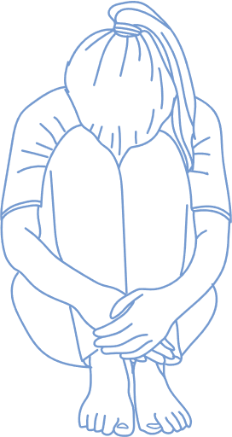
YOUTH PERSPECTIVE
“Our minds isn’t fully developed so sometimes we make stupid decisions off of impulse. We don’t think of the consequences untill after we’ve made our decision. The best way to handle these situations is to put the children in therapy untill they show progress.
A lot of the children that end up in situations like this has been through a lot of abuse and trama, like me. I grew up in foster care [and was] abused mentally and physically. I never reported these things cause I felt it was my fault. I just hope that every kid that’s going through the same thing that I went through get the proper treatment. I want the adults to not label them as young criminals but to see them as kids." - L.J.
Source: Children's Law Center, In Their Own Words, Bindover Storytelling Project

Slide 6
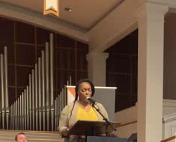
PARENT PERSPECTIVE
Placing children hours away from family is harmful.
Parents don’t have resources to prevent children from entering DYS systems. We can ask for help from multiple systems for years and get nothing. Only when our child commits a serious crime does the system respond, and then the only solution seems to be incarceration.

Slide 7
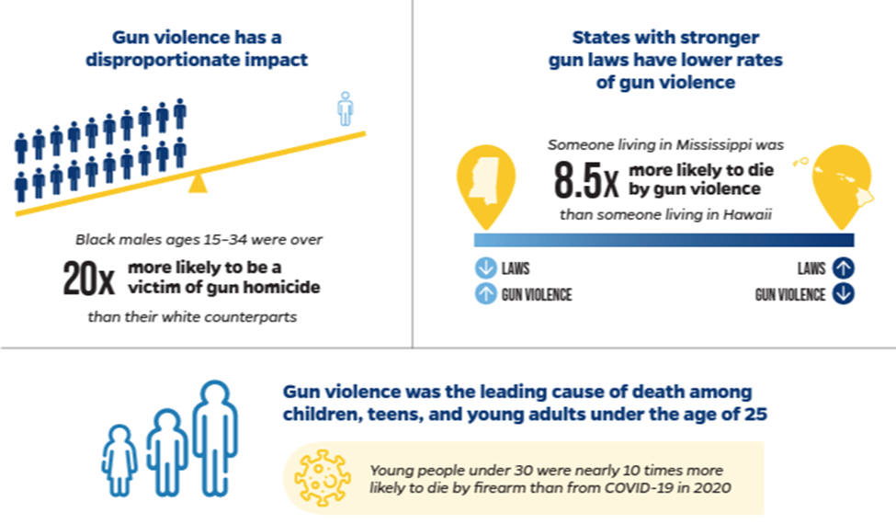
DATA REVEALS: KIDS CARRY TO PROTECT
Comprehensive research finds most young people who possess or use guns are motivated by fear, not criminal interests.
Young people report carrying guns to increase their feelings of safety:
    A generalized fear of being victimized
    A specific fear of retaliation
    A history of violent victimization
    A pervasive fear of law enforcement
Sources: Lopez, Basia E., Haskins, Paul A., The Fight Against Rampant Gun Violence: Data-Driven Scientific Research Will Light the Way, National Institute of Justice (Dec. 2, 2021). Johns Hopkins Center for Gun Violence Solutions. (2022). A Year in Review: 2020 Gun Deaths in the U.S.

Slide 8

WHAT WE KNOW
Proportional and Developmentally-Informed Interventions Are Key to Supporting Public Safety
    Age-crime desistence curve
      Most youth stop engaging in offending behaviors as they grow and mature
    Brains continue to develop into the mid-20's
      Marked by risk-taking, boundary testing, impulsivity, acting out
      Late adolescents (18-21) closely resemble brain functioning of youth (13-17)
    Youth respond to effective interventions
      Credible Messengers & Mentoring
      Evidence-Based, Family-Focused Therapy
      Restorative Justice
Sources: Center for Law, Brain & Behavior at Massachusetts General Hospital, White Paper on the Science of Late Adolescence, A Guide for Judges, Attorneys, and Policy Makers (2022); The Sentencing Project, Effective Alternatives to Youth Incarceration (June 2023).

Slide 9
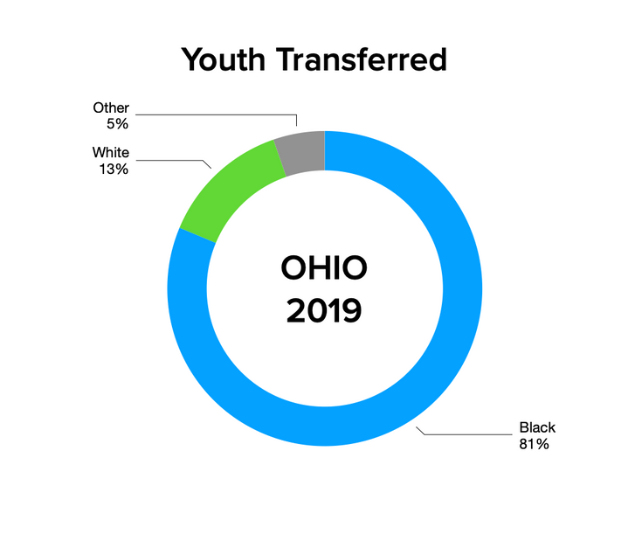
US AGAINST THE WORLD
Youth Crime Data Trends
  For the last 25 years, youth incarceration has fallen from 107,000 to 25,000 daily population
  During the same time, youth arrests fell by 80%
  2022 saw 32% fewer arrests than in 2019
  Youth arrests accounted for only 9% in 2022
  Youth arrests for serious offenses (non-weapon) fell significantly
  Youth under 18 were responsible for less than 11% of non-fatal violent crime incidents
  Despite declining nationally, transfer in Ohio has increased
  Those increases are led by Cuyahoga County
Source: Campaign for the Fair Sentencing of Youth, Winning the Campaign: State Trends in Fighting the Treatment of Children as Adults in the Criminal Justice System; and The Sentencing Project: Incarceration and Crime: A Weak Relationship (June 13, 2024).

Slide 10
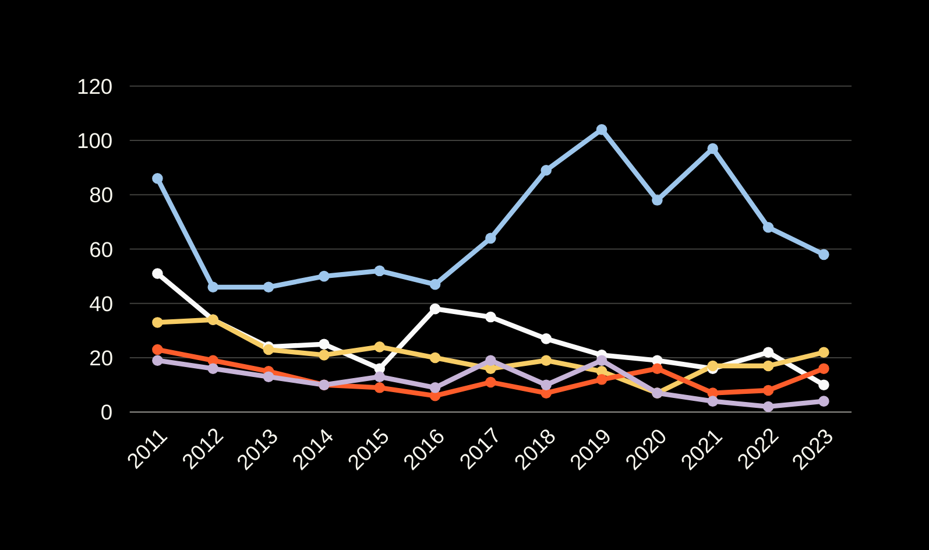
RECENT COUNTY BINDOVER TRENDS
Fiscal Year
Cuyahoga Franklin Hamilton Montgomery Summit
Source: Ohio Department of Youth Services FIscal Year Data, Youth Transferred to Adult Court, available: https://data.ohio.gov/wps/portal/gov/data/view/youth-transferred-to-adult-court

Slide 11
TYPES OF BINDOVER
MANDATORY
The court must transfer a child to adult court if:
DISCRETIONARY
The court may transfer a child to adult court if:
  16 or 17 y.o. charged with aggravated murder, murder, or attempt;
  16 or 17 y.o. charged with category two offense and either has previously been committed to ODYS or alleged to have used a firearm while committing the offense; or
  14 or 15 y.o. charged with aggravated murder, murder, or attempt and previously committed to ODYS for a category one or two offense
  Prior adult conviction
  Youth from outside Ohio who would have been eligible for direct file in their home state
  14 y.o. or older at the time of the act charged;
  The act charged would be a felony if committed by an adult;
  The child is not amenable* to care or rehabilitation within the juvenile system; and
  The safety of the community may require the child to be subject to adult sanctions
*Court must consider individualized evaluation and statutory factors in favor of transfer must outweigh statutory factors against

Slide 12
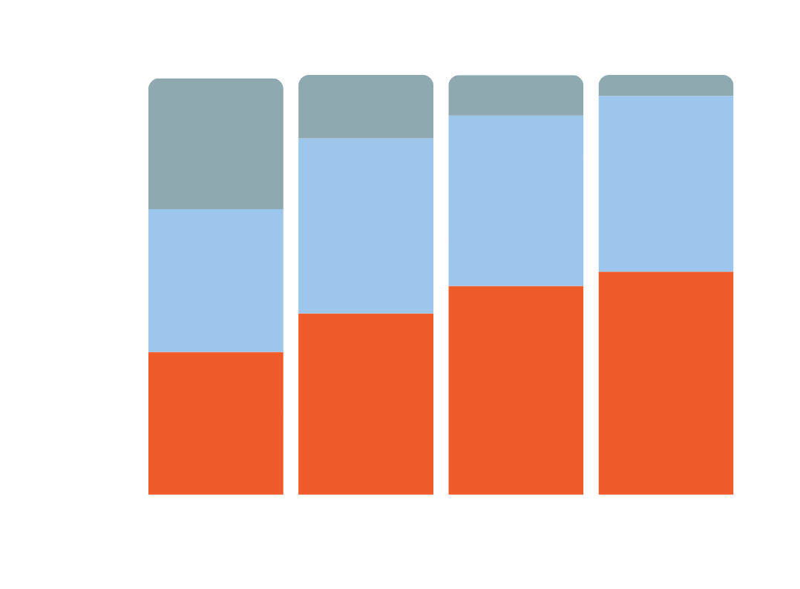
OHIO TYPE OF BINDOVER
Mandatory
Discretionary
Unknown
Sources: Ohio Department of Youth Services Public Records Request

Slide 13
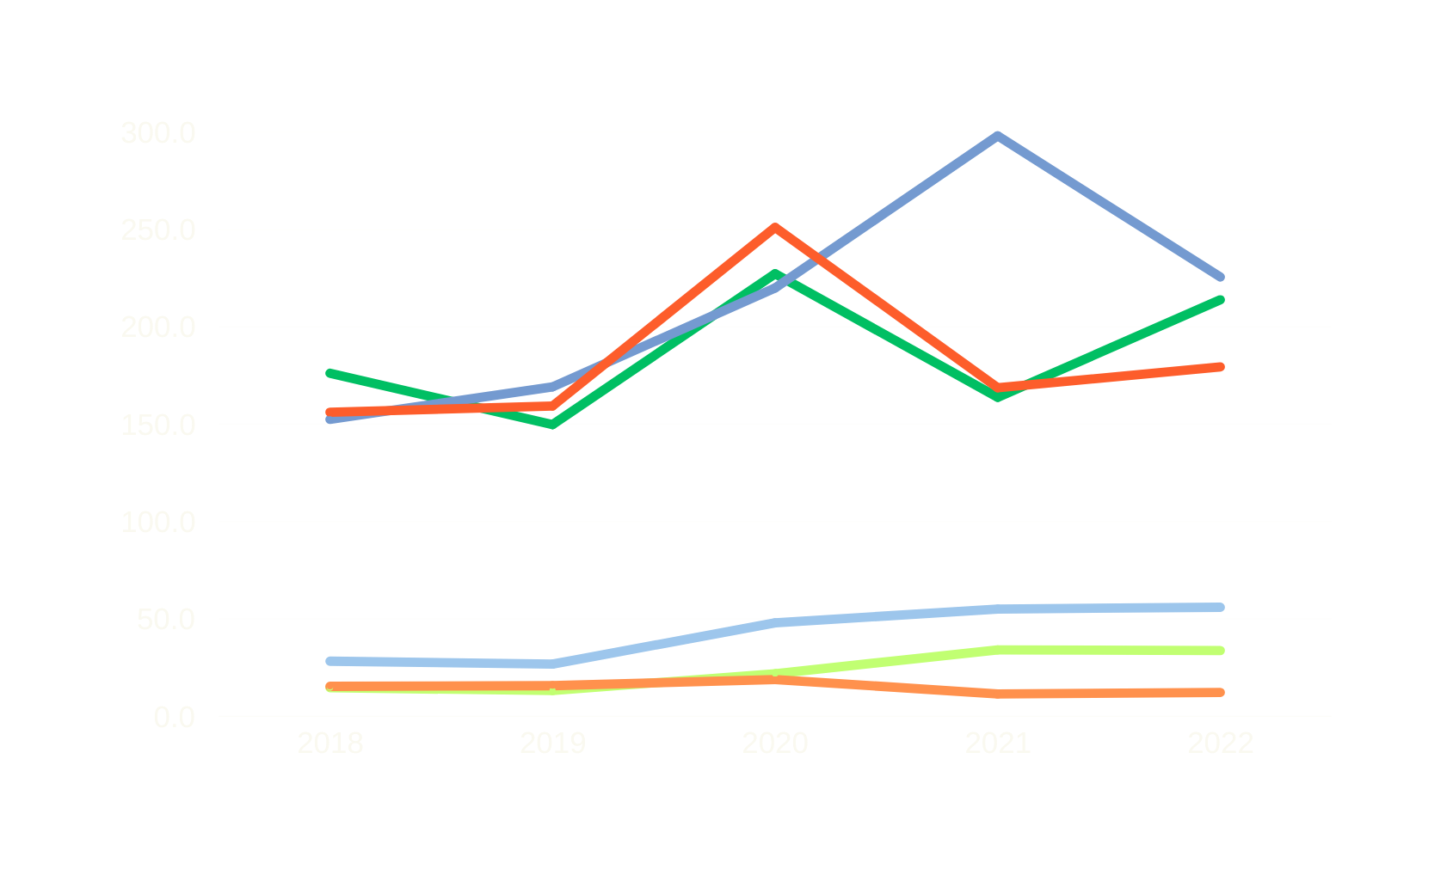
AVERAGE LENGTH OF STAY IN COUNTY DETENTION
Bindover Youth
Cuyahoga
Franklin
Montgomery
Days in Detention
Non-Bindover Youth
Cuyahoga
Franklin
Montgomery
Calendar Year
Source: County Juvenile Courts Public Records Request

Slide 14
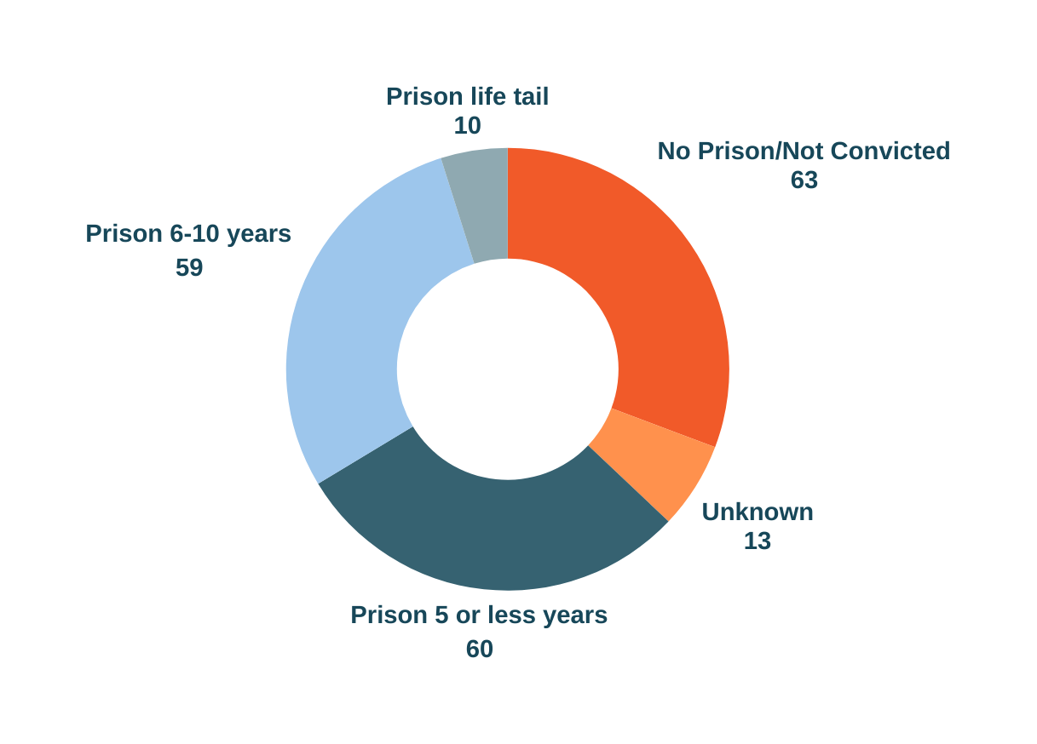
OHIO BINDOVER OUTCOMES
Snapshot of Dispositions of Bindover Youth FY 2018
205 youth boundover
    more than half (61%) were mandatory transfers
    6% went to trial
    60% received a non-prison sentence or prison sentence of 5 years or less
Source: Office of the Ohio Public Defender

Slide 15
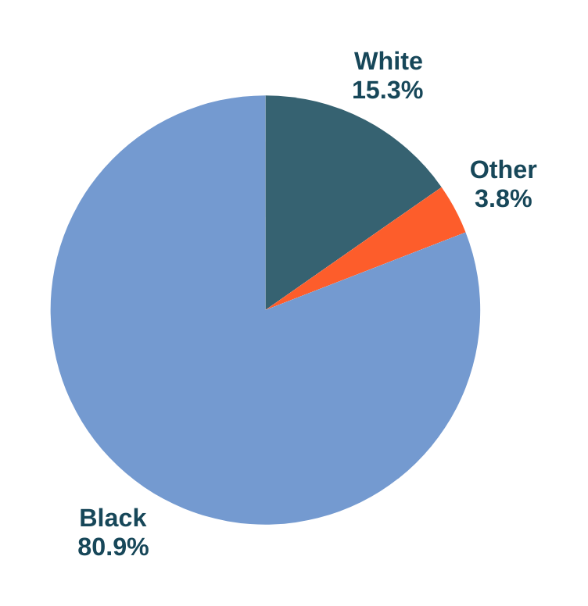
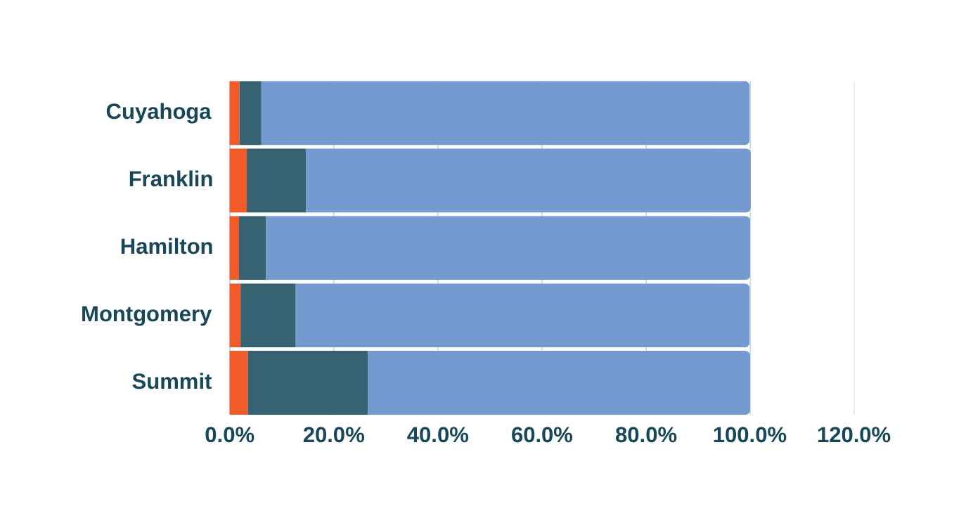
OHIO'S RACIAL DISPARITIES
Bindover Youth FY 2011-2022
Black White Other
Source: Ohio Department of Youth Services FIscal Year Data, Youth Transferred to Adult Court: https://data.ohio.gov/wps/portal/gov/data/view/youth-transferred-to-adult-court

Slide 16
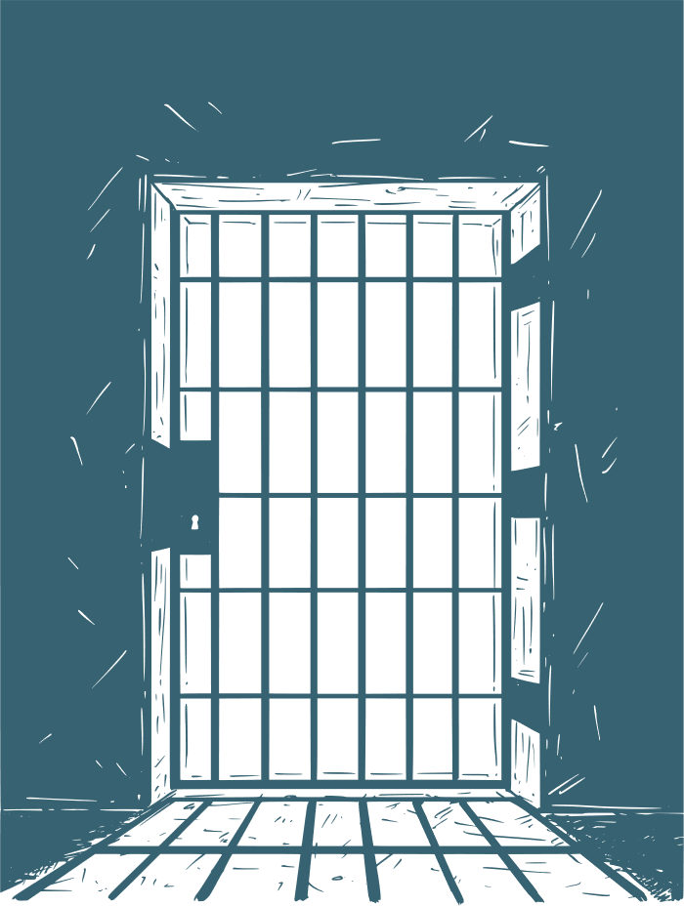
THE IMPACT OF BINDOVER
Children face profound and long lasting consequences
    Youth incarcerated in adult facilities often face brutal conditions
      5 times more likely to be sexually assaulted
      8 times more likely to commit suicide
      2 times as likely to be beaten or attacked
      Often kept in solitary confinement for long periods
      More likely to die prematurely
    Adult prisons lack academic, vocational, and social skill building education adolescents need
    Bindover increases future re-offending: 34% more likely to commit additional felony offenses
    Recidivism costs taxpayers and crime victims

Slide 17

RECOMMENDATIONS
Commit to sustained funding for services that address environmental risk factors
Encourage race equity initiatives to address points in the system where disparities are most profound
Audit costs associated with deep-end systems and shift funds to cost-effective, promising alternatives
Support local court rules that assign attorneys based on state standards and provide for continuity of counsel
Increase diversion opportunities for low risk, low-level offenses and decrease probation caseloads
Reserve commitments to ODYS for Felony 1 and 2 adjudications, allowing for adequate youth to staff ratios

Slide 18
THANK YOU
Please feel free to reach out with questions
Cullen Sweeney, Chief Public Defender
Csweeney@cuyahogacounty.gov
Leah Winsberg, Community Engagement Attorney
Lwinsberg@cuyahogacounty.gov
Brooke M. Burns, Managing Counsel, Youth Defense
Brooke.Burns@opd.ohio.gov

