Slide 1



GREATER CLE YOUTH JUSTICE COLLECTIVE: AMPLIFYING YOUTH VOICE
FEBRUARY 25, 2025
Draft as of March 19, 2025
Notes:
Introductions

Slide 2
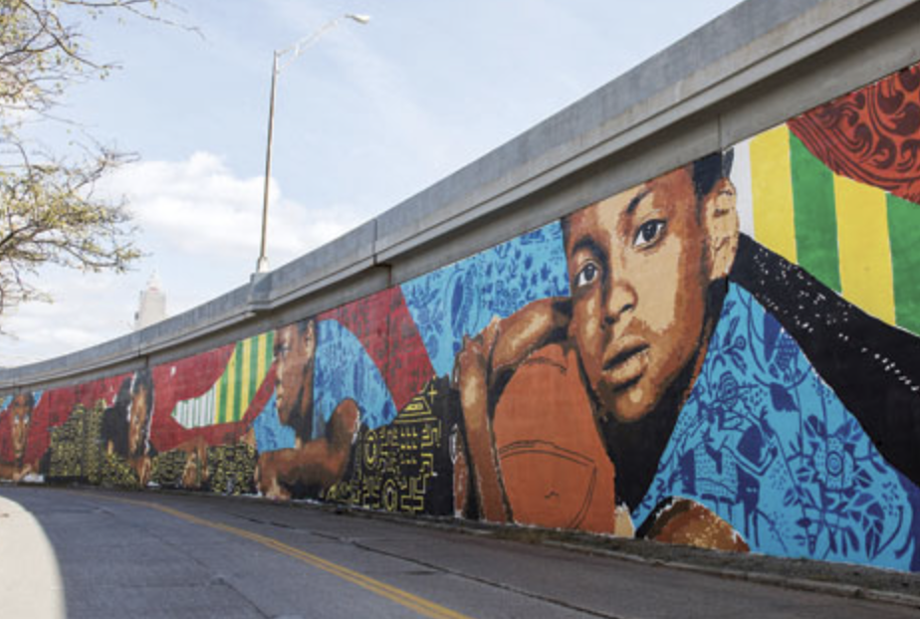
Rethinking Safety &
Youth Success
Greater CLE YJ Collective Briefing Local Policymakers Overview
1. Setting the Context: Kids Are Different
2. Youth Data Highlights
Youth Crime Trends & Youth as Victims of Gun Violence
Social & Emotional Challenges Facing Youth
COVID Impact on Youth
Juvenile Justice System & Detention Center
3. A Better Path Forward: Opportunities Be Strategic (Not Reactive)
Creating a Youth Safety Vision
Mobile Crisis Stabilization & Peer Supports
Age-Appropriate Interventions, Diversion & Policing
Evidence-Informed Approaches
Juvenile Court Collaboration with City & County
Economic Opportunity & Vibrant Neighborhoods

Slide 3
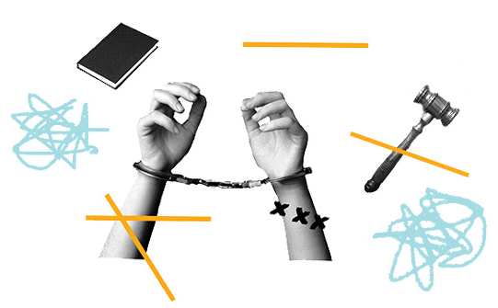
AGENDA: Youth Focus Groups Project
Background
  The Problem
  The Solution
Focus Groups
  Goals
  Methodology
  Key Themes
The Road Ahead
Draft as of March 19, 2025

Slide 4
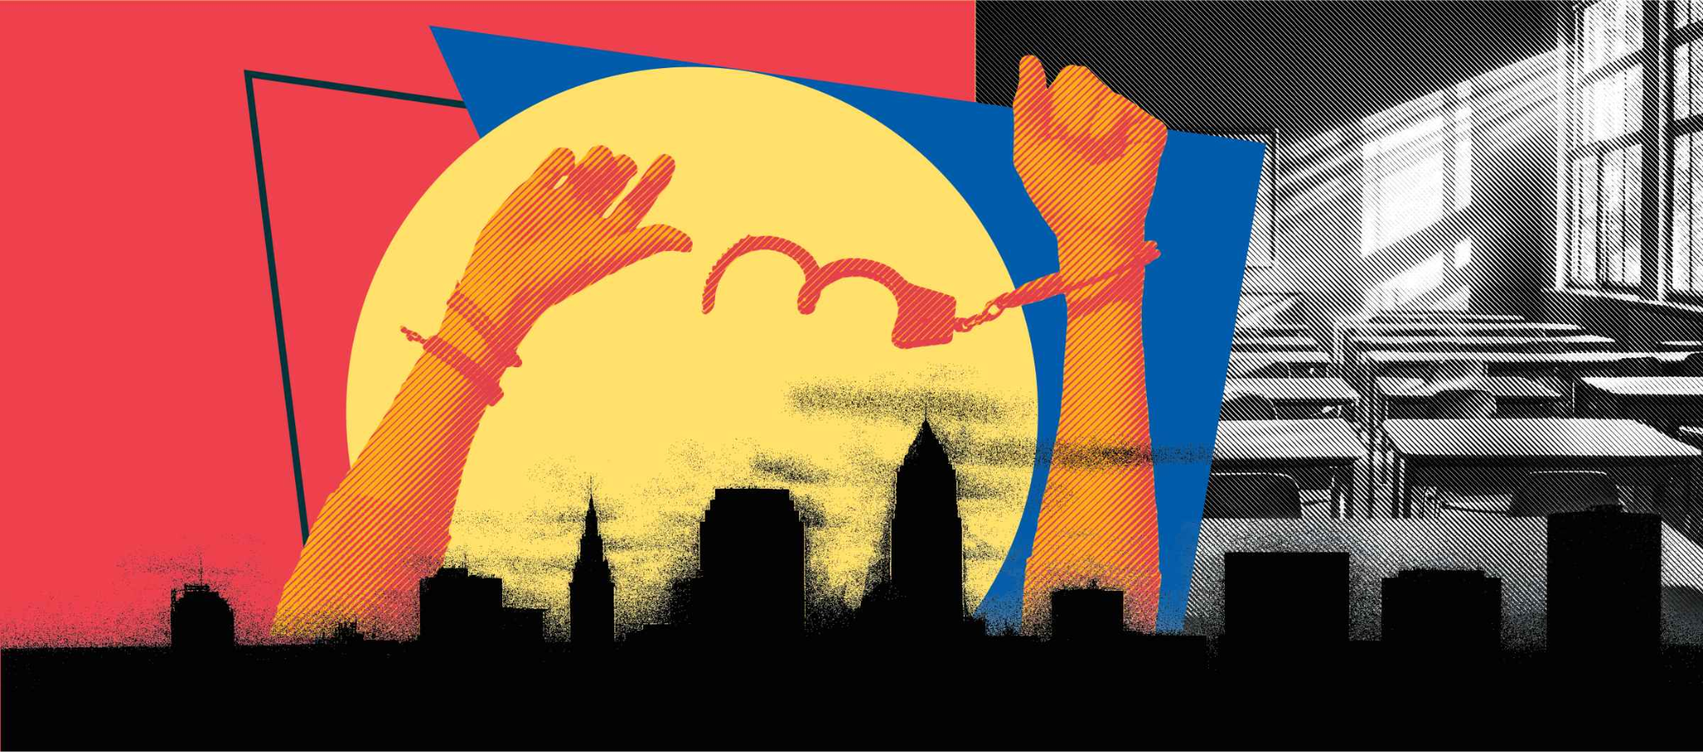
BACKGROUND
The Problem: 2022-2024, Negative “buzz” in the media and elsewhere. Tough on crime narratives were pervasive with no context.
Our Partnership. Education to counter false narratives and lay the foundation for treating all kids as kids.
Draft as of March 19, 2025

Slide 5

BACKGROUND
The Solution: Focus Groups to hear from Cleveland youth.
  Partnered with B4U Services, specifically Dr. NJ Akbar and Djuan Wash, to conduct focus groups
  Made possible by the generous support of The George Gund Foundation
Draft as of March 19, 2025

Slide 6
PROJECT GOALS
Combat harmful rhetoric on safety and youth.
Understand how negative framing in the media, from public leaders, stakeholders and elsewhere effects kids.
Humanize Cleveland’s youth with the understanding of all kids are kids.
Uplift impacted youth perspective and voice in this space.
Offer a snapshot of the challenges faced by justice-involved youth, young adults, and families in underserved areas.
Foster greater understanding and empathy among policymakers, law enforcement, and the broader community.
Draft as of March 19, 2025

Slide 7
METHODOLOGY
Engagement Pool:
1. Youth currently detained or incarcerated in a state or local facility.
2. Youth recently released from the Cuyahoga County Juvenile Detention Center, an Ohio Department of Youth Services facility, or those currently under formal court monitoring.
3. Youth who live in key zip codes.
4. Young adults (ages 18–25) who were formerly involved in the juvenile court system.
5. Adults in key zip codes who are system-impacted (e.g., those who were themselves in the juvenile justice system, have/had children in the juvenile justice system or reside in one of the most impacted zip codes.
Draft as of March 19, 2025

Slide 8
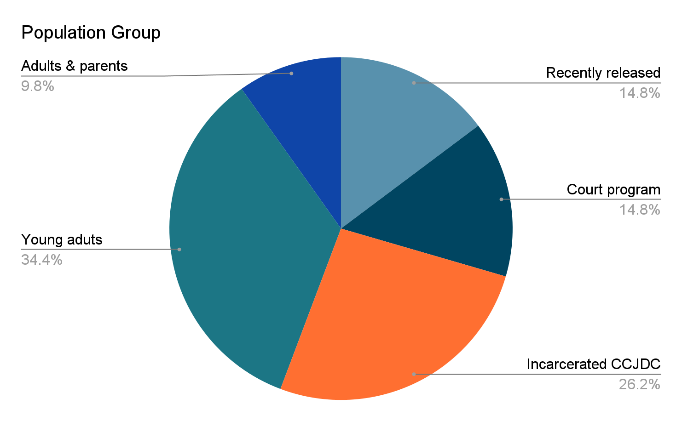
METHODOLOGY, continued
Engagement Pool:
61 Total Participants
    By gender:
      42, Male
      19, Female
    By age:
      25, 17 and below
      29, 18-25
      7, 25+
    By Zipcode:
      41, High Priority Zip Codes
      17, Moderate Priority Zip Codes
      2, Unknown Zip Codes
      1, Lowest Priority Zip Codes
7
9
9
20
16
Draft as of March 19, 2025

Slide 9
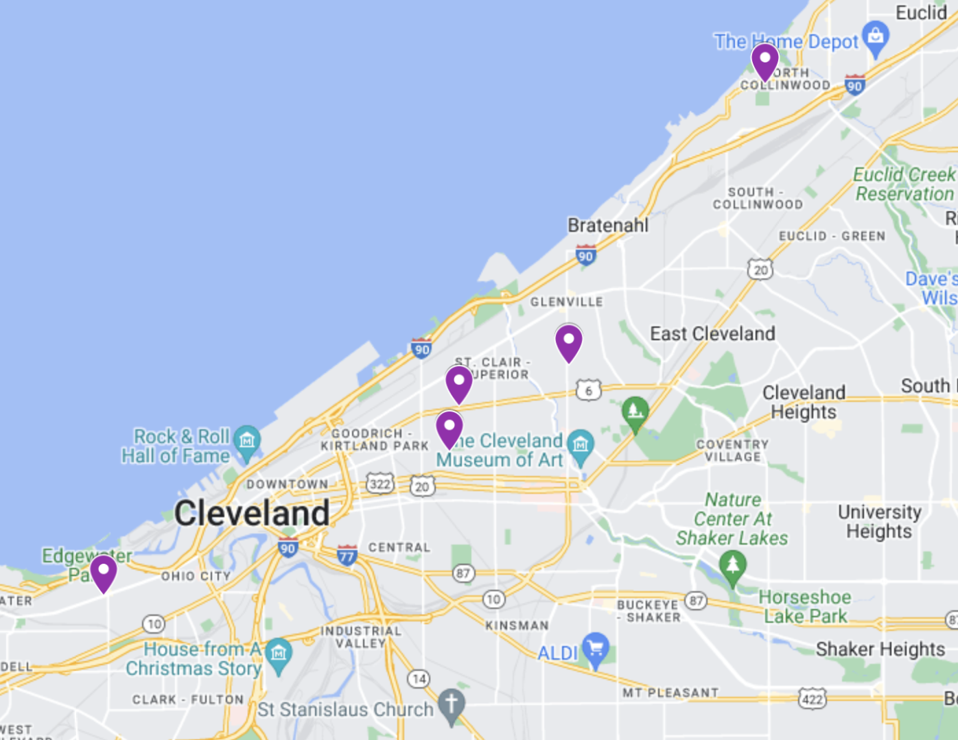
METHODOLOGY, continued
  9 Focus Groups
    Local Community Centers
      Addison Library
      Cory Recreation Center
      Collinwood Recreation Center
      Hough Library**
      LGBT Center of Greater Cleveland
    Cuyahoga county Juvenile Detention Center**
    Community-Based Intervention Center
Draft as of March 19, 2025

Slide 10
METHODOLOGY, Focus Group Discussion Prompts
11. Describe what a healthy, fun, safe
Cleveland looks like to you.
12. What do you think is needed to help you
feel good in your community?
13. How could the community – meaning the
city and caring adults - better support you?
14. What resources do you wish your
community offered?
15. If you had a magic wand, what needs to
change soon that would make life better
for youth?
How would you describe your community?
What do you want people to know about you?
If you could make one change in your community what would it be?
What do you think adults don't understand about kids your age?
Do you feel safe in your community?
What does “safety” mean to you?
What makes you feel safe ?
What have you seen/heard about crime?
  Where have you heard it?
  How does this make you feel?
What are adults/ the media/ politicians getting wrong on safety?
What should be changed for you and others who have experience with the juvenile justice system to have the best chance for success and personal safety?
Draft as of March 19, 2025

Slide 11
KEY THEME: SAFETY IS COMPLEX
Safety means having people you can trust to protect you, but we don’t have
that here. – “Laura” (F, 14-18 yrs).
Honestly, nothing makes me feel safer. I can feel safer with my family but it ain't going to make me feel safer other than getting a gun. I can't really do that. I just got to do what I got to do. Stay in the house. Try to stay sober. “Jordan” (M, 14-18 yrs)
I feel safest when I’m at home, but even there, it’s not guaranteed. – “Tyler” (M, 18-25 yrs)
Draft as of March 19, 2025

Slide 12
KEY THEME: GUNS HAVE A DUAL ROLE
It feels like you have to choose between being a target or having protection. – “Fred” (M, 14-18 yrs).
Guns are everywhere. It’s like you can't avoid them even if you try. – “Kari” (F, 14-18 yrs).
Every time there’s gun violence, it just adds more trauma
to the community. – “Gus” (M, 14-18 yrs)
Draft as of March 19, 2025

Slide 13
KEY THEME: GRIEF AND LOSS IS PERVASIVE
Grief is part of everyday life for us, and it’s exhausting. “Fred” (M, 14-18 yrs) JDC
It’s like losses, loss after loss…that's a struggle. It's a lot on your plate…you got a lot of pain to hold on to, you got a lot of emotion built up in you. “Terrance” (M, 18-25 yrs)
Every time I lose someone; it feels like a part of me is gone too. How can you feel safe when that keeps happening?
“David” (M, 18-25 yrs)
Grief is just part of life here.
We don’t talk about it because we don’t have the tools to deal with it. “Tina” (F, 14-18 yrs)
Draft as of March 19, 2025

Slide 14
KEY THEME: TRAUMA IS GENERATIONAL, NORMALIZED & COMPROMISES MENTAL HEALTH
Every generation carries the weight of the last. We’re never really free. “Marcus” (M, 18-25 yrs)
Trauma runs deep, and we don’t have anyone to help us heal.
“Cosby” (M, 14-18 yrs)
If mental health resources were prioritized we could break the cycles of violence. “Kristin” (F, 18-25 yrs)
It’s not just about me – my kids feel this too and I don’t know how to protect them. “Gloria” (F, 25+ yrs)
Draft as of March 19, 2025

Slide 15
KEY THEME: PROTECTIVE FACTORS & CARING ADULTS
[If I had a magic wand] I would rewind the way that adults address (us) when wrong is being done. Instead of them coming at (us) crazy or hurting (us) physically or putting harsh punishments, I feel like they should come to (us) stern, strict, but with love and telling (us): “Come on, I got you. You need help. I'm gonna pick you up every time you fall down. Try it again. We're gonna keep trying and trying. No matter how many times you fall down, you ain't gonna stay on that ground. You're gonna get up and you're gonna keep pushing. You can't. You can't stay there.” I feel like the world would be so much better. “Vera” (F, 14-18 yrs)
Music helps me process my emotions and stay grounded -“Jay”
Drawing and journaling help me stay out of trouble - “Cece”
Helping others in my community motivates me to keep going - “Tim”
Sports taught me discipline and hope for my future - “Traci”
Creating something from nothing is my way of pushing through hardships - “Aaron”
Draft as of March 19, 2025

Slide 16
KEY THEME: COMMUNITY CULTURE - BELONGING & NEGLECT
The people in my community are resilient; they support each other through tough times.
“Tim” (M, 18-25 yrs)
There’s nowhere safe to just hang out without feeling like a target. – “Aaron” (M, 14-18 yrs)
A strong community means there’s always someone looking out for you, but that doesn’t happen here anymore. “Janice” (F, 25+ yrs)
It’s hard to focus on education when your environment is chaotic. “Jay” (M, 14-18 yrs)
It’s not all bad. There’s still a lot of good in our community. “Brad” (M, 18-25 yrs)
Having someone to talk to about my problems makes me feel less alone. “Cece” (F, 18-25 yrs)
Draft as of March 19, 2025

Slide 17
KEY THEME: SOCIAL MEDIA CAN BURDEN OUR YOUTH
I feel like the media creates a narrative that Black people are the ones causing crime, which isn’t true... The media puts out these stories to scare people, so when we walk in the community, people fear us. They think we’re out to hurt them, which isn’t the case at all. - “Jerry” (M, 18-25 yrs)
I hear about crimes on Instagram, YouTube, outside, the news, specifically the Cleve Remembrance page. Yeah, a numerous number of places. - “Carl” (M, 18-24 yrs)
Draft as of March 19, 2025

Slide 18
KEY THEME: RACIAL & ECONOMIC DISPARITIES HARM YOUTH
The police see us as threats, not people. – “Jordan” (M, 18-25 yrs)
We’re guilty before we even speak. – “Jerry” (M, 18-25 yrs)
Shouldn't nobody feel like they have a target on their back just because of ethnicity, skin color, sexual orientation, any of that.
– “Kristin” (F, 18-25 yrs)
Draft as of March 19, 2025

Slide 19
KEY THEME: CLEVELAND HAS WORK TO DO
If I stay here, it’s like I’m stuck in this cycle. I’ve gotta get out to have a chance at something better. - “Gabe” (M, 14-18 yrs).
Cleveland ain’t safe for us. I feel like I have to leave to breathe and not always look over my shoulder. - “Marty” (M,18-25 yrs)
Draft as of March 19, 2025

Slide 20
KEY THEME: DESIRE FOR INCLUSION IN DECISION-MAKING
If we’re not included, how can we trust the system to work for us? – “Theo” (M, 18-25 yrs)
Representation means more than just being seen—it means being valued. – “Cece” (F, 18-25 yrs)
Youth voices matter, but we’re never given a seat at the table. – “Linda” (F, 18-25 yrs).
“Politicians promise a lot but deliver nothing. – “Joshua” (M, 18-25 yrs)
Draft as of March 19, 2025

Slide 21
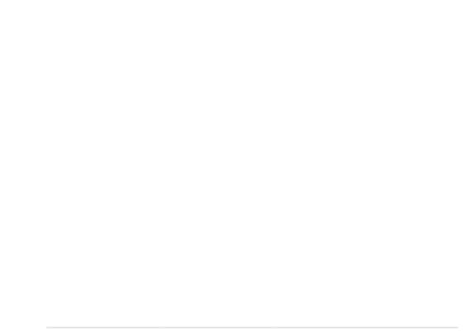

KEY THEME: ASPIRATIONS & HOPE FOR THEIR FUTURE
I want to go back to school and get my diploma because education is key. “Nico” (18-25)
Career training programs would make a big difference in my life. “Elliot” (14-18)
My goal is to learn a trade so I can provide for my family. “Traci” (18-25)
I look up to people who have succeeded despite the odds. “Theo” (18-25)
I dream of becoming an entrepreneur and creating opportunities for others."Aaron” (14-18)
Draft as of March 19, 2025

Slide 22
Questions & Conversation
WHERE DO WE GO FROM HERE?
Draft as of March 19, 2025

