Slide 1
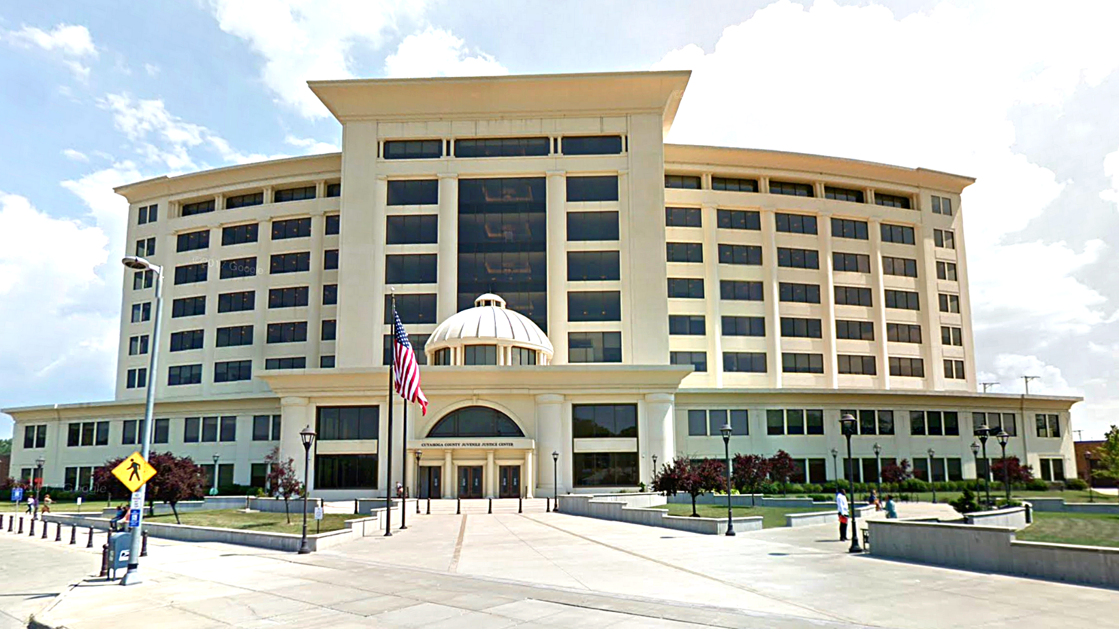

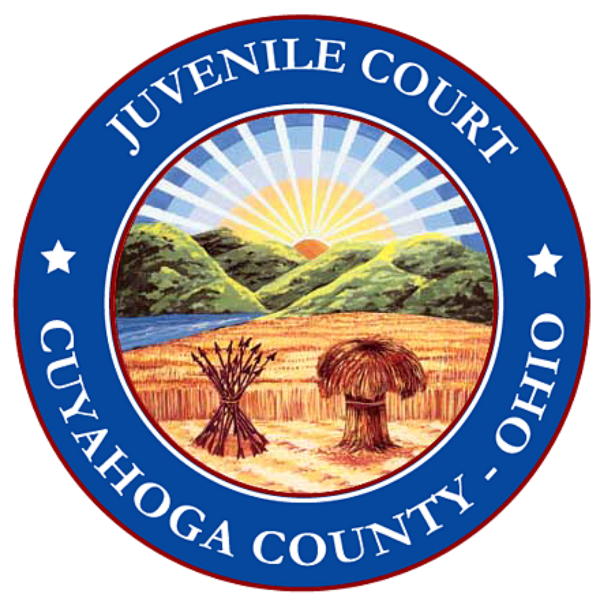

JUVENILE JUSTICE
CENTER
Youth Justice Advisory Committee
August 19, 2024

Slide 2

Purpose of Juvenile Court
Mission to administer justice, rehabilitate juveniles, support and strengthen families and promote public safety
The following are guiding principles
  Family centered approach
  Community-based
  Positive youth development focus

Slide 3

Language Matters
Our committee believes it is vital to not lose sight on who we are talking about:
Youth, adolescents, young people
People first language
Humanizing language that does not separate these youth from our own kids at home.
Notes:
While some of these young people have made impulsive and dangerous decisions, they are still our kids. They are someone's child. Terms like "offenders or juveniles" are used to other them. When I come home, I never ask my husband where the juveniles are. Their behaviors do not define who they are to our society.
By othering them, it certainly makes it easier to see them as a problem/community problem to be solved rather than tapping into their full potential and promise
he words we choose have a significant impact on the young people we serve. We may inadvertently use language laden with bias, disapproval, and negative judgment that can impact youths’ perceptions of themselves. Our language can also impact our own thinking and decision-making.

Slide 4

Community Engagement
Accountability
Transparency
  The Court has worked for several years to increase transparency, community feedback and engagement.
Notes:
The following slides will go over our process to improve community engagement and involvement with improving outcomes for the youth justice system.

Slide 5
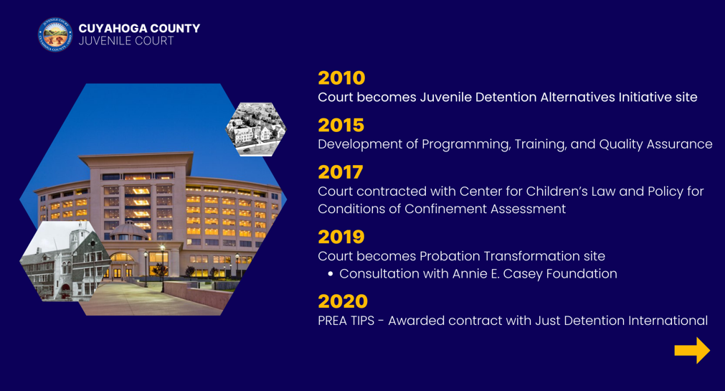

Slide 6
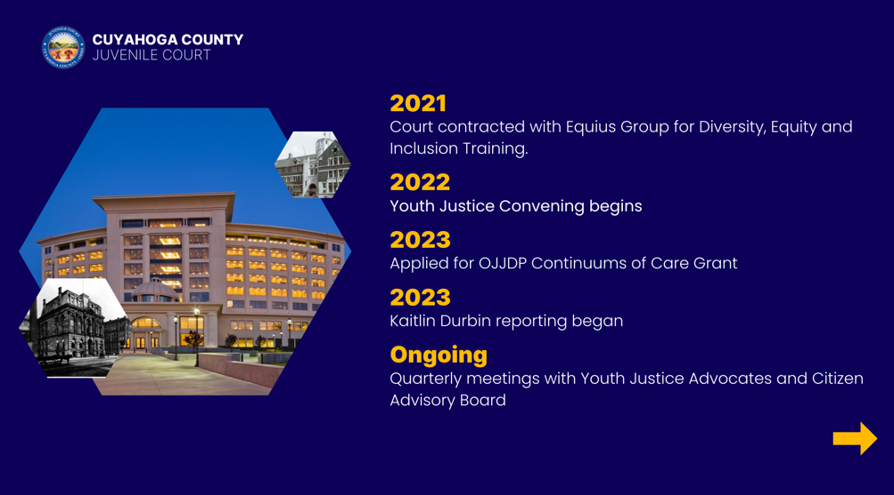

Slide 7
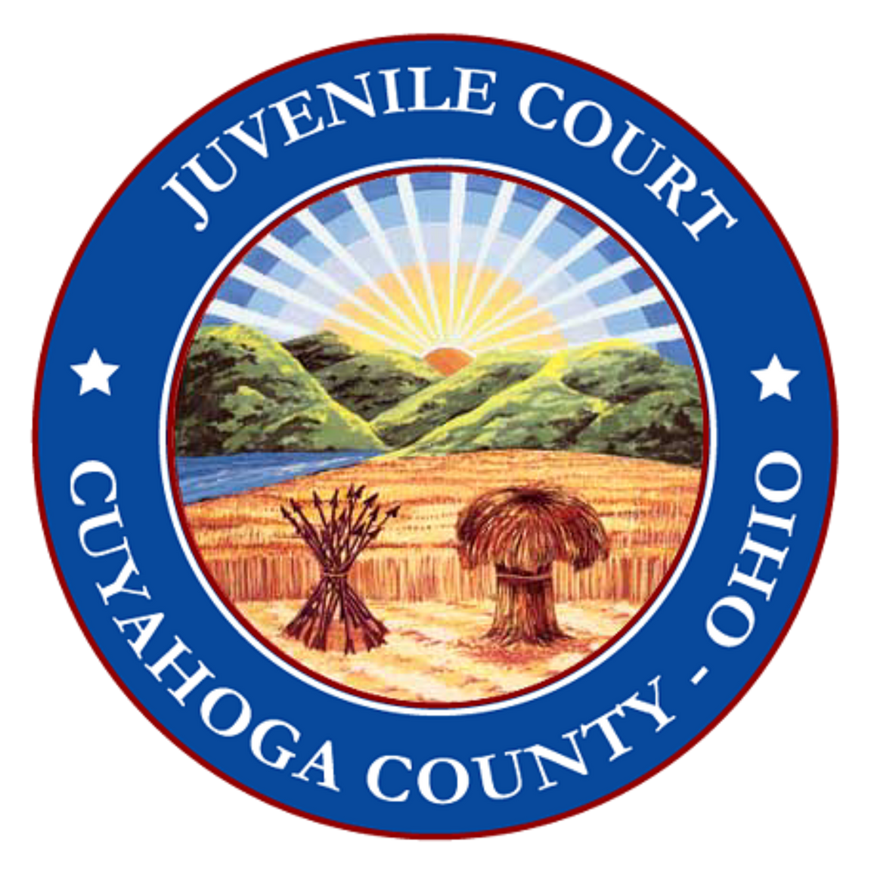

Office of Juvenile Justice and Delinquency Prevention Act
Building Local Continuums of Care to Support Youth Success
(O-OJJDP-2023-171851)
  Project is designed with racial equity framework remove barriers and promote opportunities for communities historically underserved
  The target population for the CFC initiative will be youth aged 12-17 and their families with, or at-risk of involvement with the Cuyahoga County juvenile justice system, particularly Black youth that are disproportionately represented in the juvenile justice system.
  Asset mapping
  Gap Analysis
Resulting in a new continuum of care for justice involved youth

Slide 8

Trauma & Mental Health
70% of youth have a diagnosable behavioral health disorder
92.5% of detained youth reported at least one traumatic experience, and 84 percent reported more than one (Abram et al. 2013).
More than 66% of youth in juvenile justice have a history with child welfare system in Cuyahoga County. (US DOJ)
Notes:
Intersection between Mental Health and Juvenile Justice System Literature Review (ojp.gov)

Slide 9

Reforms in JJS are informed by adolescent brain science
Youth are uniquely different:
  High risk-taking behavior is normal part of adolescent development
  Vast majority of cases, youth outgrow law breaking behaviors with little to no intervention
  Detainment results in significant decreased in high school completion rate and increases likelihood of adult incarceration

Slide 10
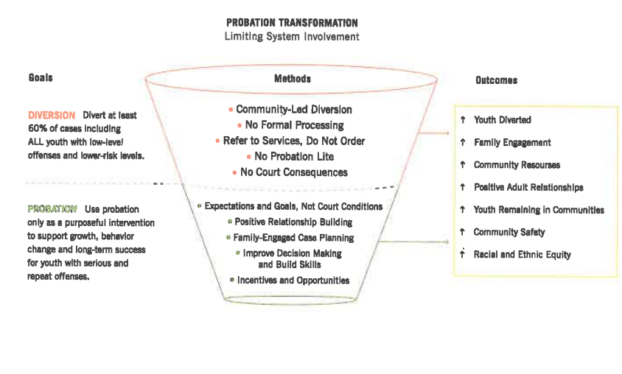
Overview on Juvenile Justice Reform

Slide 11
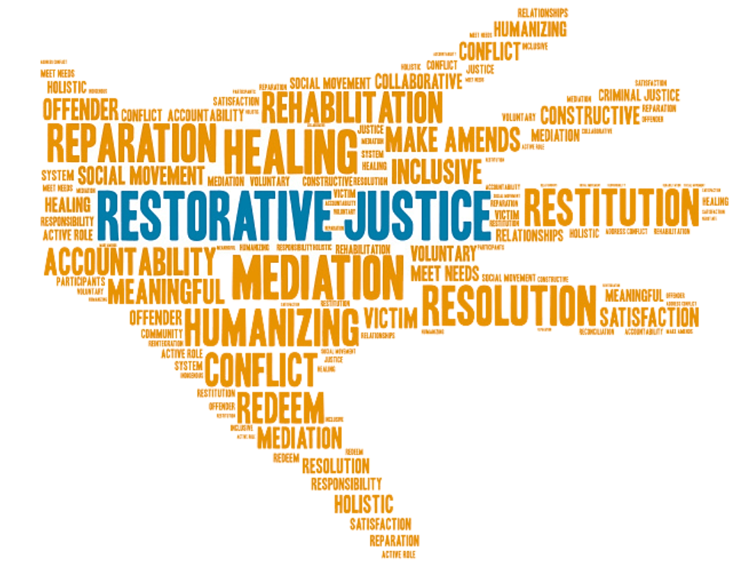

Cuyahoga County Juvenile Court
New programming!
  Restorative Justice Programs
  Mentoring Programs
  Educational/Vocational
  Positive Youth Development

Slide 12

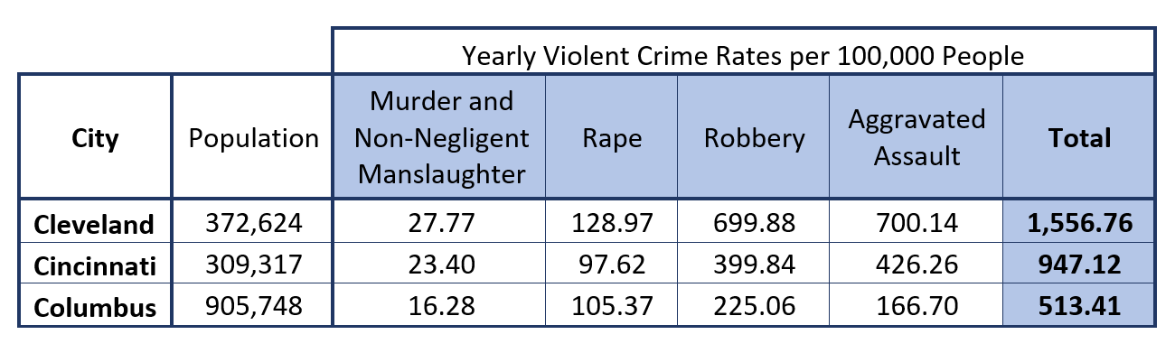
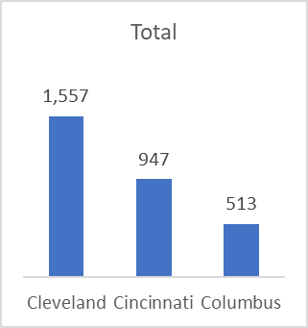
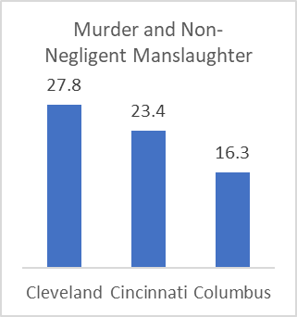
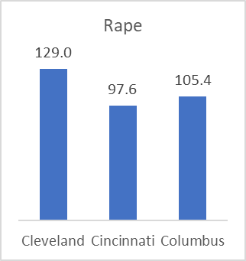
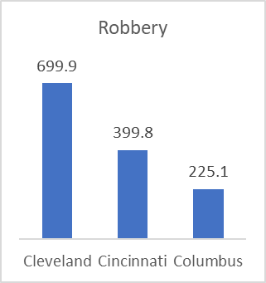
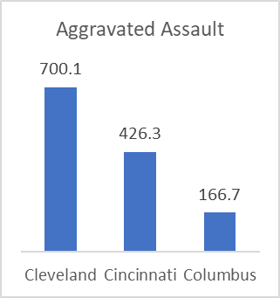
Landscape of Violent Offenses
2019 Federal Bureau of Investigation Uniform Crime Reports
Yearly Violent Crime Rates per 100,000 People
Juvenile Justice Center
Notes:
City data not County data
Murder and nonnegligent manslaughter: Cleveland 7, Cincinnati 10, Columbus 28,
Rape: Cleveland 3, Cincinnati 12, Columbus 6
Robbery: Cleveland 2, Cincinnati 13, Columbus 38
Total Violent Crime: Cleveland 7, Cincinnati 26, Columbus 63

Slide 13
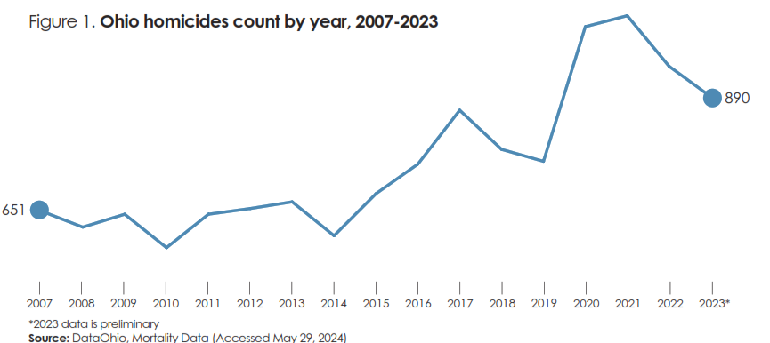
Landscape of Violent Offenses
Health Policy Brief, Criminal Justice and Health
Social drivers of violence crime
Juvenile Justice Center
Notes:
City data not County data. Ohio ranks 34
th
in the nation in homicide deaths. Like
• Community conditions can
perpetuate or prevent violence.
Community factors including social
norms, exposure to racism, income
inequality and access to quality
housing, education, employment
and health care impact violence.
national trends, homicide in Ohio peaked during the
COVID-19 pandemic, but has not returned to prepandemic rates (as displayed in figure
1).

Slide 14
Overview of Court Process
Complaint Filed
All charges sent to Prosecutor
Prosecutor Review
Agreed upon matrix
Case sent to EIDC
Intervention Specialists schedule meeting with family
Automatic diversion
Automatic official
Pending assessment
Arrest
F1 or F2 possible admission to DC

Slide 15
Overview of Court Process (Continued)
Screening Appointment
Diversion OYAS
MH Clinician Assessment
Only when indicated
Recommend services
Available for all youth
MAYSI-2
SOGIE
On-site, same-day
Both Court-contracted and community-based
Recommend diversion level
For pending assessment cases only

Slide 16
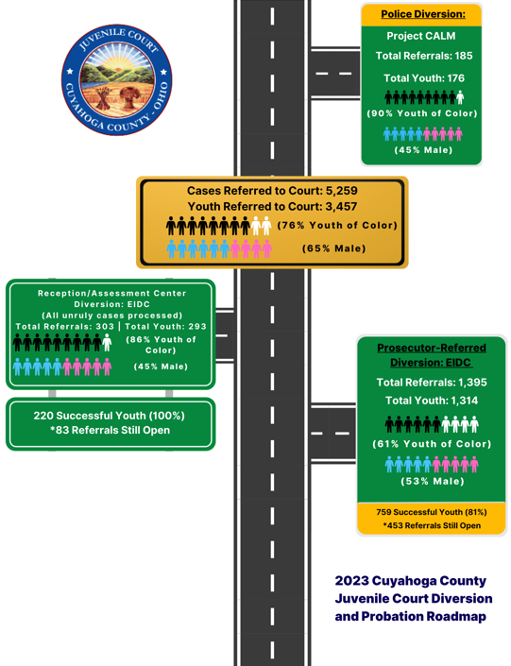
Notes:
About 2,000 some cases a year diverted through EIDC- on average- we divert about 50% of cases- (some are still open so it is not about subtracting # cases referred to those diverted- still have diversion open)

Slide 17
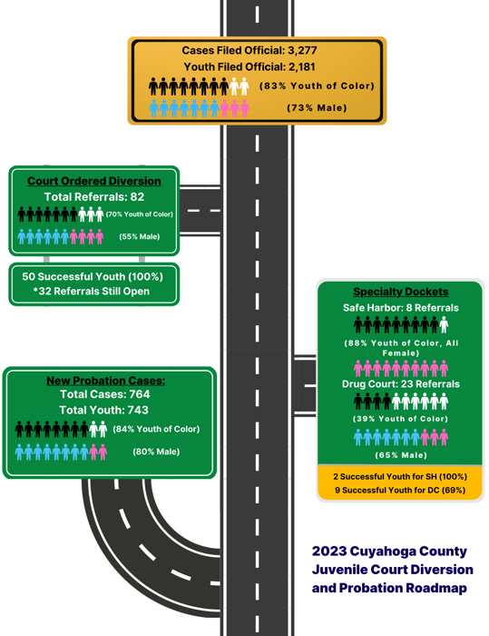

Slide 18
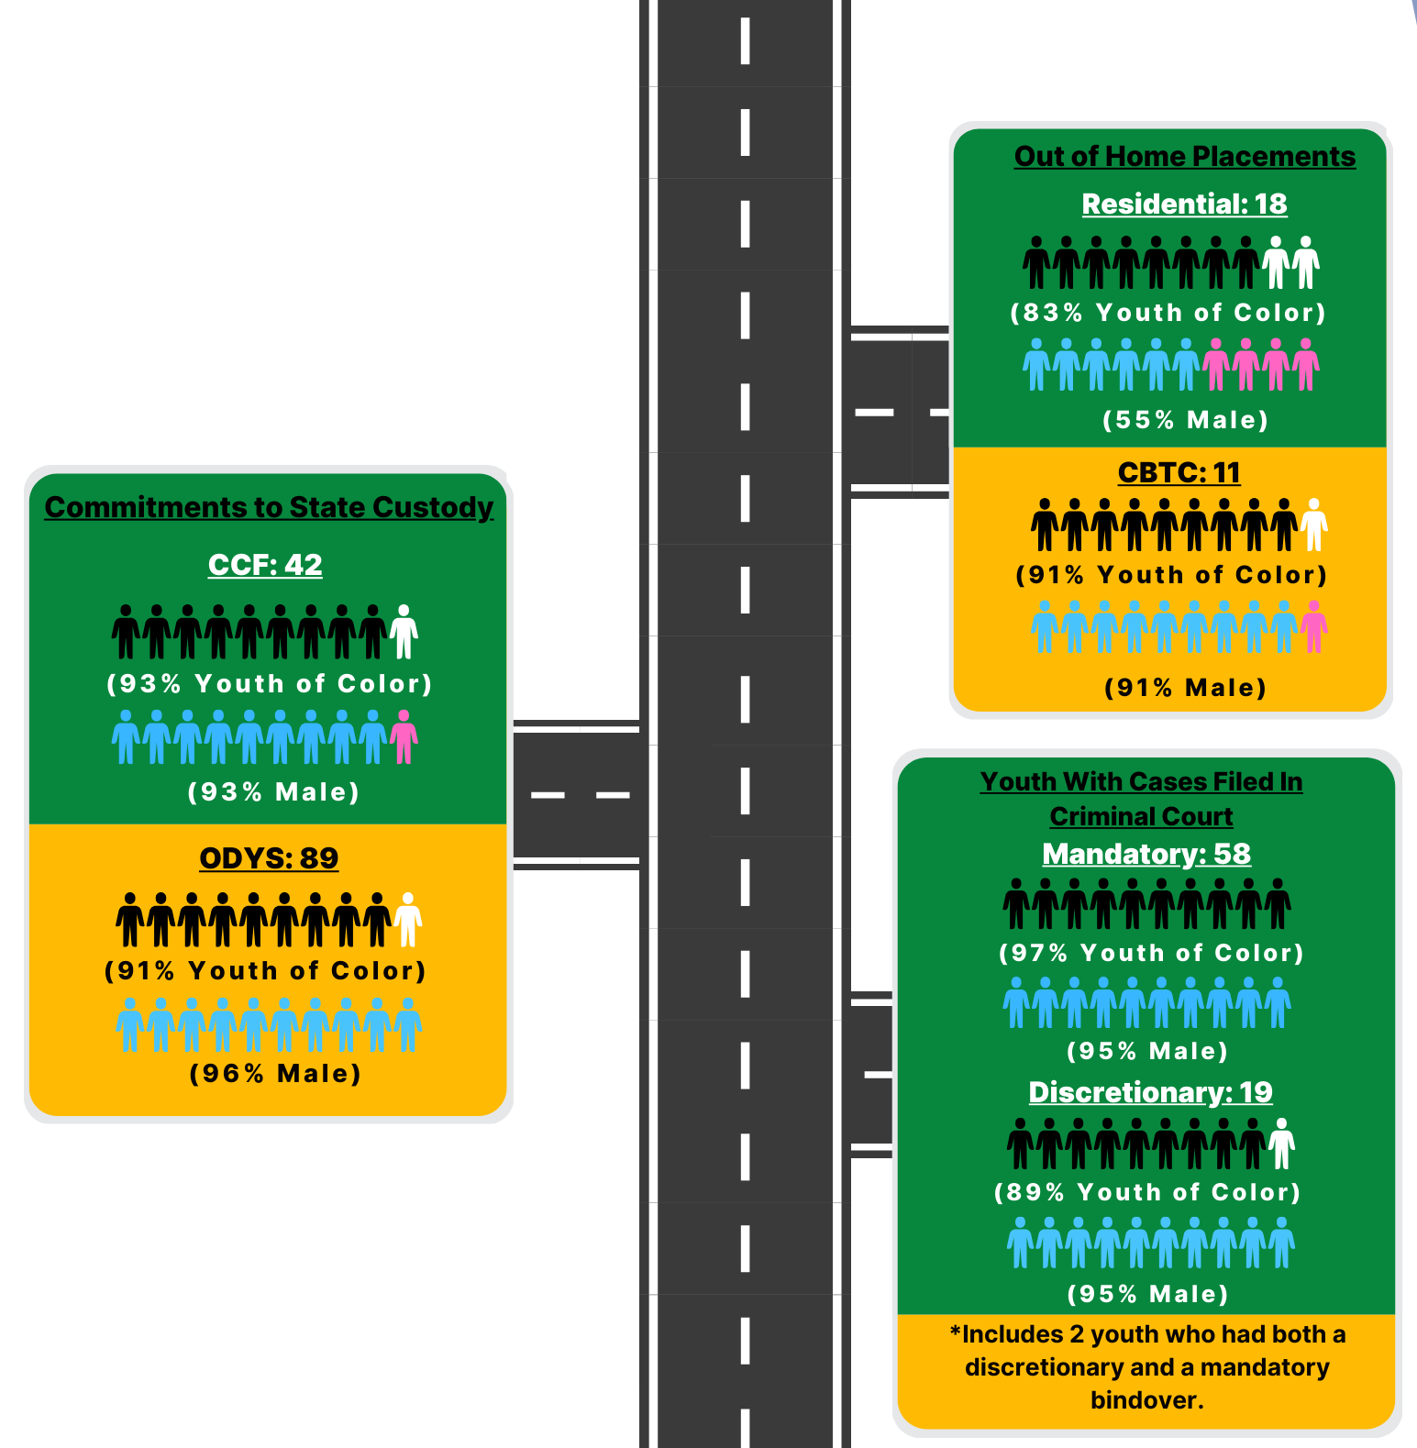

Slide 19
Diversion Services
Juvenile Justice Center
Notes:
\

Slide 20


Project CALM (Coordinated Approach Low-Level Misdemeanors)
  Domestic Violence diversion that has prevented hundreds of youth each year from admission to the Detention Center started in 2015
  Links to trauma informed placement and immediate family support services
  Faster processing time for law enforcement (1^{½} hour reduction)
Cuyahoga County Juvenile Court

Slide 21

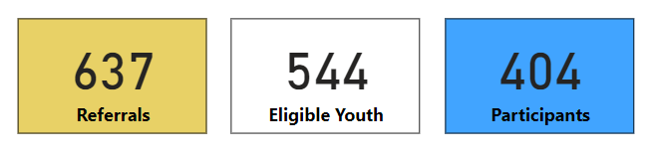
JUVENILE JUSTICE CENTER
CALM Referrals
July 1, 2021 – December 31, 2023
Overall, 63% of referrals ended up participating in CALM.
  66% of total referrals from Cleveland participated
  58% of total referrals from other cities participated
Cleveland districts had 405 referrals
Top 4 suburbs had a total of 69 referrals
All suburbs had 232 referrals all together

Slide 22

Early Intervention & Diversion Center
  Increases diversion options
  Allows for immediate access to court and community referrals versus waiting for disposition
  Intentional focus to reduce racial disparities
Notes:
Update this to reflect 1/1/2023 through October 31st – EIDC dashboard - Done

Slide 23
Two Tiers for Diversion
Care Coordination
  More intensive supports
  May have a history of unsuccessful diversion
  More mental behavioral health needs
  Need for more intensive family supports
    Multisystemic Therapy
    Integrative Co-Occurring Therapy
    Care Coordinators have clinical experience or specialty docket experience
    School-based Therapy
    Substance abuse
    Referrals to other Intensive Home-Based Treatment
    Restorative Justice
Diversion Specialist
  Lightest touch
  Community services
  0-3 months
  Community diversion programs
  Apology restitution
  Restorative Justice
Early Intervention and Diversion Center
Notes:
\

Slide 24

Cuyahoga County Juvenile Court
Services Available in Diversion
Community Service
Sex Offender Treatment (BDE)
Family Centered Treatment
Apology/Restitution
Referrals for Mental Health Services
Community Diversion Programs
Referrals to Substance Abuse Treatment
Restorative Justice Programming

Slide 25
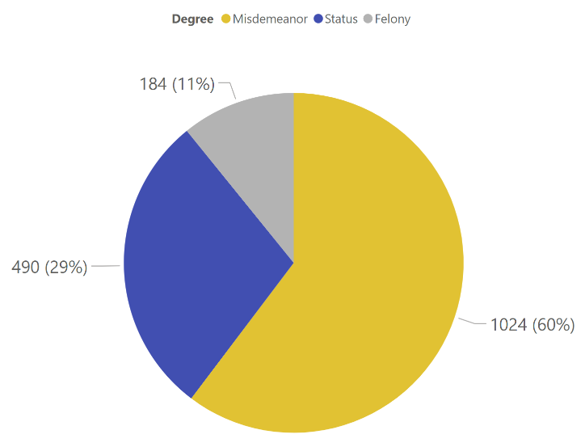
EIDC Referrals by Degree
January 2023 – December 2023
Notes:
Update this to reflect 1/1/2023 through October 31st – EIDC dashboard - Done

Slide 26
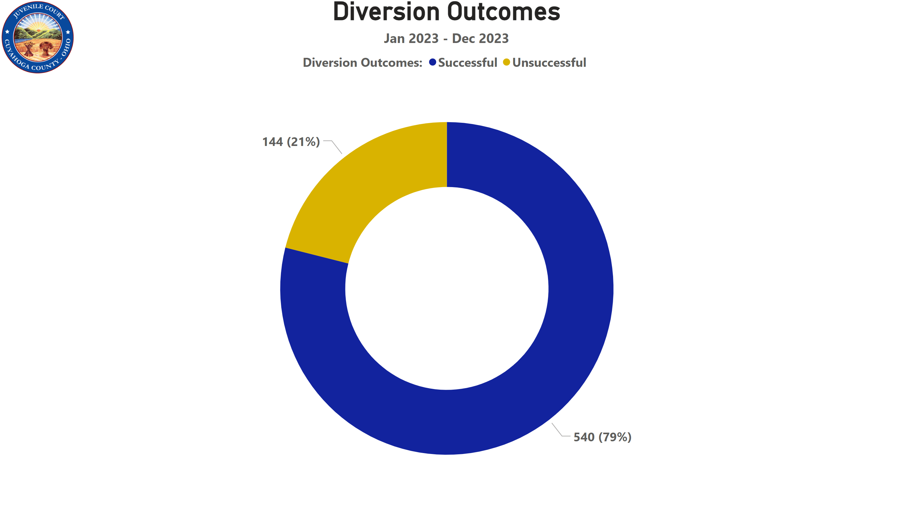
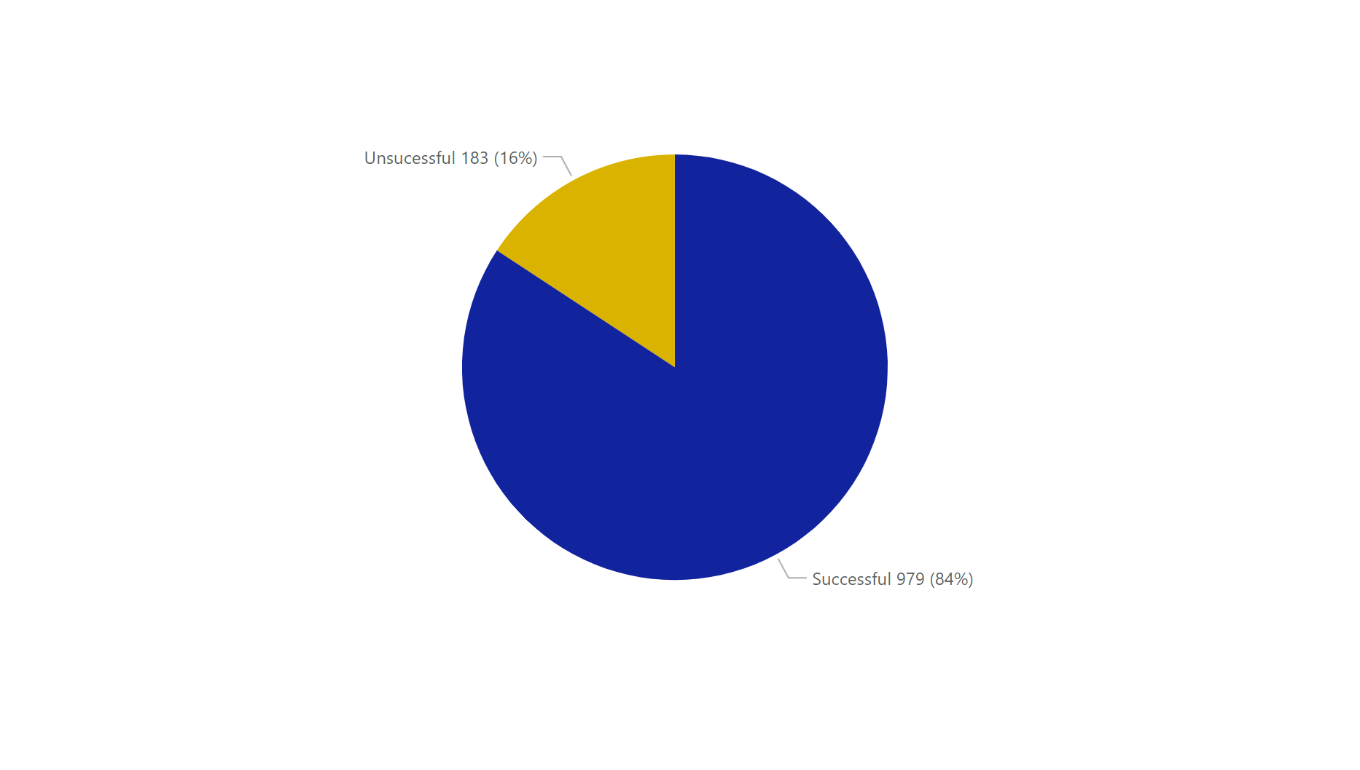
Notes:
Update this to reflect 1/1/2023 through October 31st – EIDC dashboard – Done

Slide 27
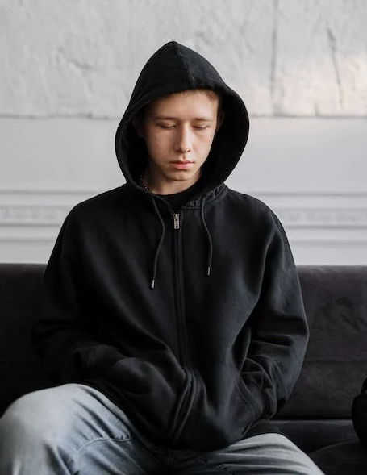
Probation Services

Slide 28
Cuyahoga County as a Probation Transformation Site
Receive Consultation from Annie E Casey Foundation (AECF)
Our current Technical Assistance provider is Catalyze Justice
Ongoing trauma training, adolescent development, implicit bias training
Exposure to other jurisdictions and experts in juvenile justice
Participation in conferences

Slide 29
RESULTS
Increase in diversion for misdemeanor youth
  Through EIDC youth have access to same services as youth on probation
Reserving Probation Supervision for higher risk youth
  A move away from compliance-based probation
Reduction in youth being placed in Detention for Violation of Court Orders
  Probation staff are using intermediate sanctions to maintain youth safely in the community
Increased engagement with the community through committees and program opportunities
Probation Transformation
Notes:
\

Slide 30

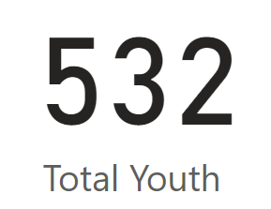
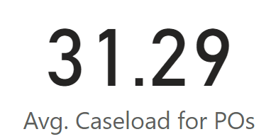
Cuyahoga County Juvenile Court
Probation Services
Receiving Probation Services as of April 16, 2024
Probation Officer Caseload Size as of April 16, 2024

Slide 31

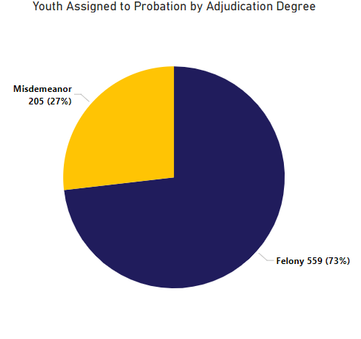
Probation
764 Total Youth
JUVENILE JUSTICE CENTER
Notes:
2023 Data– JDAI Probation Transformation Data – This chart on the right used to look about 75% misdemeanors

Slide 32
JUVENILE JUSTICE CENTER
Probation Level of Offenses by Year

Slide 33
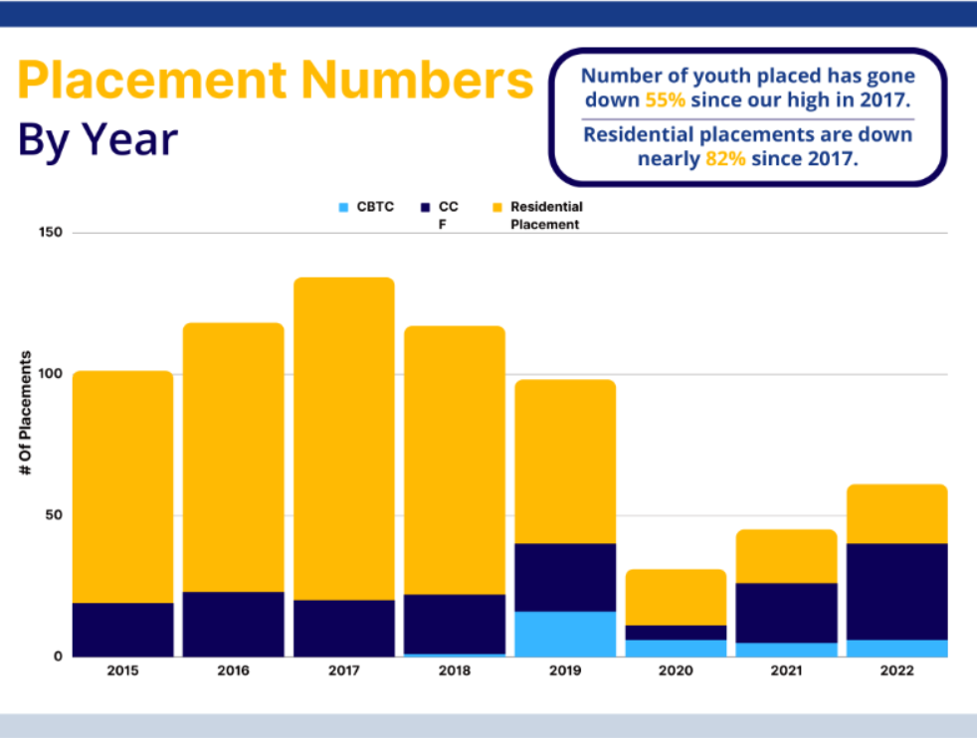
Number of youth placed has been
reduced by 55% since our high in 2017.
Residential placements are down nearly 82% since 2017.
CCF

Slide 34
Recidivism for Youth who Terminated Probation in 2020
720
Cases
666
Youth
471
Youth with No Recidivism
We reviewed all 666 youth who were terminated from Probation in 2020 to determine how many youth were adjudicated delinquent or unruly of an additional offense committed within 1 year of their placement onto probation.
71% of youth did not incur a new delinquent charge with the incident happening within 1 year of starting their probation.

Slide 35
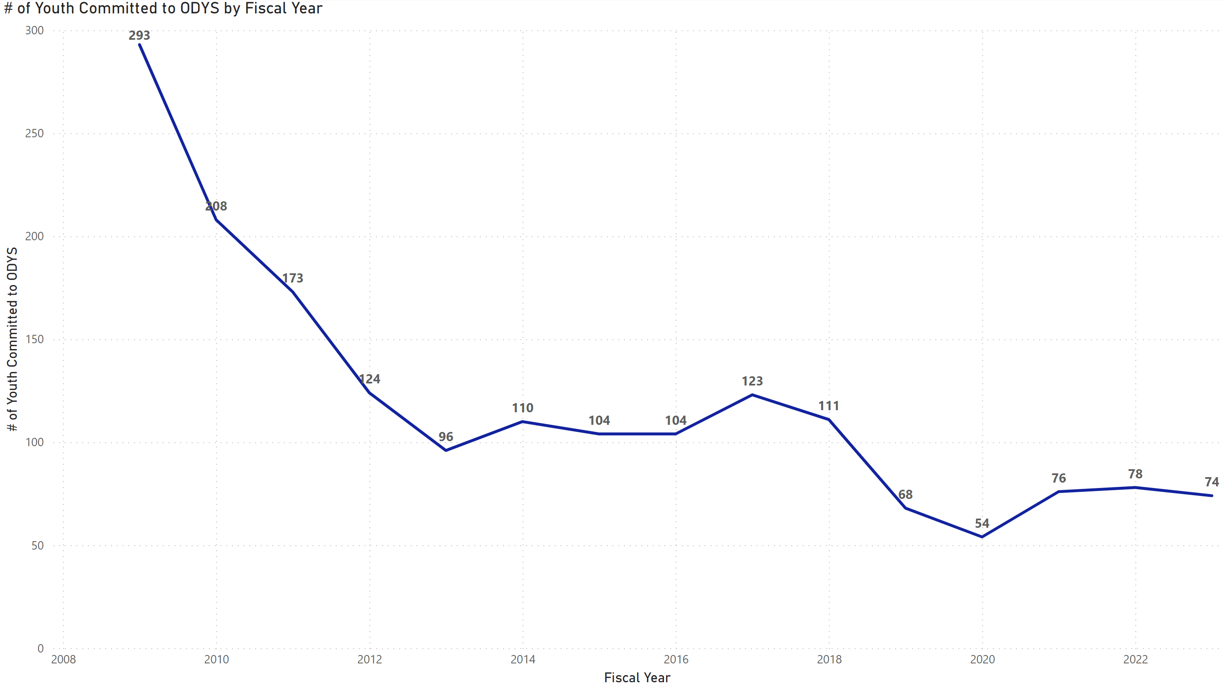
Youth Committed to ODYS by Fiscal Year
The number of youth committed to DYS has dropped by nearly 74% since 2009.
Despite the slight uptick in commitments after COVID, our 3-month rolling average remains below our pre-COVID commitment numbers.
Notes:
Update to include 2023 – ODYS commitment report in iCase – I think - Done

Slide 36



Specialized Dockets
SAFE HARBOR COURT
  Specialized treatment docket for youth at risk or survivors of human trafficking.
  REENTRY COURT
  Create safe return to the community from ODYS Commitment.
  JUVENILE DRUG COURT
  Treatment docket for youth with substance abuse disorders.
FAMILY RECOVERY COURT
  This docket assists CCDCFS parents in obtaining treatment for substance abuse disorders while maintaining custody of their children.
  PHOENIX COURT
  Treatment docket for youth with severe behavioral health disorders, including co-occurring disorders.

Slide 37
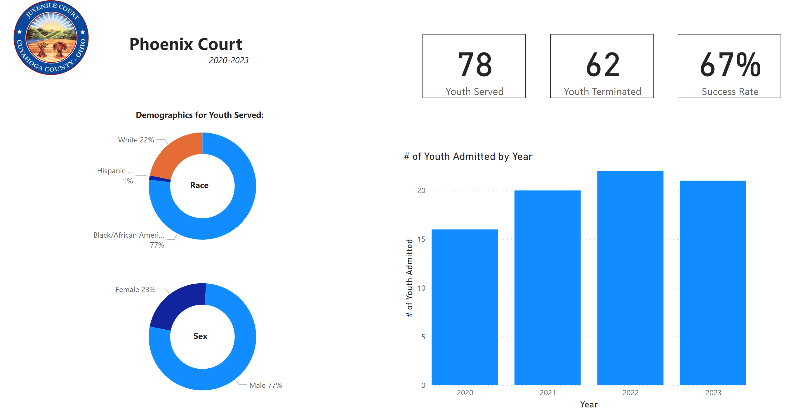
JUVENILE JUSTICE CENTER
Notes:
Update to add 2023 – program referral dashboard - Done

Slide 38
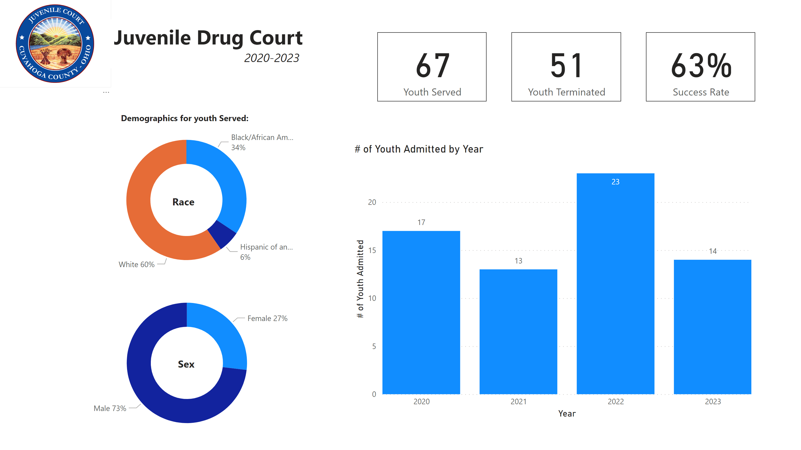
JUVENILE JUSTICE CENTER
Notes:
Update to add 2023 – program referral dashboard - Done

Slide 39
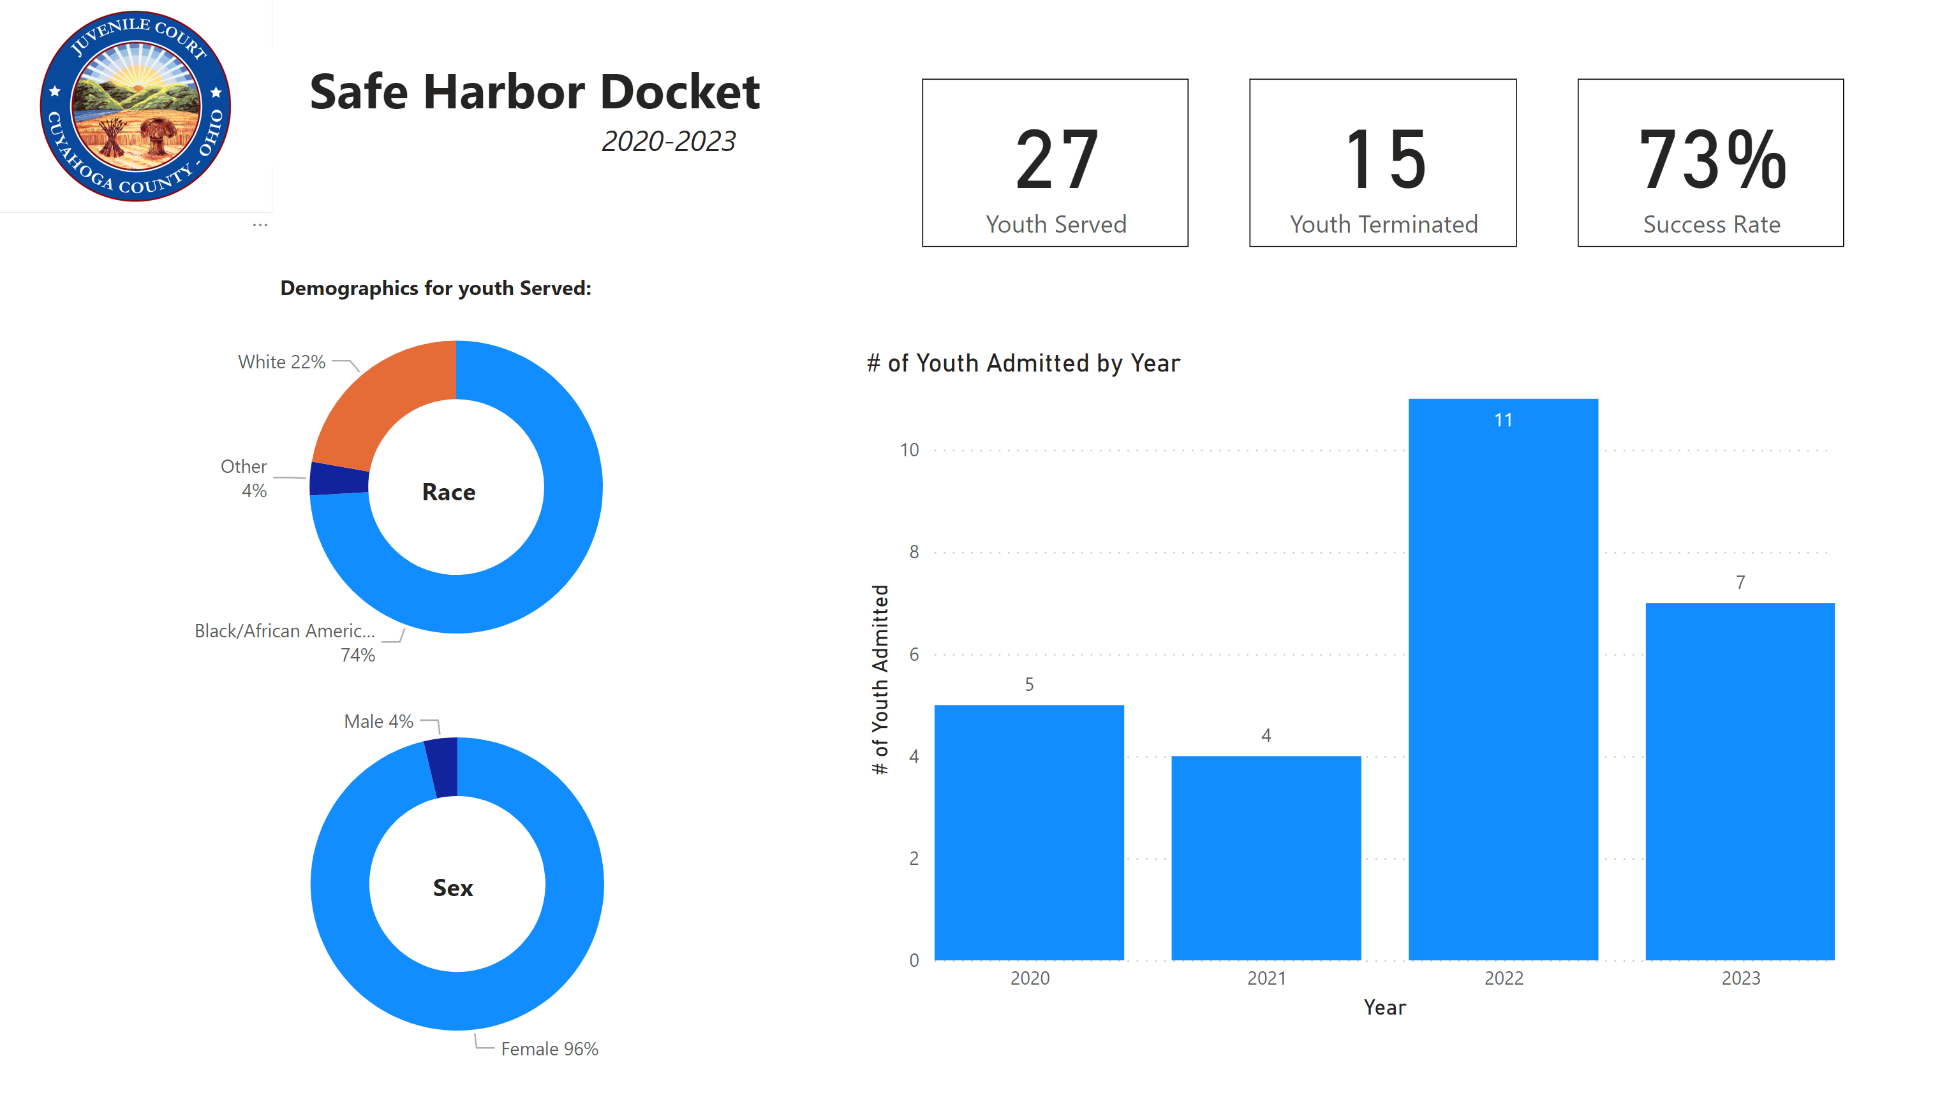
JUVENILE JUSTICE CENTER
Notes:
Update to add 2023 – program referral dashboard - Done

Slide 40




Promise Team
Promise Team is a trauma–informed approach to work with justice involved girls with a history of trauma and behavioral health disorders who are on probation and have an open or recent involvement with the Cuyahoga County Department of Children & Family Services (CCDCFS).
The initiative services include:
  Case management
  Specialized & Trauma-informed probation services
  Access to crisis stabilization bed
  Educational/Vocational mentoring
  Evidenced based in-home therapy
    Multi-Systemic Therapy (MST)
    Integrated Co-occurring Treatment (ICT)
    Trauma Focused Cognitive Behavioral Therapy (TF-CBT)
Juvenile Justice Center

Slide 41
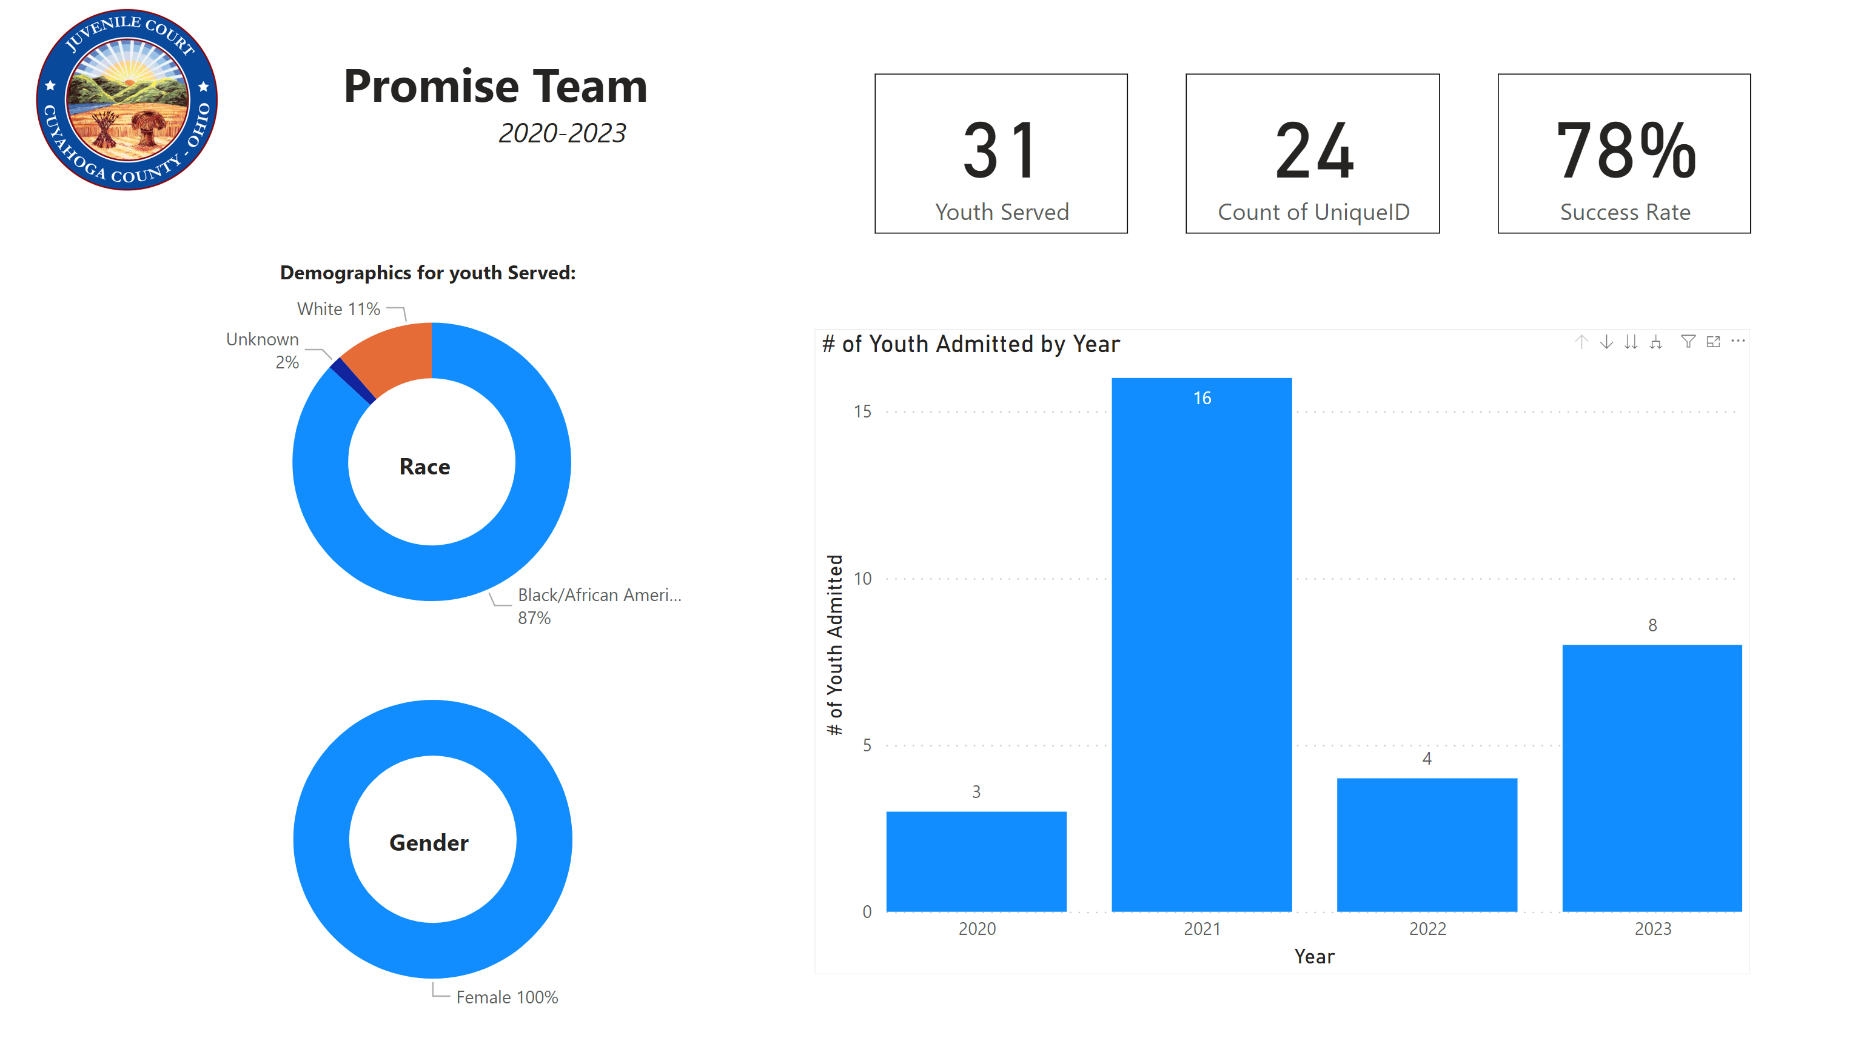
JUVENILE JUSTICE CENTER
Notes:
Update to add 2023 – program referral dashboard - Done

Slide 42


In-Home Family Therapy
Providers:
  Applewood Centers
  Bellefaire JCB
  Court MST
In recent years, the Court has utilized research in juvenile justice to improve outcomes. As a result, there has been a significant shift to family-centered treatment:
  To impower caregivers to be part of the solution
  Address family, peers, education, prosocial activities
  Community-based
Juvenile Justice Center

Slide 43
Programming
Multi-Systemic Therapy (MST):
  A unique, goal-oriented, comprehensive, and evidence-based, treatment program designed to serve youth with multiple problems
  The Court's MST Program (MST) employs eight therapists, one manager, and one assistant manager and can serve 120 youth and families per year (largest capacity in OH). Currently need 7 clinicians!!
  Provides intensive services within the family’s ecology including the home, school, and community w/therapists available 24-hours-per-day, 7-days-per-week.
81
youth referred in 2022
77%
of youth had no new arrests after completing MST
Cuyahoga County Juvenile Court

Slide 44
Alternatives to Detention
Juvenile Justice Center
Notes:
\

Slide 45

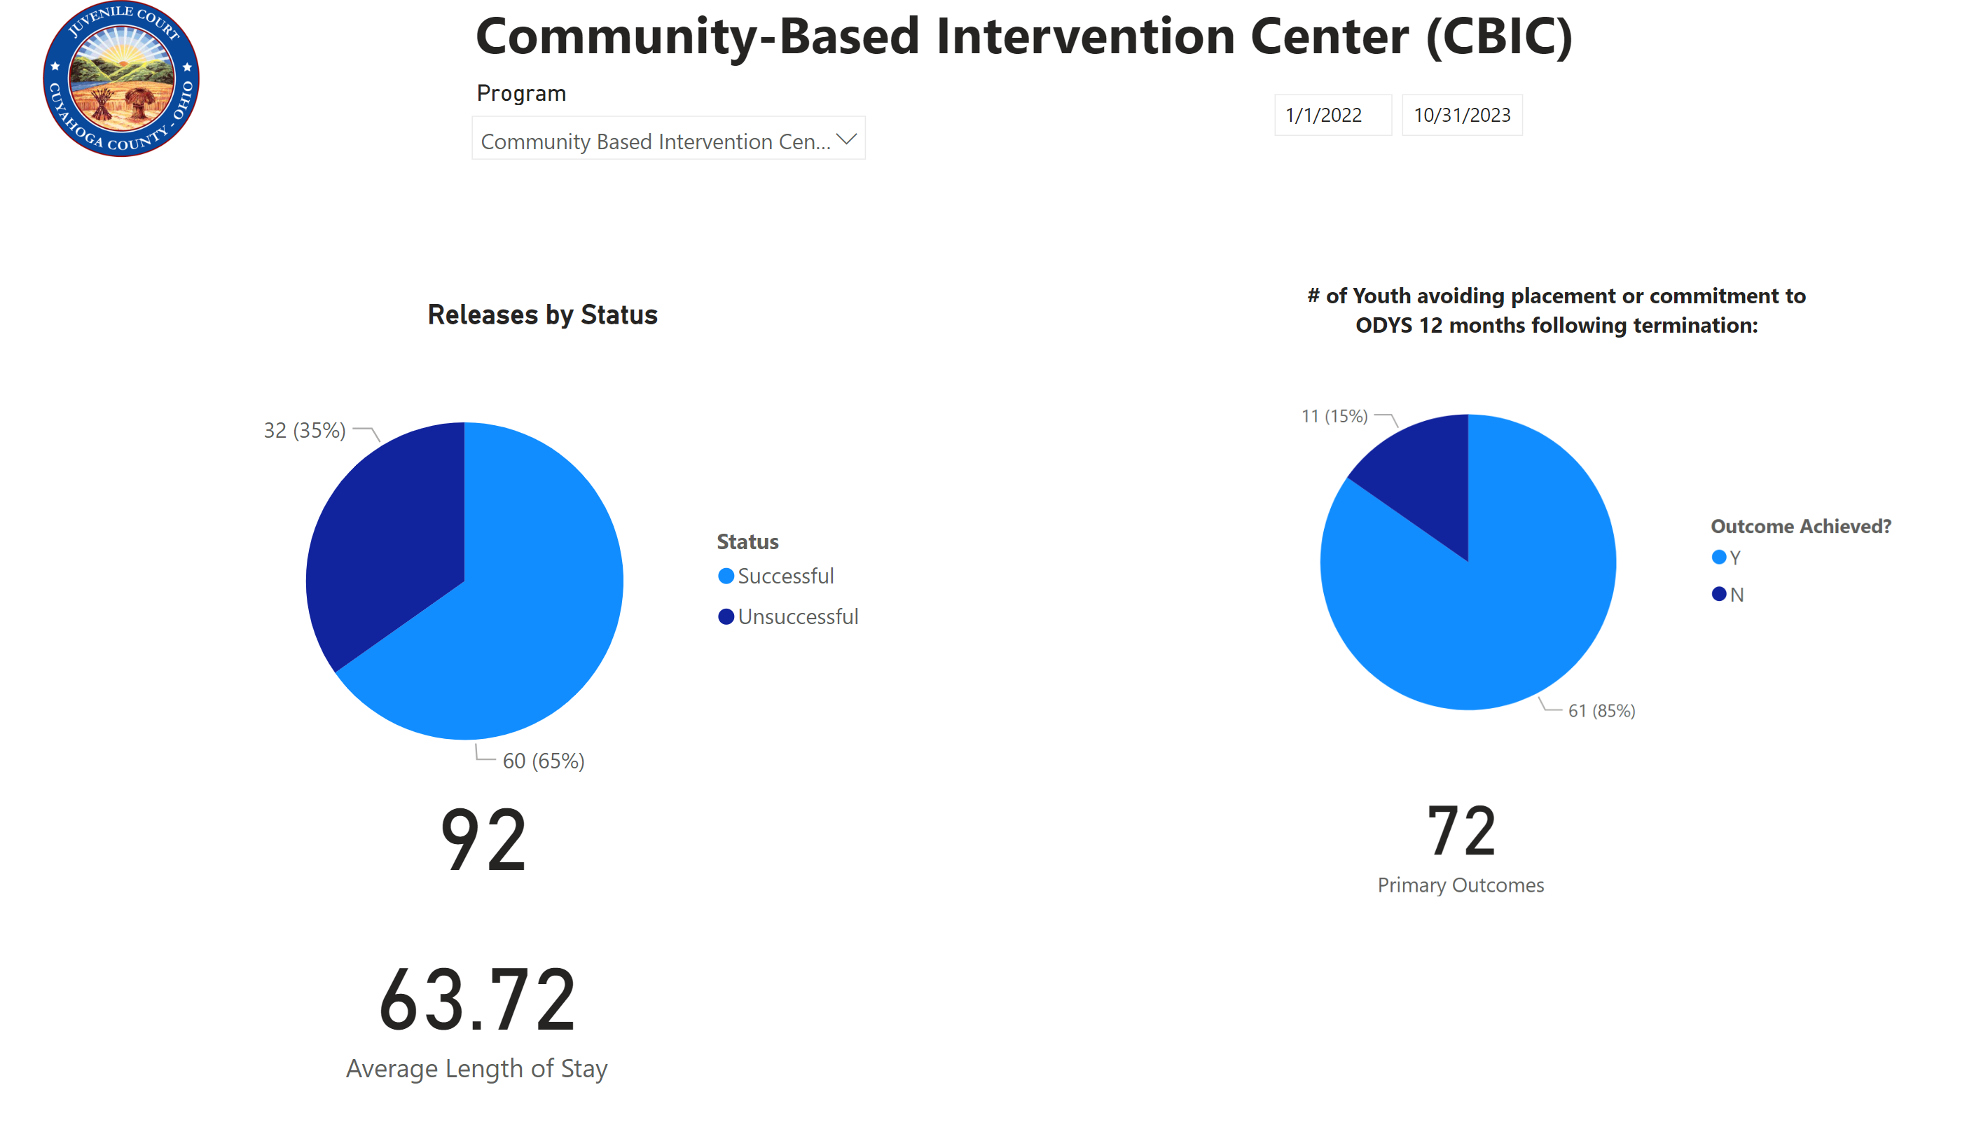
CBIC
Notes:
Update for 10/31/2023 – Program Referral -Done

Slide 46


The program serves only males, pre and post adjudicated youth that are moderate to high risk. The program is approximately 12 weeks long Monday – Friday and partners with Renounce Denounce and Cleveland Peacemakers for Saturday programming.
The curriculum is Cognitive Behavioral Interventions- Core Youth. The program teaches skills ranging from problem solving, social skills and emotional regulation. We serve both full day and half day youth, partnering with CMSD for educational services and Applewood for case management. We also collaborate with CWRU medical students for social and emotional learning and Fresh Start mentoring program.

Slide 47

Cuyahoga County Juvenile Court
Programming
Daisy House & Youth Care Centers
The Juvenile Court has worked to expand alternatives to detention.
  Daisy House completes behavioral health screening and forwards to EIDC for comprehensive behavioral health assessment.
  Placement options for the youth are at home, CALM respite, with a family friend, or Youth Care Center (therapeutic group homes).
  Law Enforcement has 24/7 access to Court.
  Youth are arraigned the following morning without touching detention center

Slide 48

Daisy House & Youth Care Centers
Youth Care Centers
  Raven House
  Luther Metropolitan Ministries
(1) Secure Bed with Applewood (a dedicated crisis bed for the Juvenile Court)
Cuyahoga County Juvenile Court

Slide 49
Home Detention
Provides 24 hour-7 days a week- 365 days a year GPS monitoring, supervision, and accountability of all youth
Used as:
  alternative to detention
  step-down from secured detention
  an order by jurists pending further court action
Works in collaboration with multiple internal and external stakeholders to assist with successfully transitioning youth into the community from secured detention.

Slide 50
JUVENILE JUSTICE CENTER
Car Theft Program
In Collaboration with Cleveland Division of Police, the Court started a pilot program to expediate the response to juvenile car thefts
  Police have access to LEADS, LEARMS, and their Field Based Reporting in the Detention Admissions
  24/7 access to place youth on Home Detention (electronic monitoring)
  Arraigned the following day
  Assessed by EIDC Specialist to link families to needed services
Presently available county-wide

Slide 51
Efforts to Improve Conditions of Confinement
With the support of our youth justice advocates through CWRU Shubert Center , ACLU and supported by the Gund Center, the Court contracted with the Center for Children’s Law and Policy to conduct a JDAI Assessment of the Conditions of Confinement.
The report highlighted areas of concern with very specific recommendations to improve conditions.
The Court is committed to continue to improve conditions of confinement and we do so in collaboration with our community partners and rely heavily on volunteer programs.
Juvenile Justice Center
Notes:
\

Slide 52

Cuyahoga County Juvenile Court
Juvenile Detention Center
Educational Services:
    16 regular education, 3 Special Education and two Physical Education CMSD teachers
    Staggered instruction times for students (7:30AM-1:30PM, 8:30AM-2:30PM, 10:30AM-4:30PM)
    Extended school year calendar which allots for an additional 19 days of instruction for students.

Slide 53


Juvenile Detention Center
Educational Services:
21
HS Graduates
94
HS Graduates
Academic Year
2023/2024
Since 2019
Cuyahoga County Juvenile Court
As of August 13, 2024

Slide 54
Juvenile Detention Center
Programming & Services:
  Creative Hope Studios
    Retrofitted one of our facility’s former “confinement rooms” to serve as a state-of-the-art recording studio
    The only staff trained, structured, and back-end supported recording studio and media space program designed specifically for at-risk youth in the nation.
    Offers opportunities for healing and self-expression through creative writing, cultural inclusion, poetry, music therapy, and the arts
    Inspires career exploration in audio production & engineering, video editing, podcasting and entrepreneurship.
Cuyahoga County Juvenile Court

Slide 55
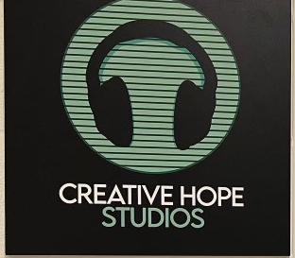
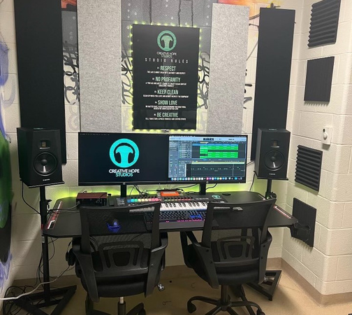
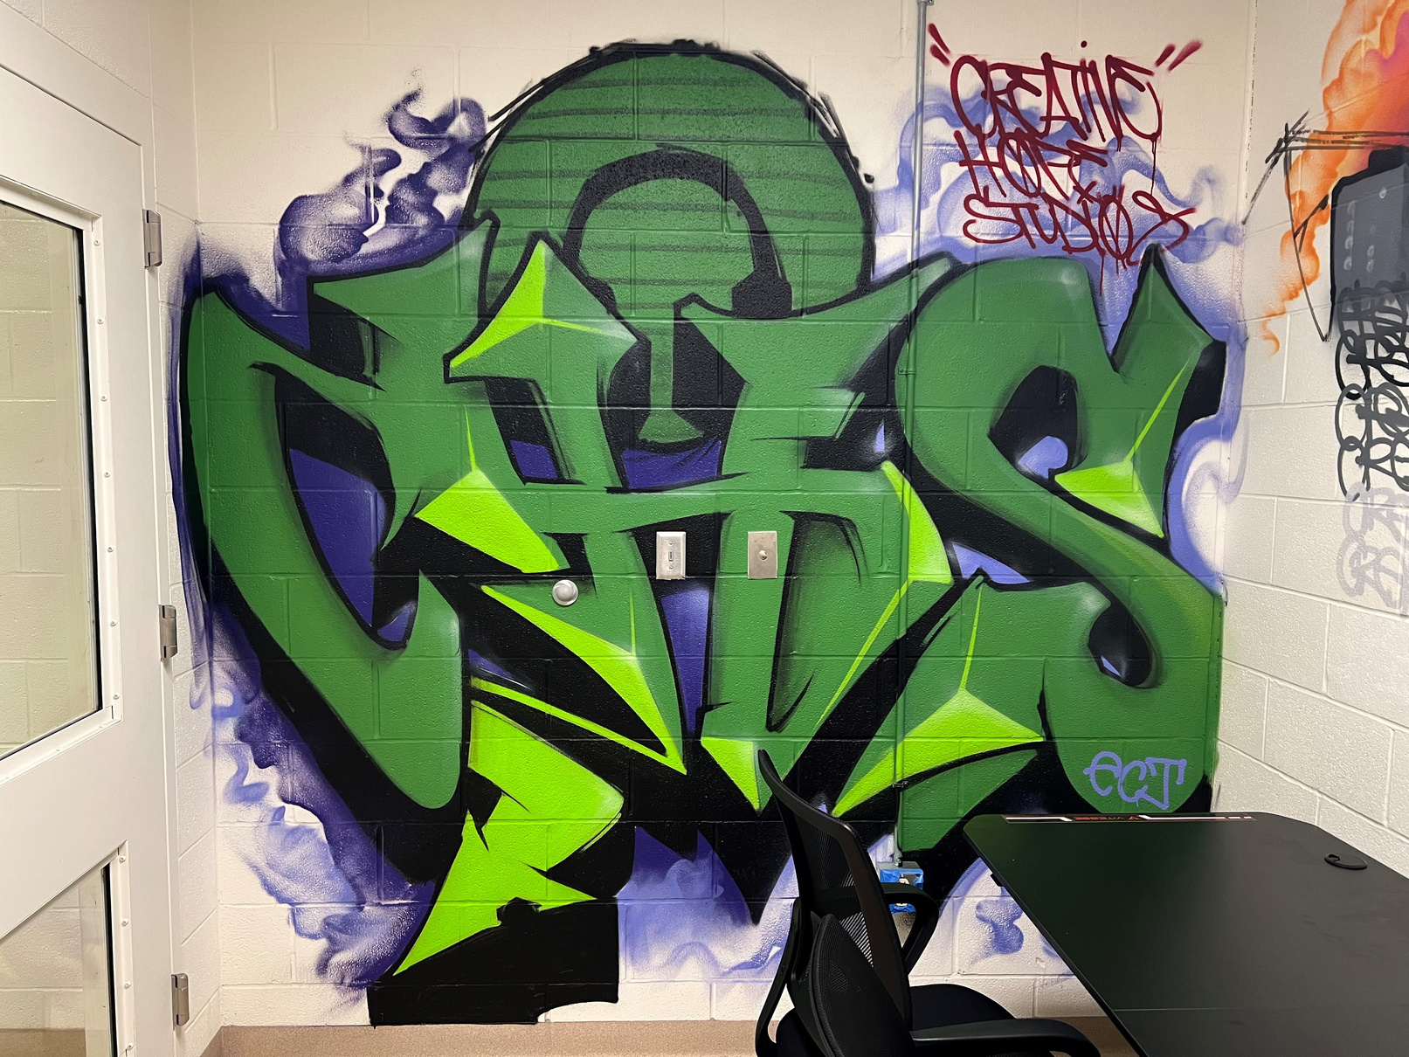
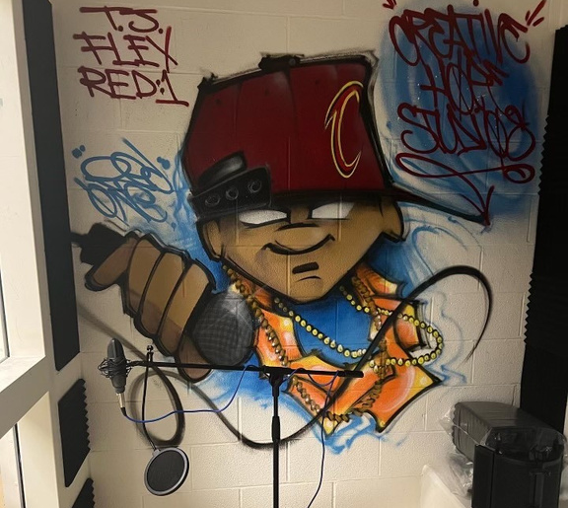
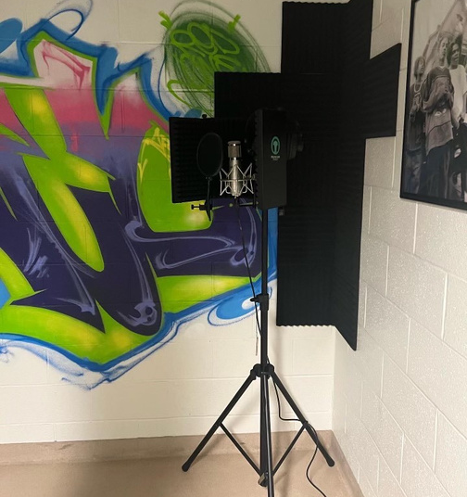
Cuyahoga County Juvenile Court
Juvenile Detention Center
Programming & Services:
  Creative Hope Studios

Slide 56
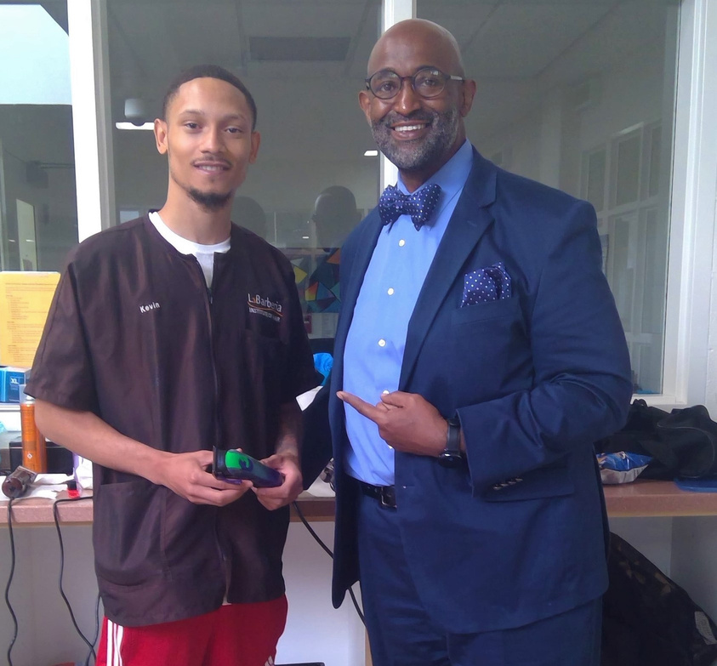
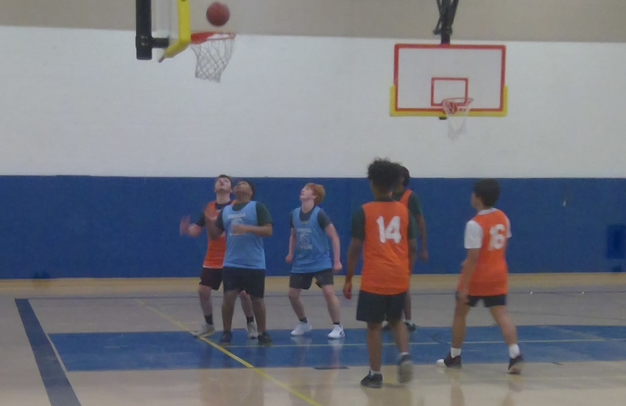
Juvenile Detention Center
Programming & Services:
  Haircare Services
    LaBarberia Institute of Hair provides barbers every 2 weeks to supply haircuts to residents.
  The John Carroll Ballers Program
    Character education combined with basketball games and pizza for residents and college students lead to breaking barriers for students to discover their commonalities.
Cuyahoga County Juvenile Court

Slide 57
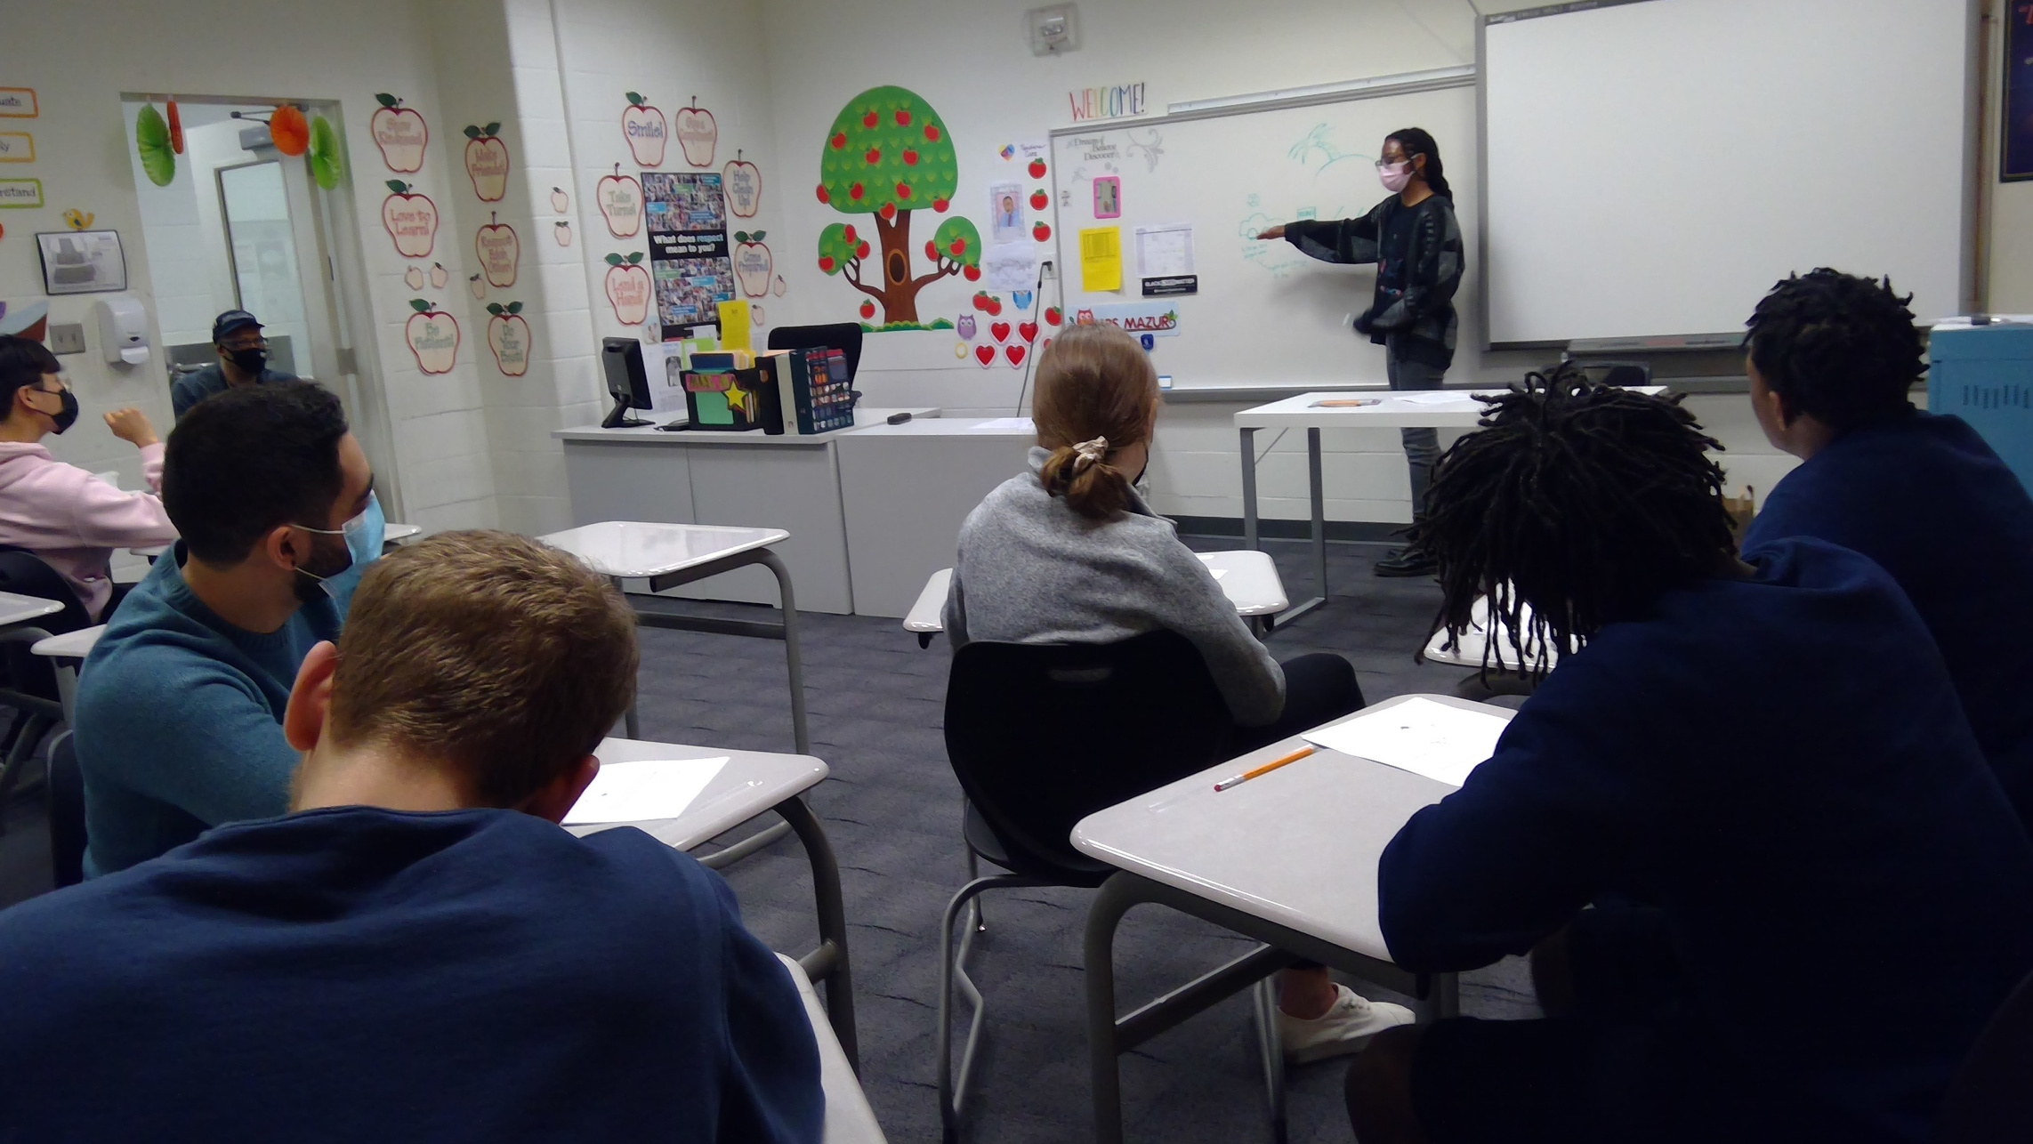

Cuyahoga County Juvenile Court
Juvenile Detention Center
Programming & Services:
  HOPE4
    Weekly group sessions and 1-on-1 workshops facilitated by CWRU medical students focused on support, belonging, self-esteem, happiness and growth.

Slide 58
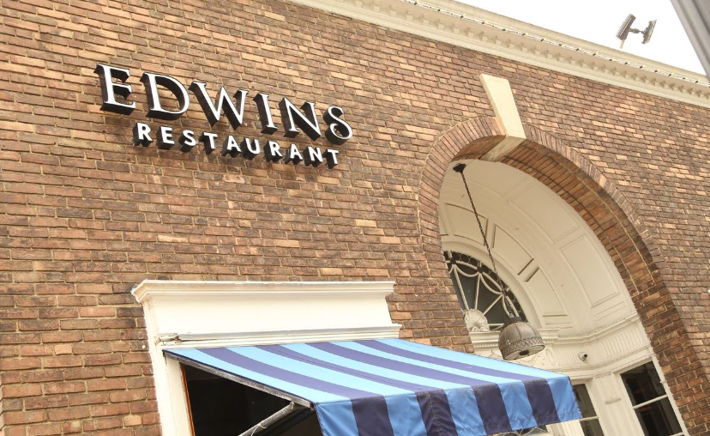
Cuyahoga County Juvenile Court
Juvenile Detention Center
Programming & Services:
  EDWINS Leadership and Restaurant Institute
    Trains and employs formerly incarcerated adults in culinary arts and hospitality
    Offers students/graduates the opportunity to learn lifelong skills that aid in their re-entry into the community.
We are proud to have partnered with EDWINS to provide their first program geared toward detained youth ages 12 to 21.

Slide 59
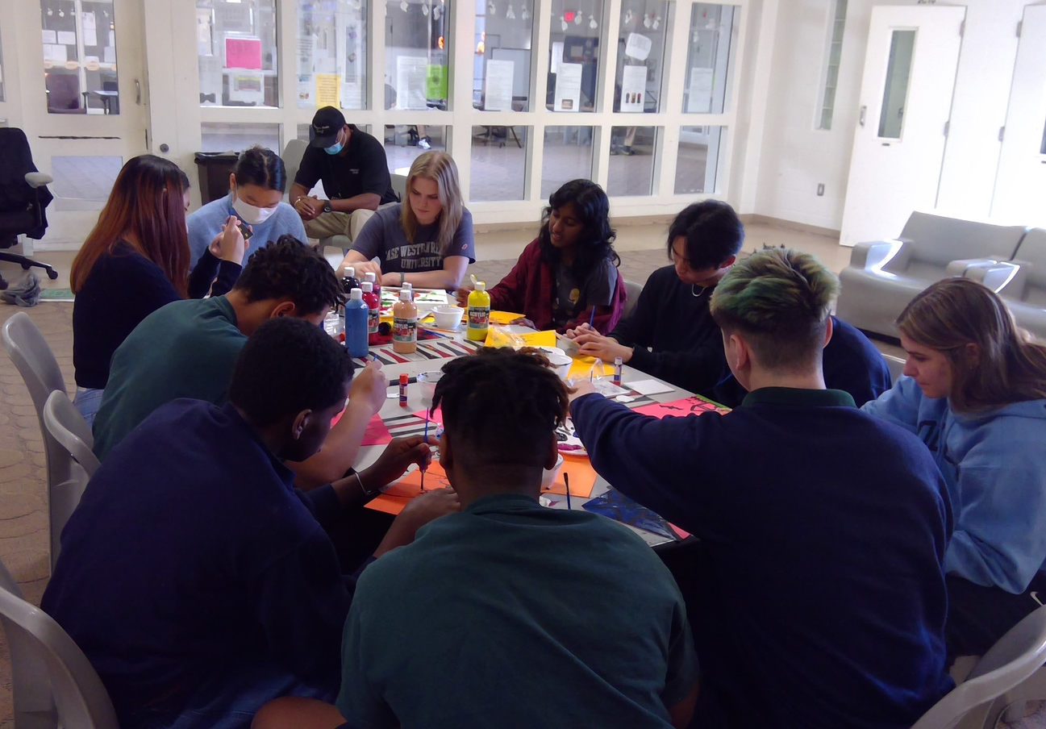
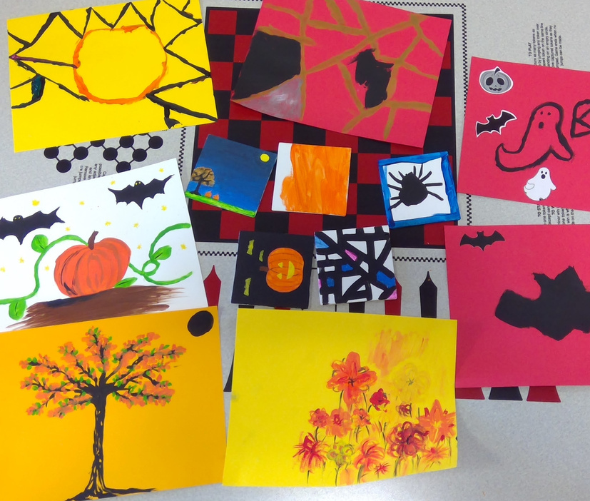
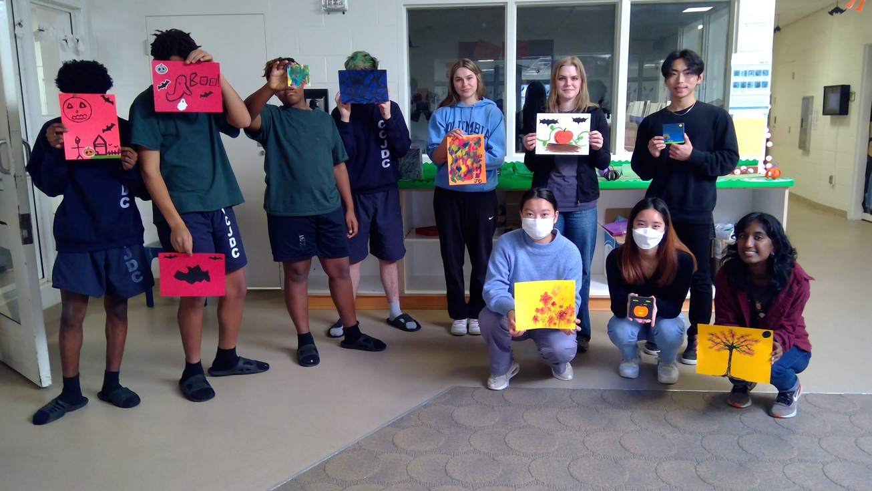
Juvenile Detention Center
Programming & Services:
  Art Forward
    Residents’ creative talents showcased through paintings, sketches, and collages with support of CWRU Art Forward student club volunteers.
Cuyahoga County Juvenile Court

Slide 60
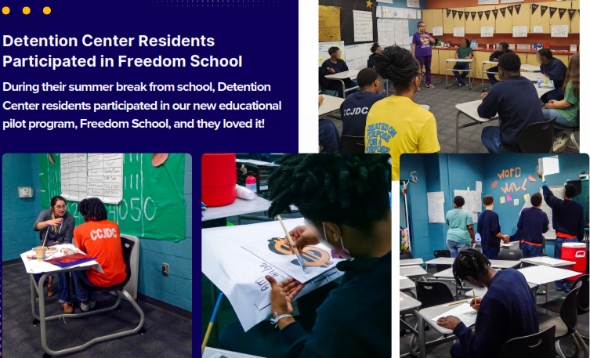
Juvenile Detention Center
Freedom Schools
Literacy Program to help youth improve reading skills and learn to love to read!
Cuyahoga County Juvenile Court

Slide 61

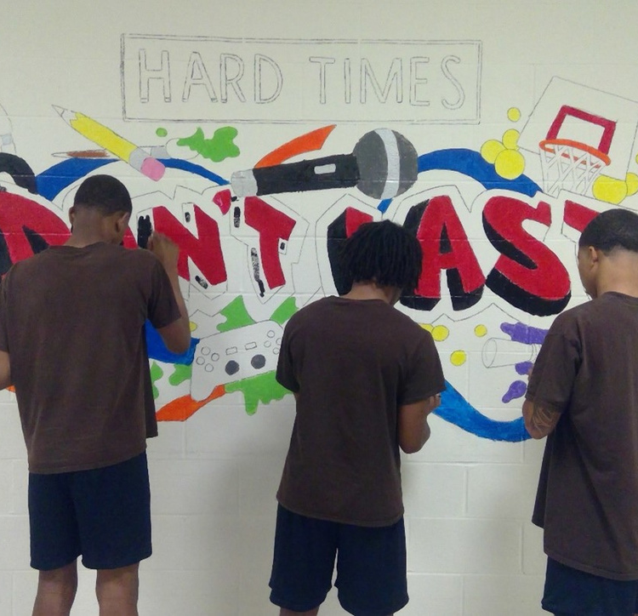
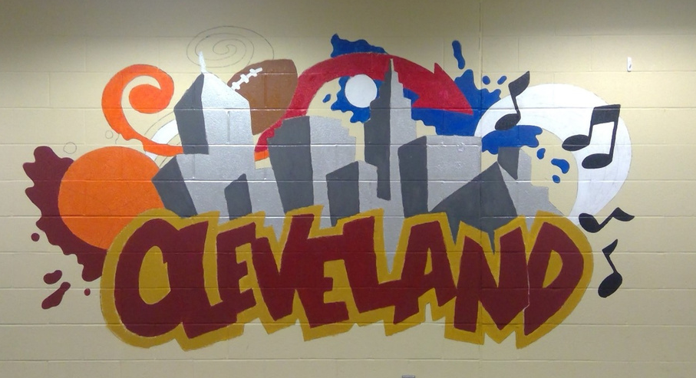
Juvenile Detention Center
Programming & Services:
  Beck Center for The Arts
    Under supervision of Beck Center artists, CCJDC residents assisted with mural designs located in visitation room and hallway adding a colorful vision and message for the observer.
Cuyahoga County Juvenile Court

Slide 62
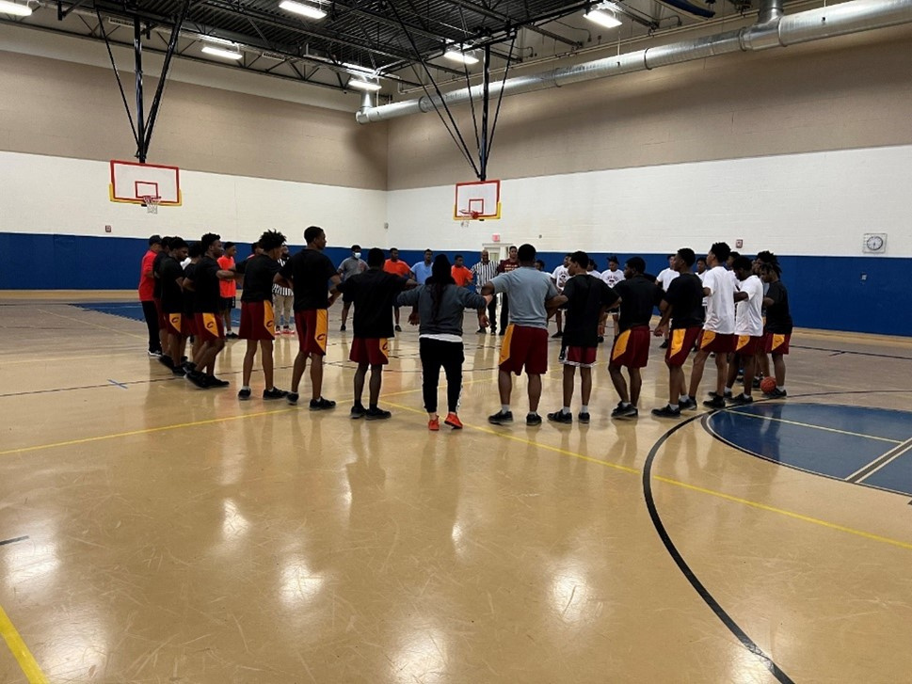
Cuyahoga County Juvenile Court
Juvenile Detention Center
Programming & Services:
  Hoops For Hope Basketball League
    League games were conducted throughout the months of October and November, with the league championship game played on December 1, 2022.
    Championship trophies were donated by the Cleveland Chapter of the National Basketball Retired Players Association.
Cuyahoga County Juvenile Court

Slide 63


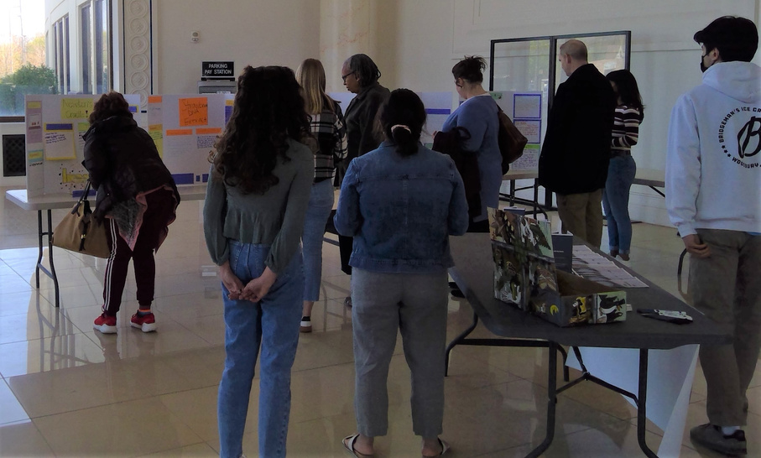
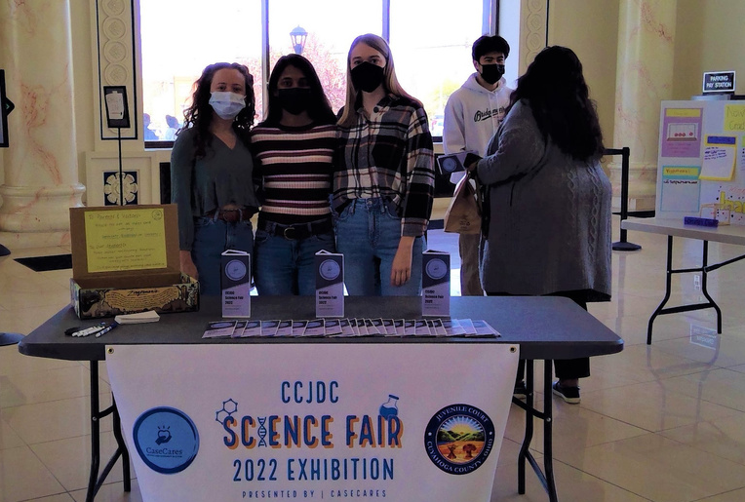

Cuyahoga County Juvenile Court
Juvenile Detention Center
Programming & Services:
  STEM Learning Experiences

Slide 64





Juvenile Detention Center
Programming & Services:
  Youth For Christ

Slide 65
Mental Health Services in the Detention Center

Slide 66


DETENTION CENTER
Total Population = 149
As of August 5, 2024

Slide 67
Questions?
Bridget Gibbons, LISW-S
Deputy Court Administrator
bgibbons@cuyahogacounty.us
Juvenile Justice Center
Notes:
\

