Slide 1
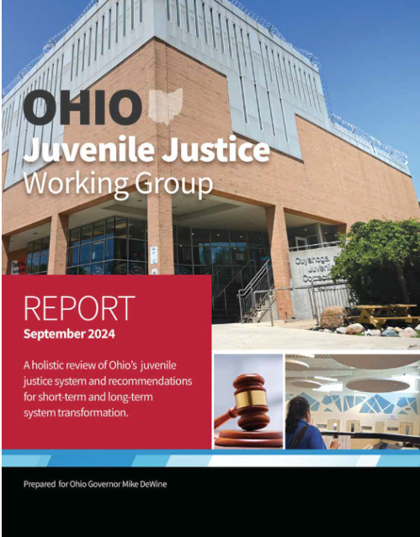
Ohio Juvenile Justice Working Group Overview & Cuyahoga County Impacts/ Opportunities
Gabriella Celeste, JD
OJJWG Member
October 28, 2024
Notes:
https://content.govdelivery.com/attachments/OHIOGOVERNOR/2024/08/30/file_attachments/2983646/Juvenile%20Justice%20Internet%20FINAL.pdf

Slide 2
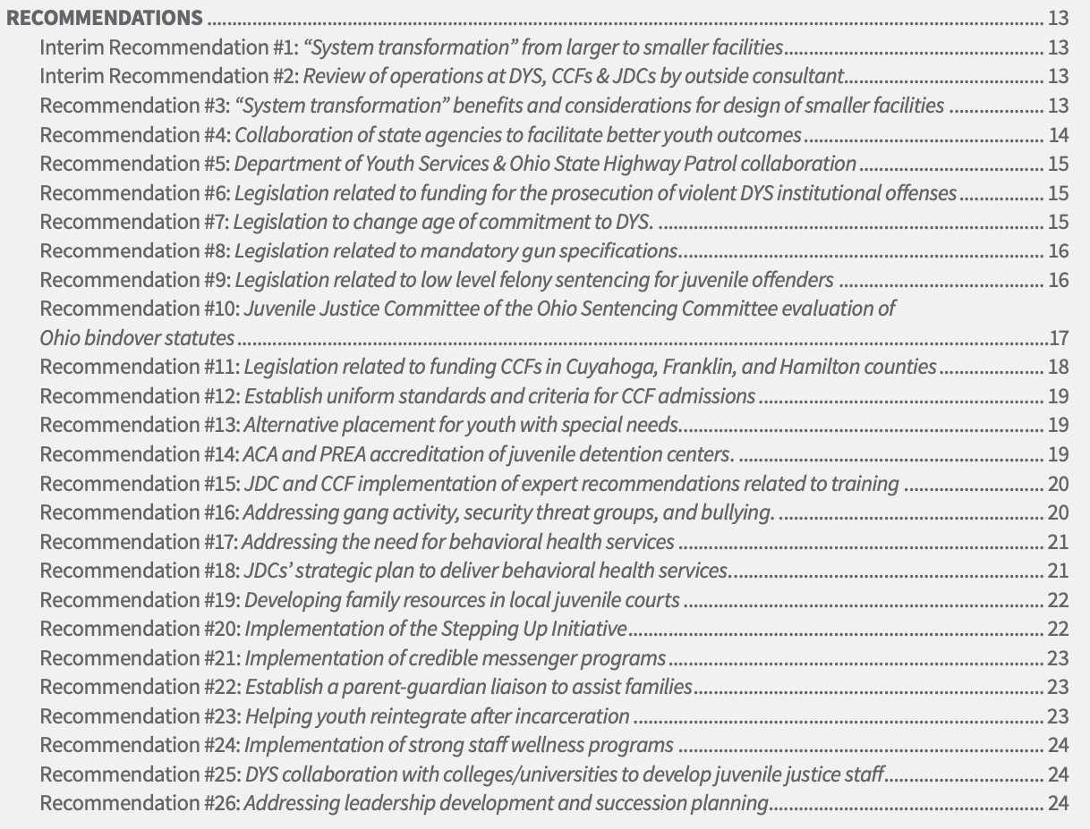



Slide 3
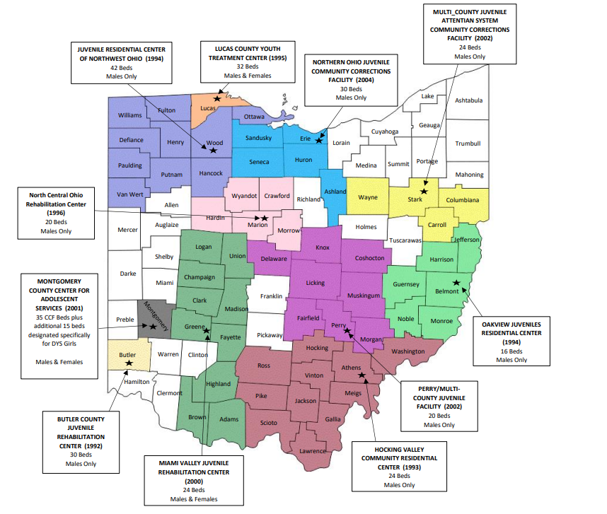
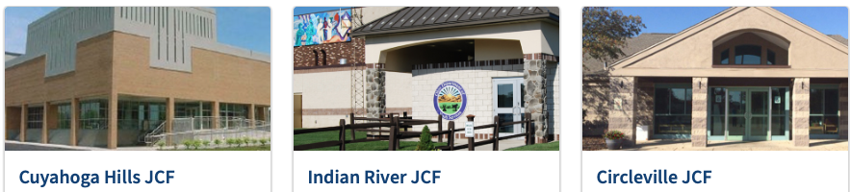
11 CCFs &
40 JDCs (Juvenile Detention Centers) in Ohio
Notes:
CCF: 329 STATE FUNDED BEDS The Ohio Administrative Code (OAC) defines a Community Correctional Facility (CCF) as a county or multi county rehabilitation center for felony delinquents who have been committed to the Ohio Department of Youth Services (ODYS) and diverted from care and custody in an institution and placed in the rehabilitation center pursuant to division (E) of section 5139.36 of the Revised Code.

Slide 4
Rightsizing Corrections – Shifting the Institutional ODYS & CCF Footprint
(1992-2014)
Notes:
ODYS State Facilities
State operated and administered
Large, institutional, 100 bed+ capacity (avg. daily pop. 118-158); avg. LOS 12.6 mos
Currently only male youth, avg. age 17.7 years
3-year recidivism rate 45%
Community Correctional Facilities
Regionally located, often closer to youth’s home community
Locally administered, state-funded and budgetary oversight
Smaller size, avg 30-bed capacity (16-50)
Cognitive Behavioral Treatment conversion
Variation in specialized treatment – avg LOS 7.4 mos
3-year recidivism rate 33.1%

Slide 5
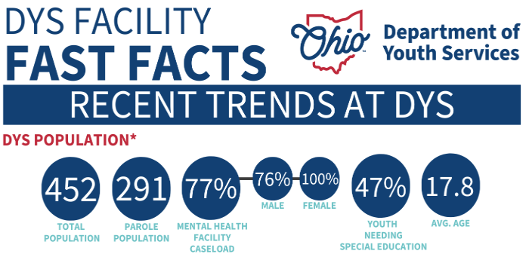
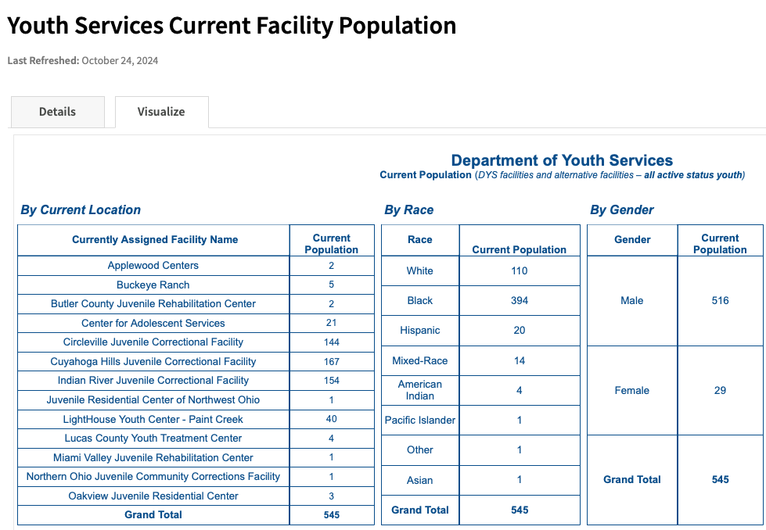



Slide 6

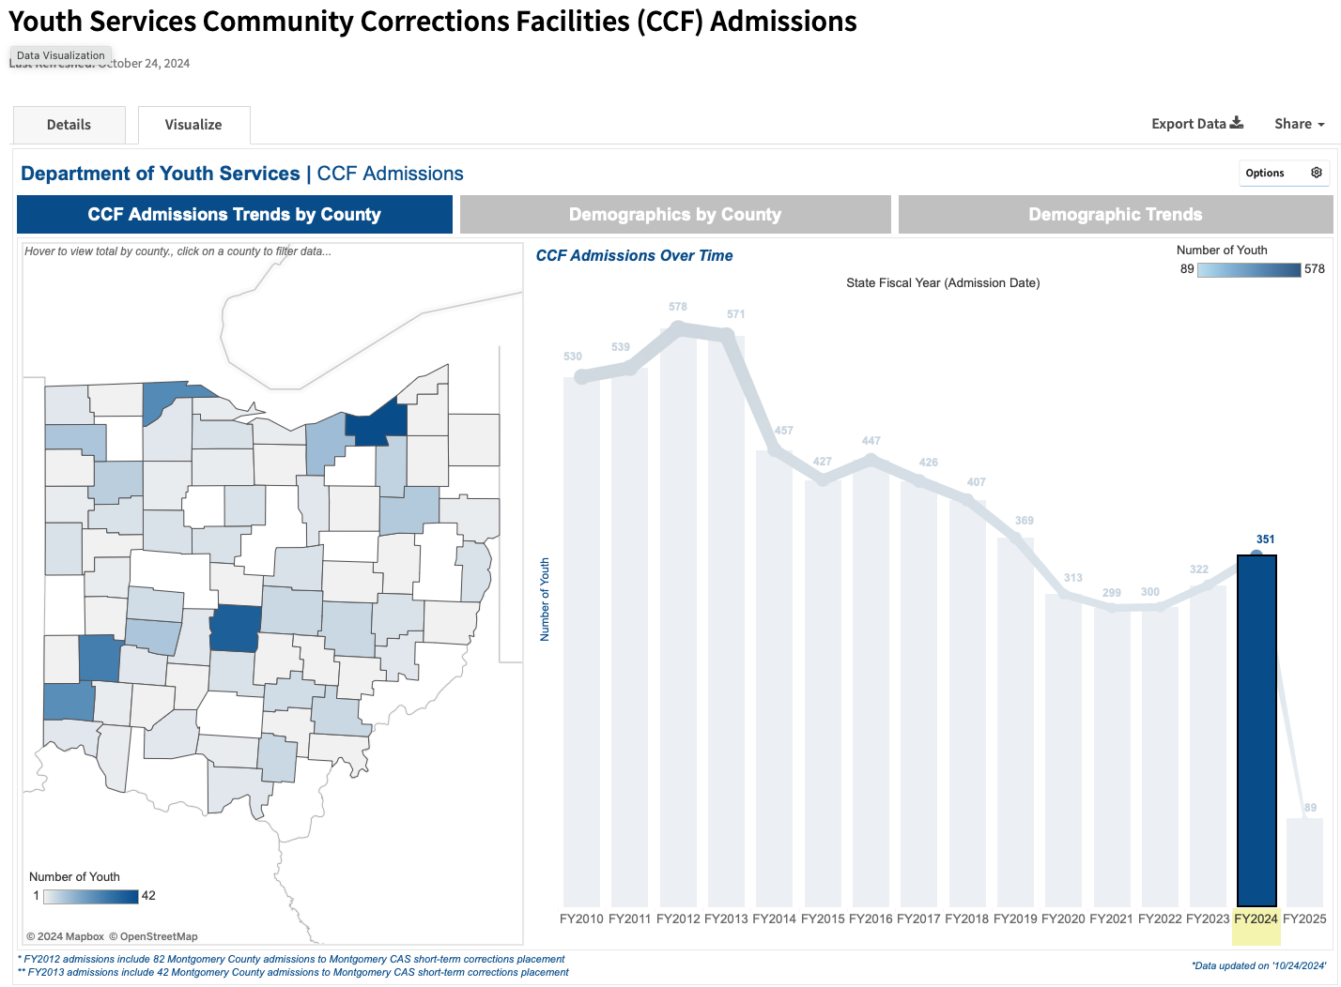

Slide 8
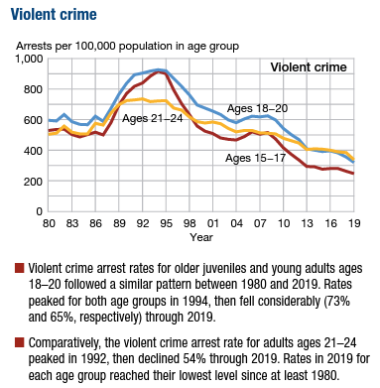
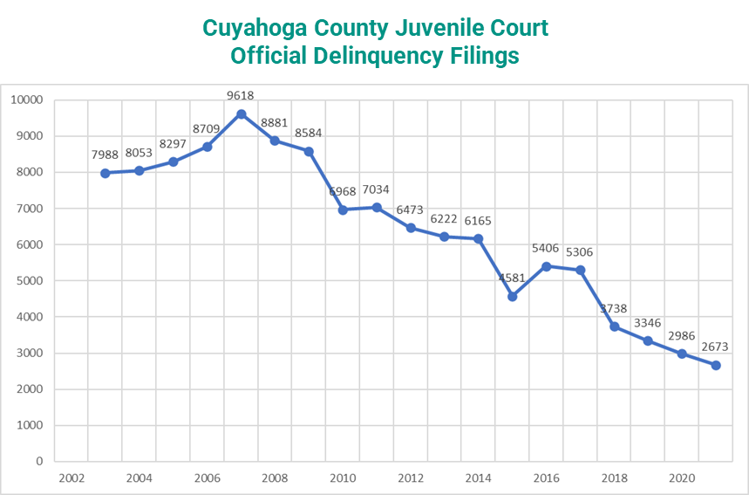
Youth Crime Trends in Context
(National data)
Sources: Cuyahoga County Juvenile Court, Annual Reports, http://juvenile.cuyahogacounty.us/en-US/AnnualReports.aspx; Charles Puzzanchera, Office of Juvenile Justice and Delinquency Prevention, Juvenile Arrests, 2019 (May 2021), available: https://ojjdp.ojp.gov/publications/juvenile-arrests-2019.pdf
Notes:
LW

Slide 9
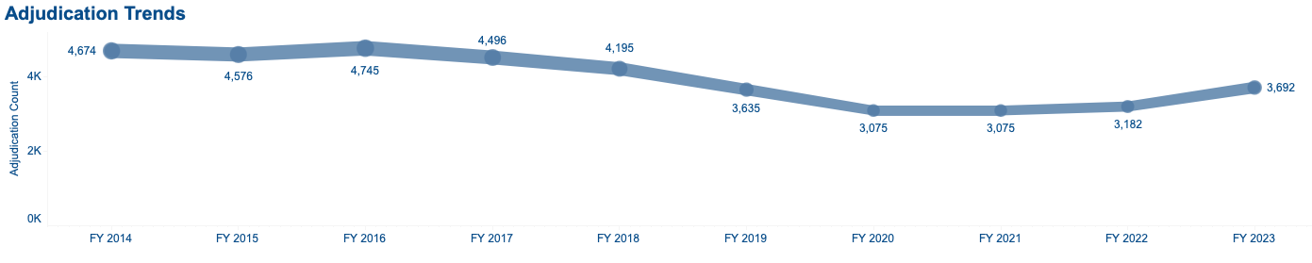

Slide 10

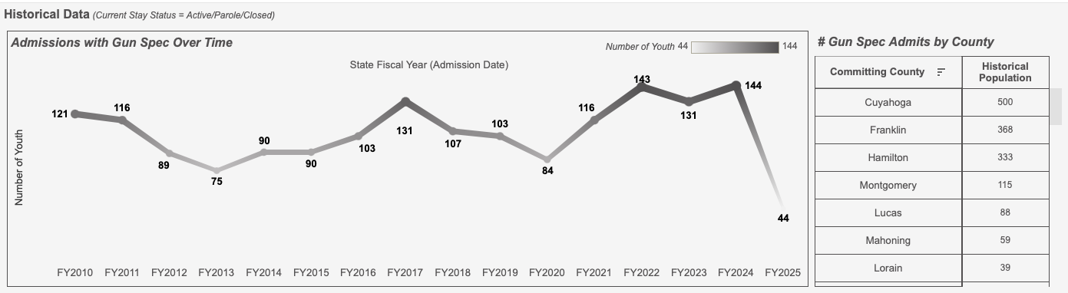

Slide 11


Slide 12
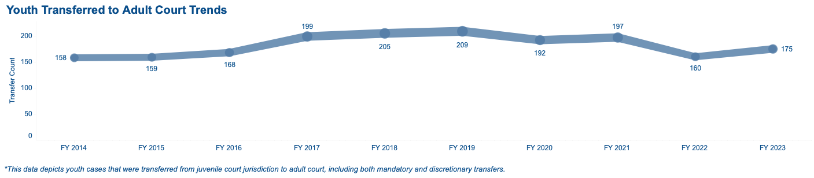
Youth Bindovers – Last 10 Years
Cuyahoga county youth bindovers have decreased in the last year – after record levels – but still are 3x the number of the next 3 highest counties combined in 2023

Slide 13
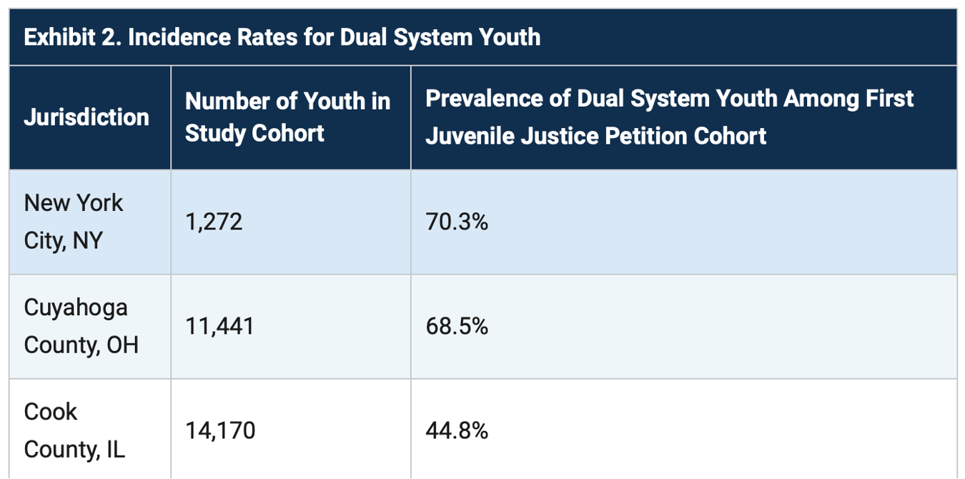

Childhood Trauma: 2/3 of Kids in Cuyahoga Juvenile Justice System had Prior Child Welfare Involvement
Source: Barbara Tatem Kelley; Paul A. Haskins, "Dual System Youth: At the Intersection of Child Maltreatment and Delinquency," August 10, 2021, nij.ojp.gov: https://nij.ojp.gov/topics/articles/dual-system-youth-intersection-child-maltreatment-and-delinquency
Notes:
LW

Slide 16

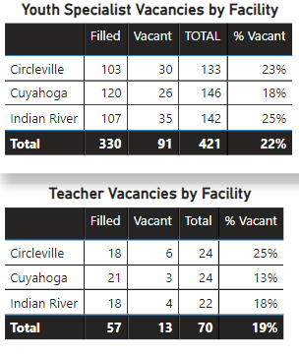
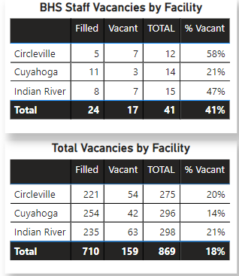


DYS Facility
Staff Vacancies 11/24/2023

Slide 17
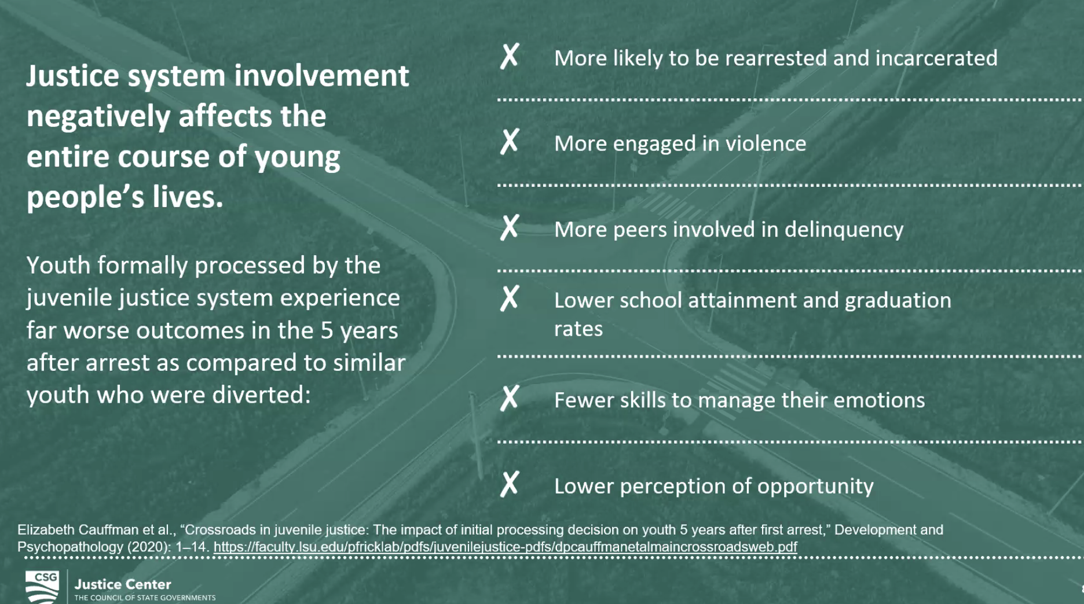
Value of Diversion & Community Based Programs:
Why Justice System Involvement Leads to Worse Youth Outcomes & Less Safety
Notes:
https://www.urban.org/sites/default/files/publication/102218/data-snapshot-of-youth-incarceration-in-ohio_0.pdf

Slide 18
Childhood Trauma: 2/3 of Kids in Cuyahoga Juvenile Justice System had Prior Child Welfare Involvement
Source: Barbara Tatem Kelley; Paul A. Haskins, "Dual System Youth: At the Intersection of Child Maltreatment and Delinquency," August 10, 2021, nij.ojp.gov: https://nij.ojp.gov/topics/articles/dual-system-youth-intersection-child-maltreatment-and-delinquency
Notes:
LW

Slide 19
KEY ISSUES & RECOMMENDATIONS:
SAFETY, STAFFING & SUPPORT for YOUTH SUCCESS*
“Smaller is Better”: Transforming Built Environment to be Trauma-Responsive – replacing 3 JCFs with up to 4 regional 36-bed facilities designed for youth [ Recs 1-3]
Targeting JCFs for Deepest-End Population through State Statutory Changes & Supporting CCFs in big counties [7-13]
Improving Local Detention & Safety Measures [14-16, 18]
Wholistic Behavioral Health Supports with Cross-System Coordination of Care [4, 17-20], Leveraging NEW mandatory & optional Medicaid coverage [23]
Credible Messenger and Family Liaison Supports [21-22]
Staff Wellness, Recruitment & Professional Development [24-26]
Notes:
https://content.govdelivery.com/attachments/OHIOGOVERNOR/2024/08/30/file_attachments/2983646/Juvenile%20Justice%20Internet%20FINAL.pdf

Slide 20
Advantages of “Smaller is Better” (vs. larger JCFs): Relational
Evidence-based design implications for youth specific facilities include 4 key design principles for best-practices:
1. small-scale,
2. locally sited and integrated with the surrounding community,
3. comprising therapeutic design characteristics (light, communal areas, layout, quiet spaces, fresh air, green spaces, etc.), and
4. designed to promote relational and differentiated security.*
Sources:
(1) Dwyer, M., Oostermeijer, S. (2023). A Model for the Design of Youth Custodial Facilities: Key Characteristics to Promote Effective Treatment. In: Moran, D., Jewkes, Y., Blount-Hill, KL., St. John, V. (eds) The Palgrave Handbook of Prison Design.
(2) Souverein F, Mulder E, van Domburgh L, Popma A. Relational security: conceptualization and operationalization in small-scale, strengths-based, community-embedded youth justice facilities. Child Adolesc Psychiatry Ment Health. 2023 Aug 17;17(1):99. Accessed at: https://pubmed.ncbi.nlm.nih.gov/37592271/
(3) Hull, O., Breackler, O. and Jaegers, L. Integrated Safety and Health Promotion among Correctional Workers and People Incarcerated: A Scoping Review. (June 2023) Int. J. Environ. Res. Public Health 2023, 20(12), 6104
“Relational security”: “most effective security measure in a youth custodial setting”
A way of working where staff establish a safe and therapeutic environment
Knowing youth individually informs the management and de-escalation of incidents
Seeing youth not merely as 'risks to be managed', but as 'resources to be developed’
Staff report feeling that their work is purposeful – everyone more likely to thrive
Notes:
EBP Design:
1. small-scale,
2. locally sited and integrated with the surrounding community,
3. comprising therapeutic design characteristics (light, communal areas, layout, quiet spaces, fresh air, green spaces, etc.), and
4. designed to promote relational and differentiated security.*
“Relational security”: “most effective of security measures within a youth custodial setting”
A way of working that guides staff in how to establish a safe and therapeutic environment in secure facilities. Relational security is not only a way of working, but also a way of being.
The understanding and knowledge staff have of residents and how this informs the management and de-escalation of incidents.
“It encompasses a vision about security and mentality towards justice-involved youth that sees them not merely as 'risks to be managed', but primarily as 'resources to be developed’.”
Bennfits to staff & youth: when individuals are in stressful living environments, like prisons, “it is important that they strive for a purpose and it is also important for the workers to feel that their work is purposeful. When workers understand the broad purpose of the organization, they are more likely to thrive.”

Slide 21
Advantages of “Smaller is Better”: Staff Benefits - Everybody Safer
Officials can govern smaller prisons more easily and safety improves for everyone:
Less likely that large groups of prisoners will challenge officials’ authority.
Officials can more easily see prisoner interactions in places b/c less crowded.
Officers and prisoners can more easily get to know each other and develop respectful relationships.
Less bureaucratic hierarchy, leading to greater responsiveness to prisoner needs (and less assembly line and warehousing approach).
More opportunities for privacy and autonomy, leading to less conflict.
Prisoners report feeling less stress, safer, and more respected by staff.
Prisoners know each other better and divisions are not as strong (vs. large prisons, prisoners often turn to organized prison gangs to exert control and/or for protection).
Source: Skarbek, D. “Smaller prisons are smarter” (Sept. 2020) Accessed at: https://urbanviolence.org/smaller-prisons-are-smarter/
Notes:
Officials can govern smaller prisons more easily and safety improves for everyone:
Less likely that large groups of prisoners will challenge officials’ authority/control.
Officials can more easily see prisoner interactions in places that are less crowded.
Officers and prisoners can more easily get to know each other and develop respectful relationships.
Smaller prisons tend to have less bureaucratic hierarchy, leading to greater responsiveness to prisoner needs. Larger prisons require more regimentation, and they tend to take on an assembly line quality and the sense that officials are merely warehousing offenders.
Smaller prisons often have more opportunities for privacy and autonomy, leading to less conflict.
Prisoners report that in smaller prisons, they feel less stress, safer, and more respected by staff.
The small size of the facility means that they know each other and divisions are not strong. In large prisons, by contrast prisoners often turn to organized prison gangs to exert control and/or for protection.

Slide 22
Advantages of “Smaller is Better”: Reducing Violence
Exposure to Violence (ETV) inside facilities & Value of Relational Security – Key findings in studies:
Institutional violence – even more then prior experiences – is extremely harmful to youth & makes them much more likely to engage in future violence.
Punitive sanctions, like solitary and loss of family visits and phone calls or recreation, often further isolate youth and increase their likelihood of using violence.
Institutional staff can be a critical buffer - Youth who viewed staff as legitimate and protective were less likely to engage in violence.
Source: Brown C, Fine A, Cauffman E. DO POSITIVE PERCEPTIONS OF CORRECTIONAL STAFF MITIGATE INSTITUTIONAL VIOLENCE AMONG YOUTHFUL OFFENDERS? Psychol Public Policy Law. 2019 Feb;25(1):38-45. Accessed at: https://pmc.ncbi.nlm.nih.gov/articles/PMC6867082/#R36
Notes:
Exposure to Violence (ETV) inside facilities & Value of Relational Security – Key findings in studies:
Institutional violence has an especially significant and detrimental impact on adolescents and likelihood of further violence. Experiencing violence while incarcerated is a stronger indicator of subsequent violent behavior, even outweighing prior violence exposure that youth bring with them into juvenile justice facilities.
Youth who engage in institutional violence commonly face punitive sanctions, loss of privileges such as phone calls or recreation time, and solitary confinement. These harsh punishments can detrimentally impact their development, and often further increase their likelihood of using violence. (de Valk, van der Helm, Beld, Schaftenaar, Kuiper, & Stams, 2015).
Institutional staff are a critical buffer for the effects of violence exposure within an incarceration setting. Youth who viewed staff as legitimate and protective were less likely to engage in violence. Even when youth were being exposed to violence within the institution, the presence of a capable and reliable adult appeared to help youth avoid engaging in violent behavior. (Marsh & Evans, 2009).

Slide 23
Advantages of “Smaller is Better”: Community Connections
Fosters local engagement by resourcing community partners to strengthen prevention and treatment.
Helps youth forge personal bonds with mentors and other caring adults in the community – foundational to healthy development.
Facilitates ongoing, intensive family involvement.
Facility can function as a resource for the community (e.g. restorative justice and restitution programs, civic engagement and volunteer programs).
Administrators can create phased youth reentry programs* for gradual and successful transition back into the.
* This will be especially vital with new Medicaid expansion for pre-release and re-entry supports that go into effect January 1, 2025.
Source: Zavlek, S. “Planning Community-Based Facilities for Violent Juvenile Offenders as Part of a System of Graduated Sanctions”, OJJDP Bulletin (2005). Accessed at: https://www.ojp.gov/pdffiles1/ojjdp/209326.pdf
Notes:
“Smaller facilities connected to local communities have programmatic advantages that are generally missing from large congregate-care facilities, which often confine youth hundreds of miles from their families and the communities they will reenter when they are released. Small, community-based or regional facilities can:
Engage local communities to provide resources for creating a comprehensive prevention, sanction, and treatment model. Potential community partners include service providers, volunteers and mentors, houses of worship, schools, civic organizations, businesses, and government agencies.
Help youth forge personal bonds with mentors and other caring adults in the community.
A key factor for healthy development is the “capacity, ability, and opportunity to build relationships with caring adults” (Masten & Coatsworth, 1998)
Studies of successful youth who live in high-risk environments indicate the critical importance of strong bonds with caregivers or other adults in preventing problem behaviors (Hawkins, Catalano & Miller, 1992).
Facilitates ongoing, intensive family involvement and intervention activities. This approach recognizes the critical role of families in treating young offenders (Thornberry, 1993).
Function as a resource for the community (e.g., victim counseling, restitution programs).
A facility that is located in the community can also offer youth enhanced opportunities for independent living. Administrators can create phased reentry programs that allow youth and their support networks to participate in a gradual and successful transition back into the community.”

Slide 24
Looking Forward – Implications & Opportunities for Cuyahoga County and Our Young People
Capital Budget Funds to close & replace 1st JCF – Cuyahoga Hills JCF proposed by DYS but CHJCF is best performing so may reconsider sequencing and pausing on CHJCF
RFP for CCF in 1st of 3 counties due 1/3/25: Cuyahoga, Franklin & Hamilton – Positioning Cuyahoga for 1st CCF
RFP for National Expert to conduct comprehensive review of JCFs and sample of CCFs and JDCs – Cuyahoga JDC included; presents opportunity for improvements
Behavioral health augmentation with local BH partners, mandatory Medicaid for re-entry, and credible messenger model creates opportunities for state $$ to align with local programs & partnerships with courts, public agencies, community providers.
State advocacy opportunities with local impacts: Gov. DeWine’s legacy budget FY26-27 & OGA legislative agenda (age of commitment, F4s & F5s, discretion no gun specs, bindover)
Notes:
https://content.govdelivery.com/attachments/OHIOGOVERNOR/2024/08/30/file_attachments/2983646/Juvenile%20Justice%20Internet%20FINAL.pdf
Looking Forward – Implications & Opportunities for Cuyahoga County and Our Young People
Capital Budget Funds to close & replace 1st JCF – Cuyahoga Hills JCF proposed by DYS but CHJCF is best performing so may reconsider sequencing and pausing on CHJCF
RFP for CCF in 1st of 3 counties due 1/3/25: Cuyahoga, Franklin & Hamilton – Positioning Cuyahoga for 1st CCF
RFP for National Expert to conduct comprehensive review of JCFs and sample of CCFs and JDCs – Cuyahoga JDC included; presents opportunity for improvements
Behavioral health augmentation with local BH partners, mandatory Medicaid for re-entry, and credible messenger model creates opportunities for state $$ to align with local programs & partnerships with courts, public agencies, community providers.
State advocacy opportunities with local impacts: Gov. DeWine’s legacy budget FY26-27 & OGA legislative agenda (age of commitment, F4s & F5s, discretion no gun specs, bindover)

