Slide 1
Cuyahoga County Together We Thrive
Cuyahoga County Together We Thrive
Cuyahoga County Together We Thrive
Cuyahoga County Department of Health and Human Services
Department of Health
and Human Services
TITLE GOES HERE
TITLE GOES HERE
Speaker name Title
Speaker name Title
David Merriman
Director
dmerriman@cuyahogacounty.us
Division of Children and Family Services
Jacqueline Fletcher
November 25, 2024
Notes:
1

Slide 2
Safe Children
Healthy and Stable Families
Division Overview
CCDCFS works to assure children at risk of abuse and neglect are protected and nurtured within a family and with the support of the community as we strive to end the over-representation of people of color in the child welfare system. Safety, permanency, and well-being are the goals for every child and family we encounter. Employees investigate allegations, assess child safety, and risk contributors, and help stabilize families that have been weakened through poverty, illness, or crisis. DCFS provides safe and appropriate placement for children in County custody, and help achieve permanency through reunification, legal custody, or adoption.
Budget Highlights
Served over 21,000 kids Y-T-D.
Revenue sources are varied and includes non-grant funds to support adoption subsidies, child enrichment programs, and youth transition services, with the largest contribution coming from Federal Title IV-E funding to support foster care as well as adoption and guardianship assistance services.
Expenditures for FY 2024 are expected to surpass 2023 spending primarily due to increased placement cost.
Workforce recruitment and retention efforts have positively impacted the agency’s compliance with safety, permanency and wellbeing standards contained in the Ohio Revised and Administrative Code as well as the Federal Child & Family Services Review.
Cuyahoga County
2

Slide 3
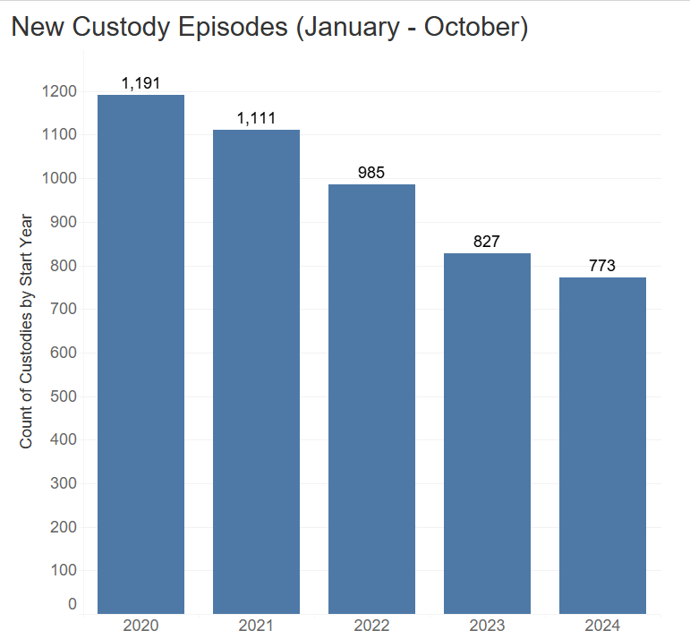
Safe Children
Healthy and Stable Families
KIDS Hotline
Total calls answered (January to October) 35,010
Average calls per day = 113
Screened-In referrals = 8,425 / 18,459 (45.3%)
BUDGETED FTE’s
DCFS IS BUDGETED FOR 840 POSITIONS, OF WHICH 140 ARE SHARED SERVICES
VACANCY RATE
OF THE 700 DEDICATED DCFS POSITIONS, 117 ARE UNFILLED
5
SW3 HIRING COUNTS
145 CASE CARRYING SW3S WERE HIRED FROM 8/01/2022 THROUGH 7/31/2023
SW3 RETENTION DATA
69% (99) OF THE 145 CASE CARRYING SW3S HIRED FROM 8/1/2022 THROUGH 7/31/2023 WERE RETAINED
Cuyahoga County
3
Notes:
This slide will include some comparison data related to hotline calls and screen in/out reports

Slide 4
Safe Children
Healthy and Stable Families
Budget Summary - Revenue ($56,505,680.00)
BUDGETED FTE’s
DCFS IS BUDGETED FOR 840 POSITIONS, OF WHICH 140 ARE SHARED SERVICES
VACANCY RATE
OF THE 700 DEDICATED DCFS POSITIONS, 117 ARE UNFILLED
5
SW3 HIRING COUNTS
145 CASE CARRYING SW3S WERE HIRED FROM 8/01/2022 THROUGH 7/31/2023
SW3 RETENTION DATA
69% (99) OF THE 145 CASE CARRYING SW3S HIRED FROM 8/1/2022 THROUGH 7/31/2023 WERE RETAINED
Cuyahoga County
4
Notes:
Will include a breakdown of revenue sources by category

Slide 5
Safe Children
Healthy and Stable Families
Budget Summary – Client Services ($82,340,552.00)
The majority of children receiving services following the agency’s response to a concern are receiving those supports in their own home (3064 – January to October 2024)
Prevention and early intervention
Family Centered Support Services
Community-based services
Emergency assistance
Adoption services
Youth mentoring
Comprehensive medical
Out of Home Care
Majority of children placed in a family-like setting (81%)
Kinship care represents 28% of the placement type
BUDGETED FTE’s
DCFS IS BUDGETED FOR 840 POSITIONS, OF WHICH 140 ARE SHARED SERVICES
VACANCY RATE
OF THE 700 DEDICATED DCFS POSITIONS, 117 ARE UNFILLED
5
SW3 HIRING COUNTS
145 CASE CARRYING SW3S WERE HIRED FROM 8/01/2022 THROUGH 7/31/2023
SW3 RETENTION DATA
69% (99) OF THE 145 CASE CARRYING SW3S HIRED FROM 8/1/2022 THROUGH 7/31/2023 WERE RETAINED
Cuyahoga County
5
Notes:
Summary of approved 2024 expenditures. Highlight some significant service items (i.e. FCSS contracted services and board and care cost)

Slide 6
Safe Children
Healthy and Stable Families
Budget Summary – Personnel ($67,389,39.00)
2024 authorized FTE count = 732
390 caseworker positions available
BUDGETED FTE’s
DCFS IS BUDGETED FOR 840 POSITIONS, OF WHICH 140 ARE SHARED SERVICES
Number of Caseworkers Left Their Position YTD
2019
2020
2021
2022
2023
Q1 2024
Q2 2024
Q3 2024
Q4 2024
91
79
103
121
120
22
14
18
VACANCY RATE
Number of Caseworkers Hired YTD
OF THE 700 DEDICATED DCFS POSITIONS, 117 ARE UNFILLED
Attrition for SSW3’s – improved from a high of 31% at the start of 2022 to a current rate of 15% for staff employed 1 year.
Increased starting wage
Awarded $1,436,238.00 state sponsored workforce grant
Expanded hiring events
Staff and caregiver recognition
2019
2020
2021
2022
2023
Q1 2024
Q2 2024
Q3 2024
Q4 2024
108
64
88
95
124
38
21
22
5
SW3 HIRING COUNTS
145 CASE CARRYING SW3S WERE HIRED FROM 8/01/2022 THROUGH 7/31/2023
SW3 RETENTION DATA
69% (99) OF THE 145 CASE CARRYING SW3S HIRED FROM 8/1/2022 THROUGH 7/31/2023 WERE RETAINED
https://www.casey.org/turnover-costs-and-retention-strategies/
Cuyahoga County
6
Notes:
Include personnel cost and FTE count. Highlight attrition data. Some data suggest that turnover particularly in child welfare cost agency’s approximately 70% to 200% of the exiting caseworker's salary.

Slide 7
Safe Children
Healthy and Stable Families
Key Challenges
Capacity building – youth with complex needs
Reducing the number of children coming into care
Stabilizing and supporting the workforce
Targeted Investments
Prioritize prevention of child maltreatment
Expand collaboration and partnerships throughout the various child-serving systems
Encourage community input and response to keeping kids safe and improving health outcomes
Conclusion
Recruitment and retention efforts will continue to be prioritized
Outcome trends headed in a positive direction
Maintain practice improvements with focus on safety, permanency and well-being for our kids
BUDGETED FTE’s
DCFS IS BUDGETED FOR 840 POSITIONS, OF WHICH 140 ARE SHARED SERVICES
VACANCY RATE
OF THE 700 DEDICATED DCFS POSITIONS, 117 ARE UNFILLED
5
SW3 HIRING COUNTS
145 CASE CARRYING SW3S WERE HIRED FROM 8/01/2022 THROUGH 7/31/2023
SW3 RETENTION DATA
69% (99) OF THE 145 CASE CARRYING SW3S HIRED FROM 8/1/2022 THROUGH 7/31/2023 WERE RETAINED
Cuyahoga County
7
Notes:
Highlight any critical challenges facing the agency, any new and/or expanded initiatives, and conclude with the overall budget implications.
Upstream efforts (prevention plan framework, focus on kin). Expanded collaboration (CWC, FCFC, CPT etc.) & Community input (targeted conversations with fathers, lived experience, etc.)

Slide 8
Cuyahoga County Together We Thrive
Cuyahoga County Together We Thrive
Cuyahoga County Together We Thrive
Thank You
8
Notes:
5

