Slide 1
Cuyahoga County Sheriff’s Department
Sheriff Harold A. Pretel
2025 Budget Update
November 25, 2024

Slide 2
Top Priorities in building the Premier Law Enforcement Agency in Ohio and beyond
Address morale with all staff members
Update and familiarize staff with policies and practices
Examine and improve organizational structure
Staff accordingly
Reduce risk and increase service level
This improves OUR (collective OUR) Sheriff’s Department!

Slide 3
Civil Division
Staff- 8/10, CCW 2
Civil Stalking Protection Orders -5,631
Subpoenas 5,238, Foreign Court-380=5,618
State Subpoenas-42,171
Defense Subpoenas- 1,739
Summons- 1,327
Total Writs Received
56,641
1,741 Foreign Court
58,382 TOTAL

Slide 4
Corrections Center
Average Daily Count 1,550 Residents
Employees 656 Corrections Officers
Canine Teams 10
Access Points to the Corrections Center -4

Slide 5
Electronic Monitoring Unit
Electronic Monitoring Unit- 605 clients
1,947,422 Alerts
1,681 Installations
780 Repairs / Replacements
230 Home Checks

Slide 6
Downtown Safety Patrol
Citizen Contacts-544
Partner agency requests for service -60
Firearms seized-141
Warrant arrests – 167
Warrant releases per ORI- 288
Felony NS- 86
VSDL NS- 118
Community Impact- Immeasurably positive!

Slide 7
Protective Services
Secure County operated buildings
Provide additional service in the Courts Tower
Provide 24 hour coverage and response to County facilities
Visible safety presence and force multiplier
Integrated into Internal Affairs, Policy, and Professional Development Sections, formerly called the Training Unit

Slide 8
Special Operations
Over 317 lbs of Cocaine
Over 189 lbs of Fentanyl
Over 108K lbs of Hash
Over 3,900 lbs of Marijuana
Over 24 lbs of Crack Cocaine

Slide 9
Warrant Unit Statistics
3 Deputies, 1 Sergeant
235 Capiases worked
154 Cleared by arrest
138 Warrant Arrests by 2 Deputies on the U.S. Marshal’s Northern Ohio Violent Fugitive Task Force
263 Arrests, 175 for violent offenses, 88 for nonviolent offenses
Great work by 3 Deputies and 1 Sergeant

Slide 10
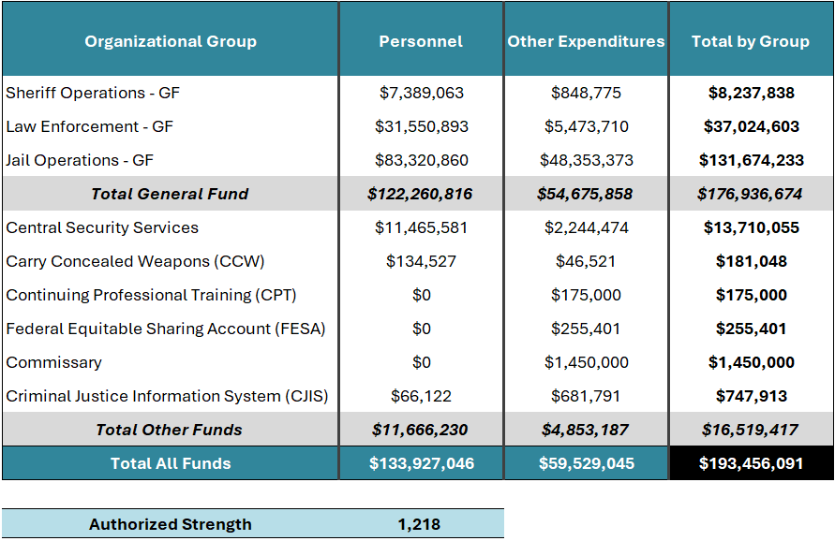
2025 CCSD Biennial Budget Update
Budget Summary

Slide 11
2025 Sheriff’s Department Biennial Budget Highlights
New Corrections Center Food Contract
New Jail Management System (JMS)
New Medical Services Contract, out for RFP
New LiveScan Contract
New Legal Mail Scanners
New Vehicles
New William Day Building Security Contract
New Security Services, 1801 Superior

Slide 12
2025 CCSD Biennial Budget Update
Highlights
Questions?

