Slide 1


Cuyahoga County
General Certification & Program Overview Resource

Slide 2

SBE/MBE/WBE Eligibility
SBE:
  Demonstrate continuous operation in the category or the related category for which it is requesting certification for one year
  Majority ownership has at least one (1) year of work experience relevant to the business certification category
  Annual gross revenues or total workforce must be at or less than the amounts established by the Small Business Administration
  Located in Cuyahoga County
MBE
  A minimum of 51% ownership must be individuals who are a minority
WBE
  A minimum of 51% ownership by one or more individuals who are women
Both MBE/WBE:
  Must demonstrate continuous operation for a minimum of one year in the category or the related category for which it is requesting certification
  Have operational and managerial control, interest in capital, and earnings commensurate with the percentage of ownership
  Must be located and doing business in Cuyahoga County, Geauga County, Lake County, Lorain County, or Medina County
Cuyahoga County

Slide 3
SBE/MBE/WBE Certification
Submission of completed SBE/MBE/WBE certification application (including notarized affidavit with original signatures) and supporting documentation
Review of the certification application and supporting documents
Onsite visit with business owner for all new certifications and recertifications every 4-6 years
Final review and approval of the certification/recertification
Recertification every 2 years
Cuyahoga County

Slide 4
CCBB/CCBEIP Eligibility
CCBB:
The business must demonstrate that its principal place of business has been, located in Cuyahoga County for at least three (3) years
The business must be a business organization with a "significant economic presence” in Cuyahoga County For the purpose of this program
  "Significant economic presence" means a business organization that has for at least three years:
    Had a sales office, division, sales outlet or manufacturing facility in Cuyahoga County; and
    Pays required taxes to Cuyahoga County; and
    Has an annual gross payroll in Cuyahoga County of at least $100,000.00
CCBEIP: For this program, a business applying for certification as an “Inclusive Business” must meet the following standards:
The business must demonstrate that they have used a Minority Business Enterprise and/or Women Business Enterprise in at least three projects within the past two years
The business must demonstrate that it hired and employed a diverse workforce based on payroll records within the past two years
Cuyahoga County

Slide 5
CCBB/CCBEIP Certification
  Submission of completed CCBB/CCBEIP certification application (including notarized affidavit with original signatures) and supporting documentation
  Review of the certification application and supporting documents. As applicable, additional documents may be requested.
  Final review and approval of the certification/recertification
  Recertification every 2 years
  Match Preference
    CCBB – a CCBB whose bid is within 2% of a non-Cuyahoga County business’ lowest price or lowest evaluated price, shall be given the option to match the lowest bid
    CCBEIP – similar to CCBB; the difference is the business does not have to be in Cuyahoga County but must demonstrate that they are a diverse and “inclusive business” that hires a diverse work force and/or demonstrates a commitment to utilizing MBE’s and WBE’s for projects and other procurement opportunities.
Cuyahoga County

Slide 6
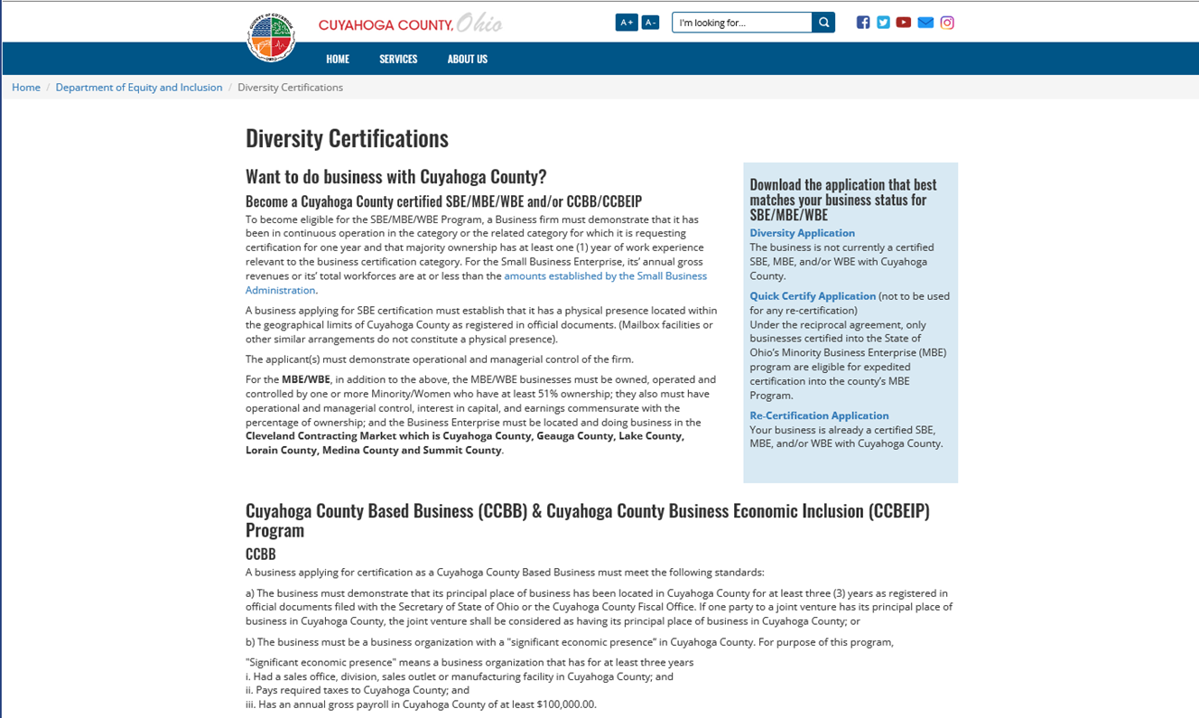
SBE/MBE/WBE & CCBB/CCBEIP Applications
Download various certification applications (https://cuyahogacounty.us/department-of-equity-and-inclusion/diversity-certifications
Cuyahoga County

Slide 7
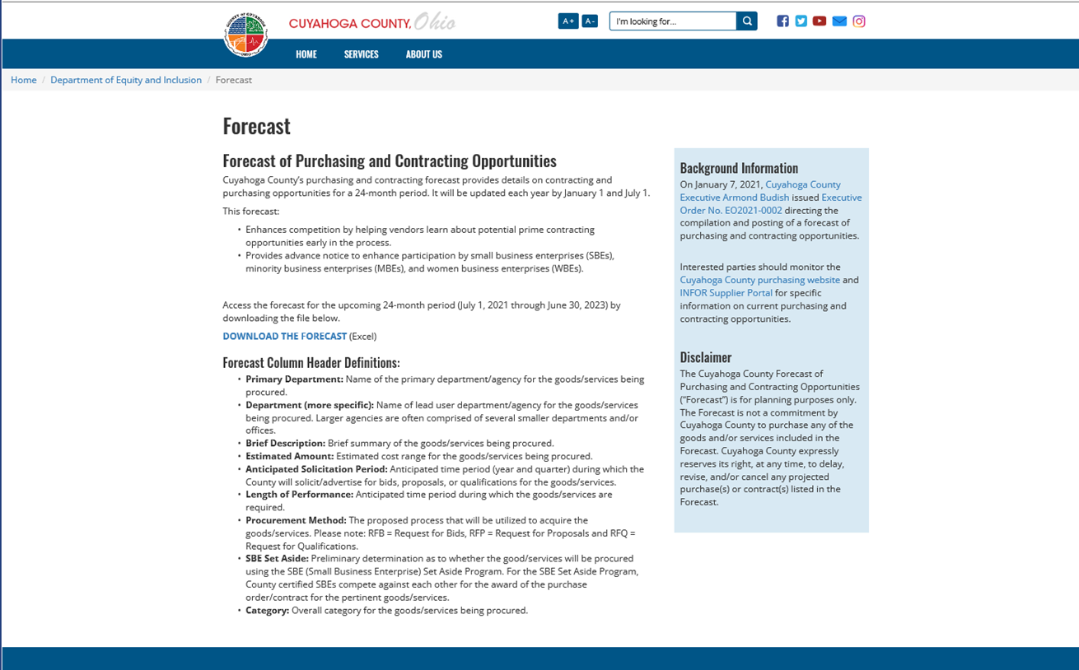
The Cuyahoga County “Forecast”
The forecast details contracting and purchasing opportunities for a 24-month period
  Updated versions posted semiannually, January 1st and July 1st
Advance notice to enhance participation by SBE/MBE/WBEs
The Forecast is available on the County’s website: https://cuyahogacounty.us/department-of-equity-and-inclusion/forecast
Cuyahoga County

Slide 8
Utilizing the County “Forecast”
Review, sort, and filter the information to determine opportunities that match the goods and services your business provides
Register in Cuyahoga County’s Supplier Portal System: INFOR Supplier Portal
  Resources are available on the County website: Cuyahoga County Office of Procurement and Diversity
  Select all applicable NIGP Codes that relate to the goods and services offered by your business
  Keep your registration up to date
Monitor Cuyahoga County’s purchasing website: Cuyahoga County purchasing website.
Research and prepare to submit bid, proposals, qualifications on items
  Solicitation Period varies by procurement method:
    Informal RFB/RFP/RFQ: 8 hours minimum
    Bid – Non-Construction, Bid – Construction, RFP, and RFQ: 30-day minimum
  Determine if you want to team with other businesses and reach out to potential partners early
Cuyahoga County

Slide 9
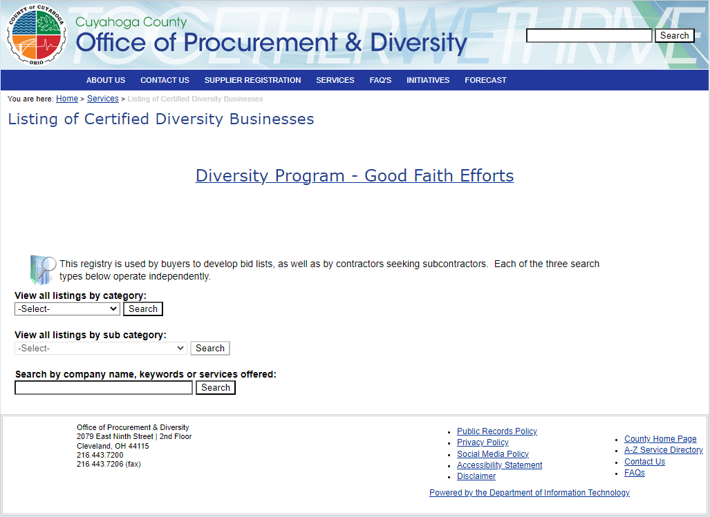
Certified Vendor Listing
Search for County Certified SBE/MBE/WBEs: https://opd.cuyahogacounty.us/en-US/listing.aspx
Cuyahoga County

Slide 10
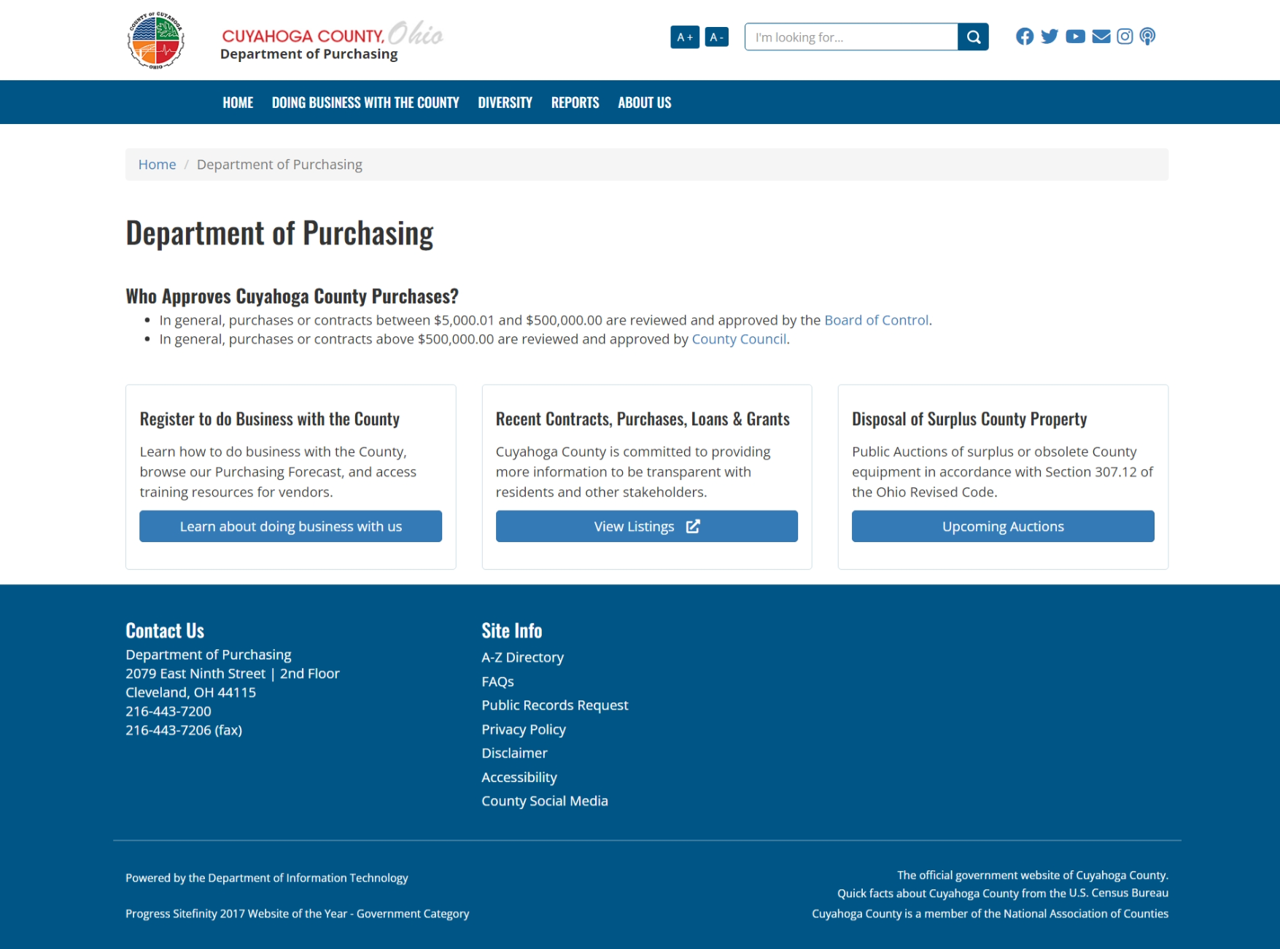
You Are Certified, Now What?
You are certified, now what?
Cuyahoga County

Slide 11
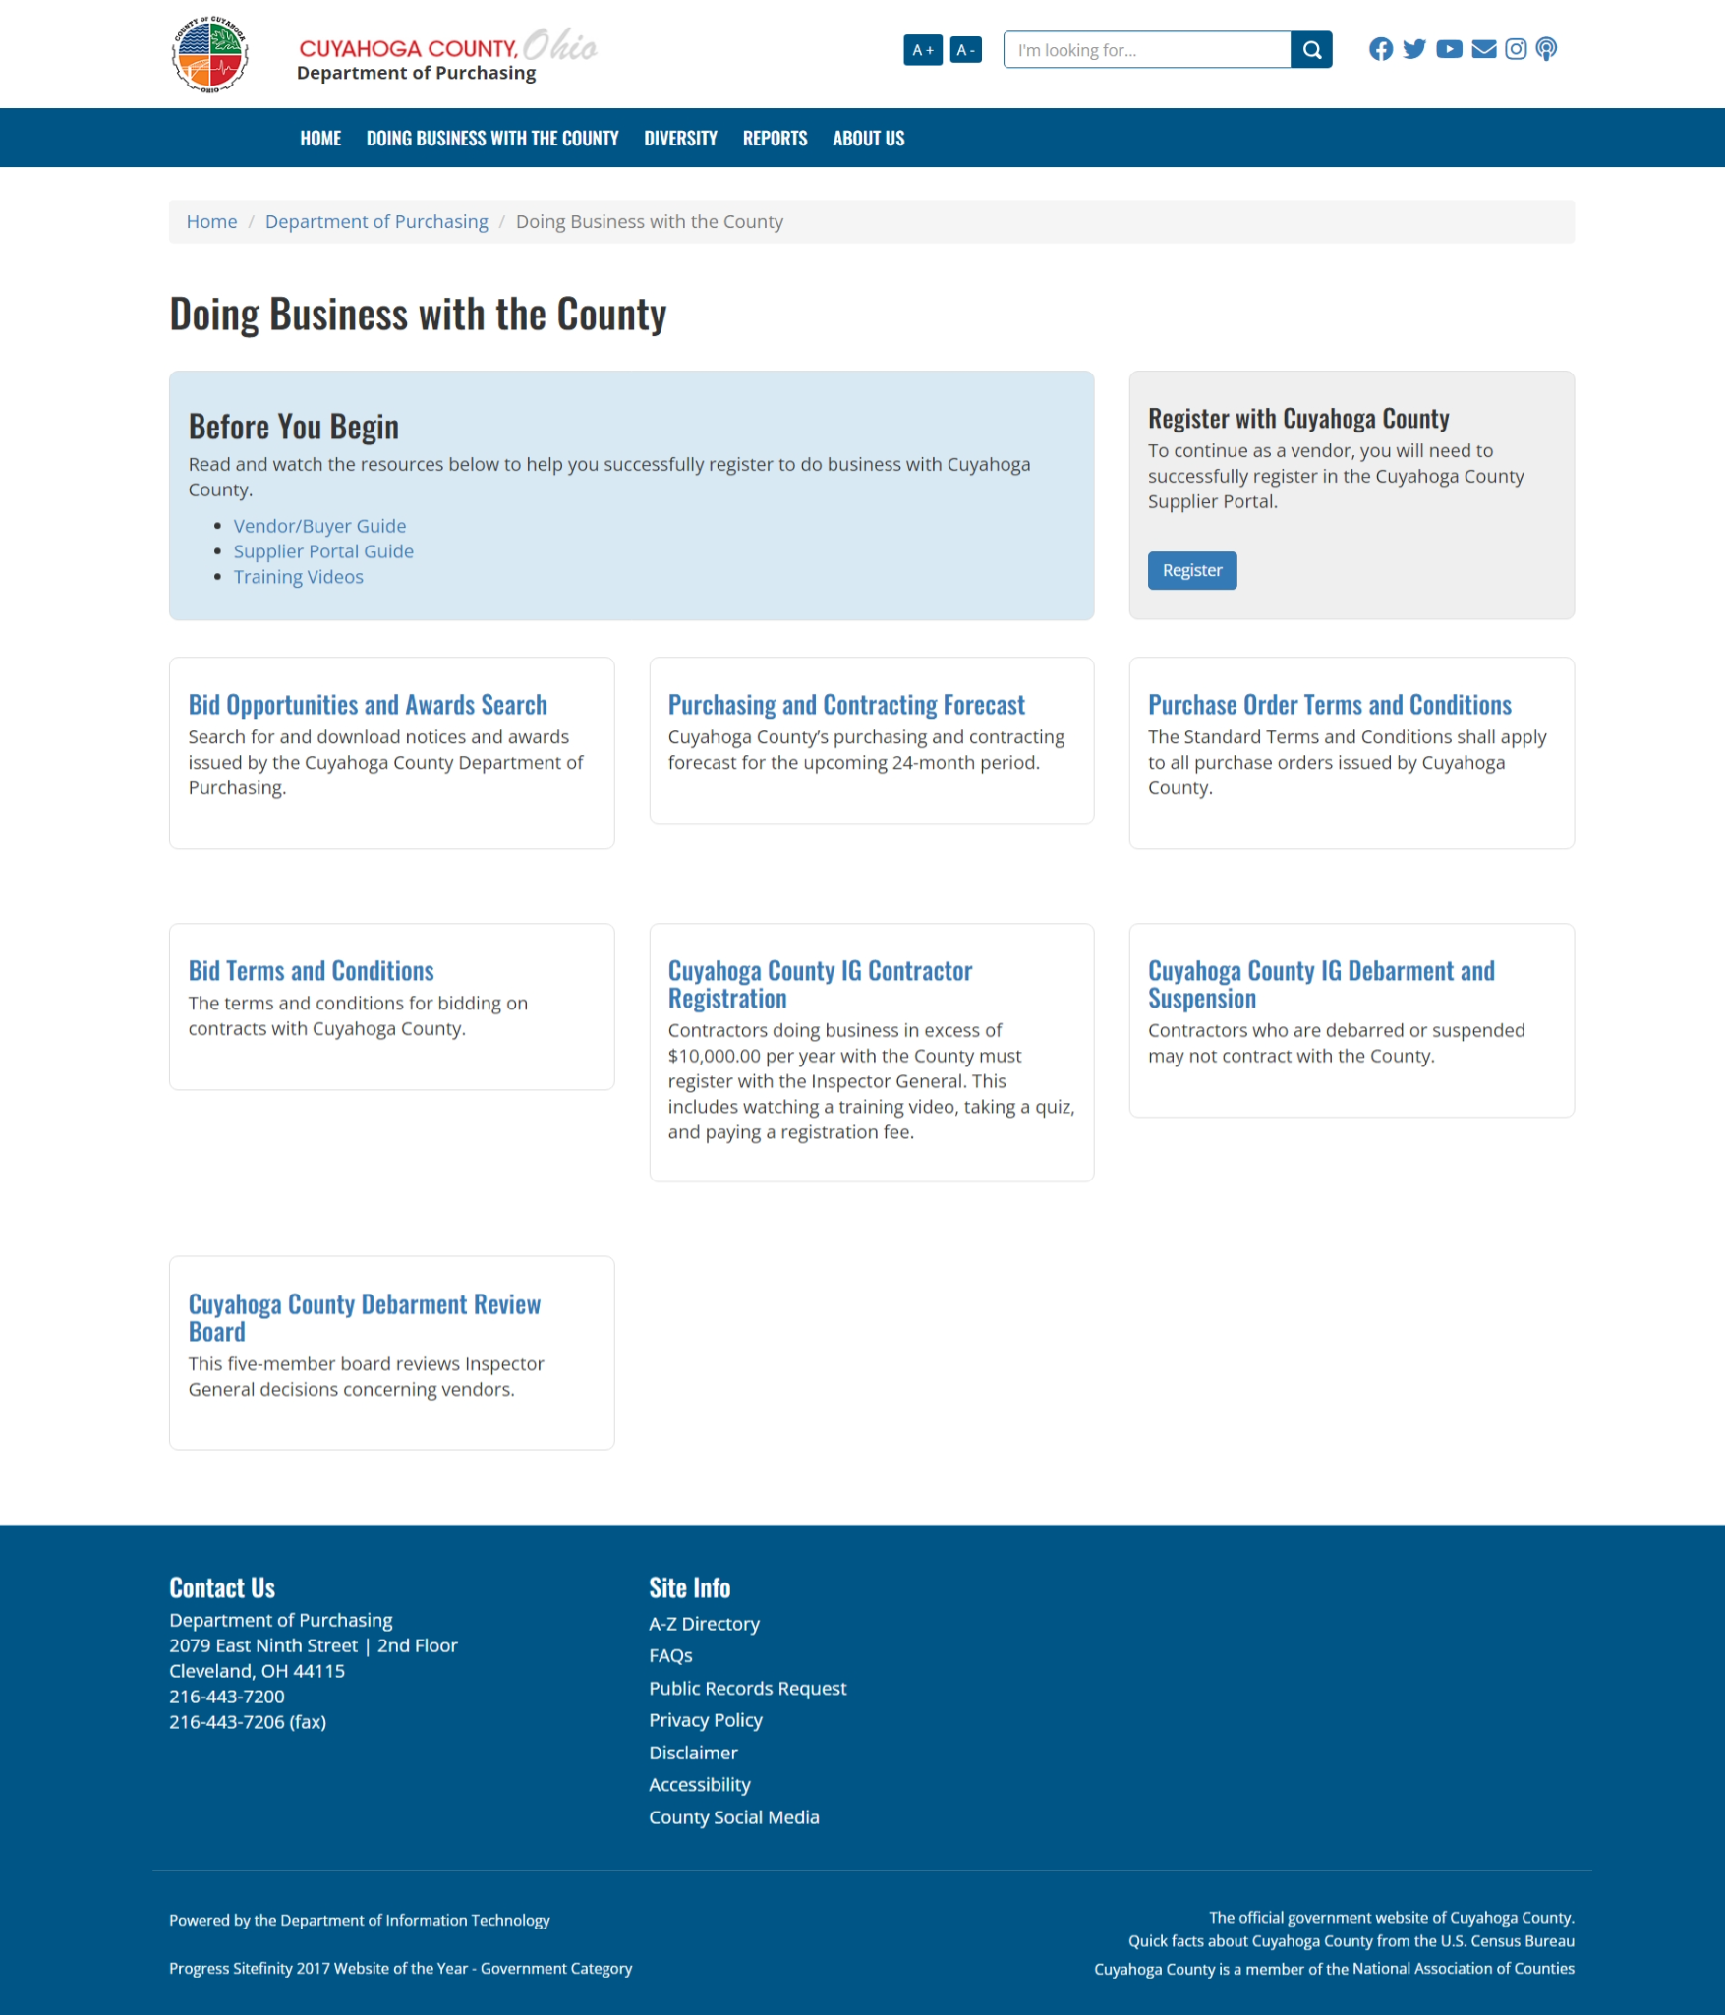
You Are Certified, Now What?
Cuyahoga County

Slide 12
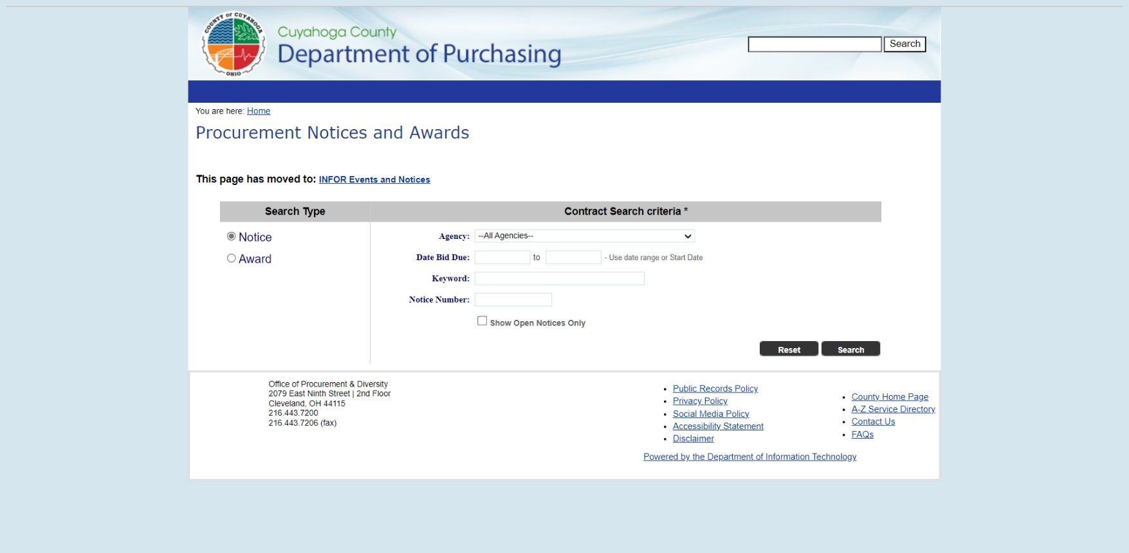
You Are Certified, Now What?
Cuyahoga County

Slide 13
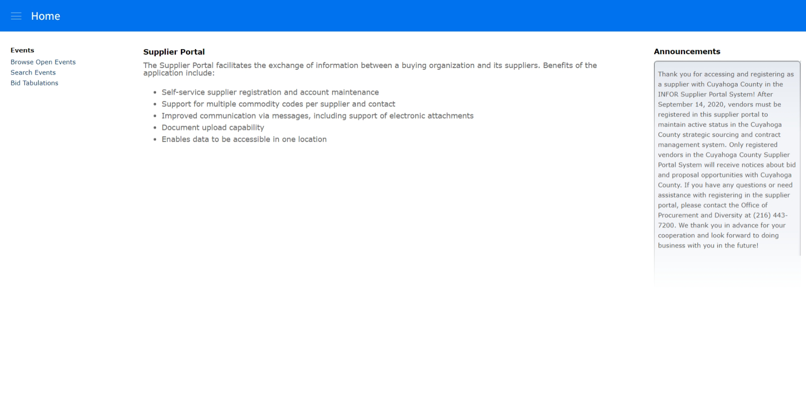
You Are Certified, Now What?
Cuyahoga County

Slide 14
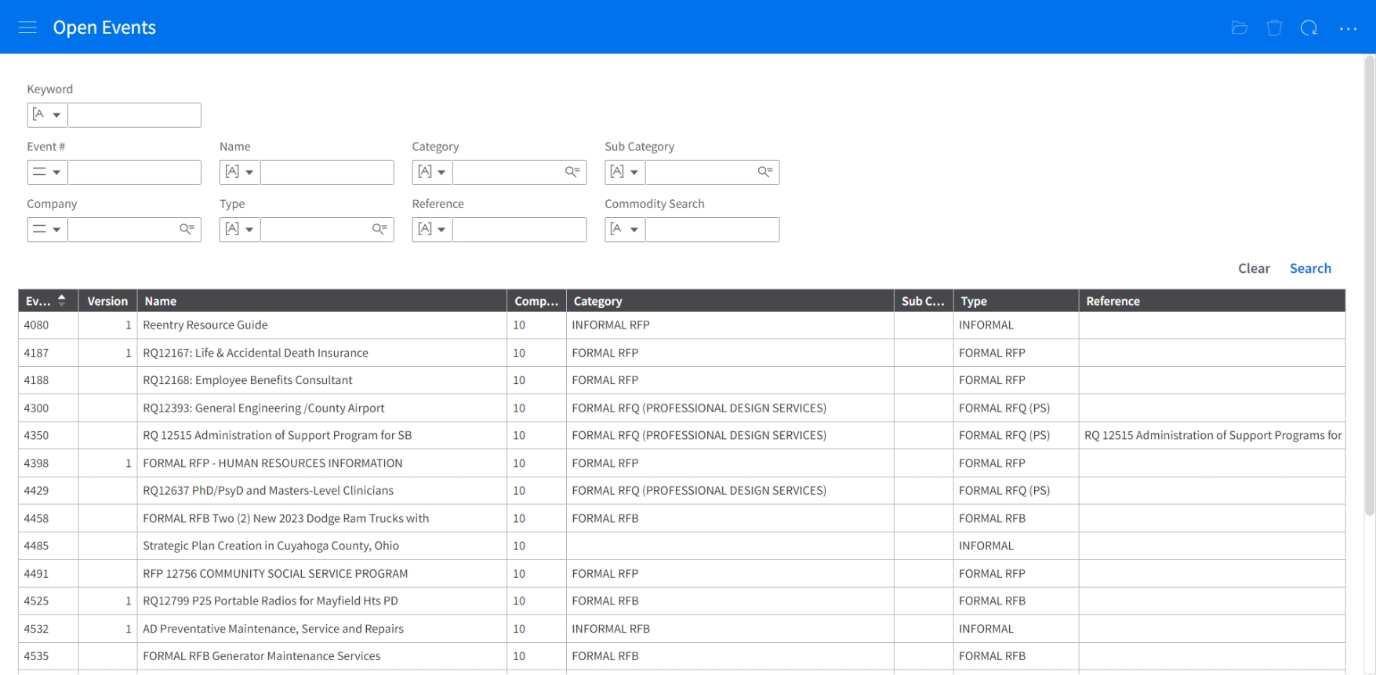
You Are Certified, Now What?
Cuyahoga County

Slide 15
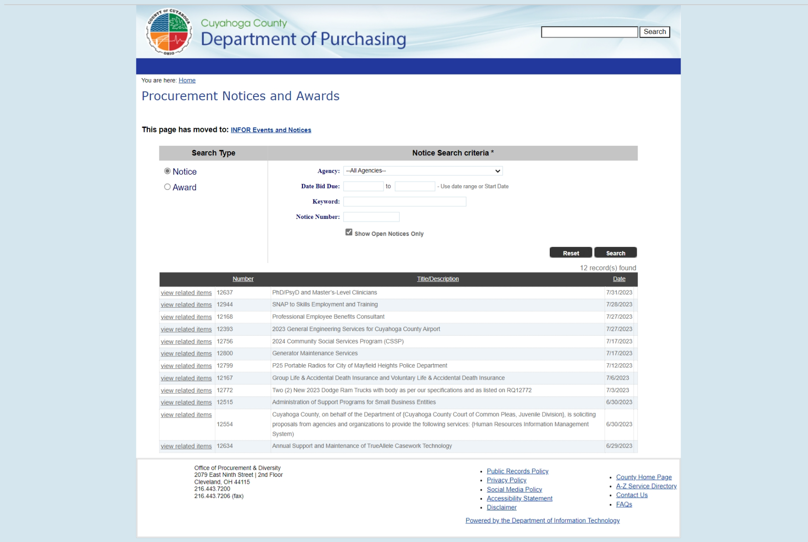
You Are Certified, Now What?
Cuyahoga County

Slide 16
How To Do Business Virtual Sessions
Get questions answered regarding:
Registering in the Cuyahoga County Supplier Portal System to get notified about business opportunities
Updating your existing Cuyahoga County Supplier Portal registration
Downloading and utilizing the County’s Purchasing and Contracting Forecast
Viewing current County bids, RFPs, and RFQs for goods and services
Applying for Small Business Enterprise (SBE), Minority Business Enterprise (MBE), and/or Women Business Enterprise (WBE) certification with Cuyahoga County
Submitting bids, proposals, and/or qualifications in response to informal and formal bids, RFPs, and RFQs
Understanding and preparing the standard required procurement documents… and much more…
Cuyahoga County

Slide 17
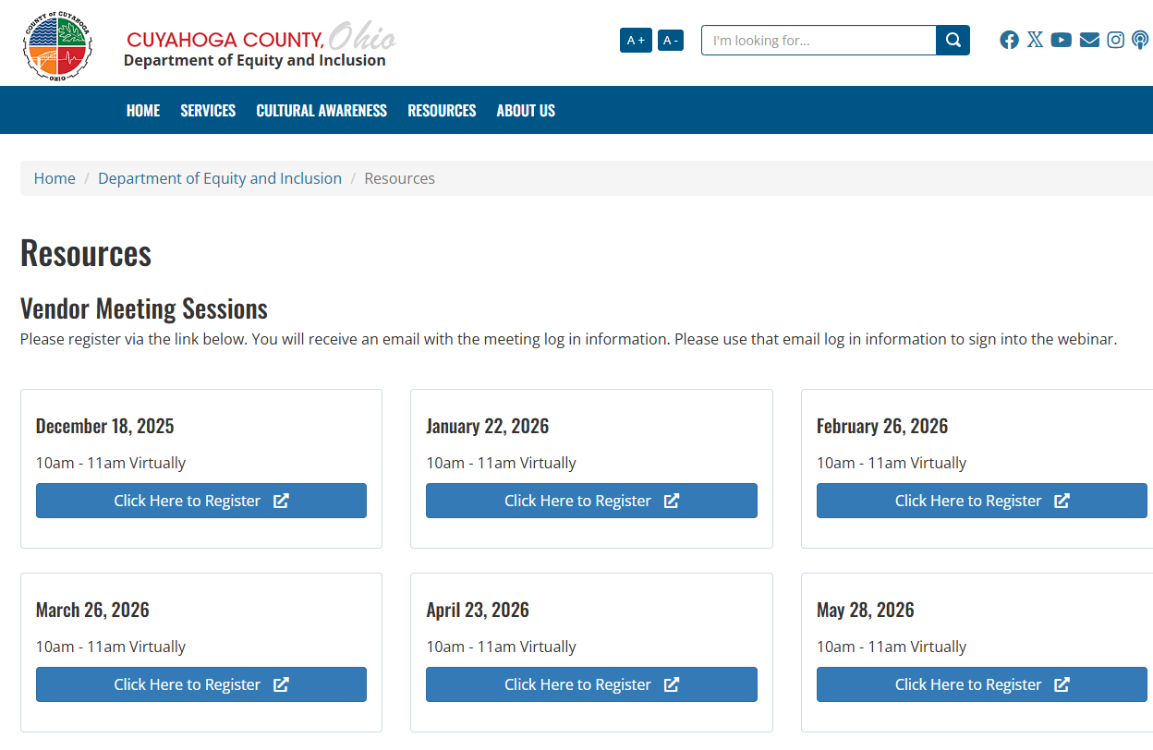

How To Do Business Virtual Sessions
How to register: https://cuyahogacounty.gov/department-of-equity-and-inclusion/resources
Next how to do business is May 28, 2026
Cuyahoga County

Slide 18
For more information, contact us:
  County Administrative Headquarters
  2079 East 9th Street – 2nd Floor Room 2-300
  Cleveland, Ohio 44115
  In-person: 8:30am – 4:30pm
  Phone: (216) 443-7230
  Email: dei@cuyahogacounty.gov
Cuyahoga County

Slide 19



