Slide 1




Cuyahoga County Council
Public Safety & Justice Affairs Committee
Cuyahoga County Central Services Campus Update
Cuyahoga County Council Chambers
February 04, 2025
1:00 PM

Slide 2
Agenda
Brief Background and Process Review
Scope Confirmation - What are we Building?
Budget Confirmation – What is the Cost?
Schedule Confirmation– What is the Timeline?
Questions

Slide 3
Brief Background

Slide 4
Process – Where We Are?
Start-Up
Programming and Project Definition
Plan Acceptance/ Project Delivery Determination
Phase I Conceptual Design
Phase II Conceptual Design
GMP and Early Work
Design-Build Construction
Programmer
Selection
(DLR)
Criteria
Architect
Selection
(HOK)
Design-Builder
Selection
( CCJP)
WE ARE HERE
Bond Sale Process Begins
Guaranteed Maximum Price
[GMP]
Goals
Process
Space Standards
Space Program
Operations
Adjacencies
Project Options
Site Criteria
Budget and Schedule Analysis
Funding Plan: Feasibility Analysis
Implement Real Estate Plan
Site Selection Process
Confirm Project Delivery
Retain Criteria Architect
Retain Design Builder
Confirm Program
Finalize Site Selection and Acquisition
Commence Schematic Design (SD)
Implement Finance Plan
Confirm Budget, Scope and Schedule
Complete Schematic Design
Complete Design Development
Commence Design Assist Process
Develop Early Procurement Plan
GMP Pricing and Reconciliation
Bond Sale Process
Early Construction Packages
Groundbreaking
Complete CDs
Construction
Move-in
Operational Commencement

Slide 5



Project Team
Owner
Cuyahoga County
County Core Project Team
Nichole English
Laurel Domanski-Diaz
AW Phillip Christopher
Lt. Russ Jaenke
Cpt. Rich Peters
Criteria Architect
HOK
Owners Rep
PMC
PMC
Jeff Appelbaum
Ellis Katz
Chris Panichi
Design-Builder
Architect of Record
Subcontractors

Slide 6
Project Scope

Slide 7
Project Scope – What Are We Building?
Building Metrics
  Project Size – 872,000 ft.²
    Main Campus Building – 852,000 ft.²
    Professional Development Center –20,000 ft.²
  Housing
    Rated Capacity - 1886 Beds
      52 Housing Units
      24 Classifications
    Operational Capacity – 85%
  Core Support Facilities
    Facilities designed for expansion up to 2400 beds
  Sheriff’s Administration and Professional Development Center

Slide 8
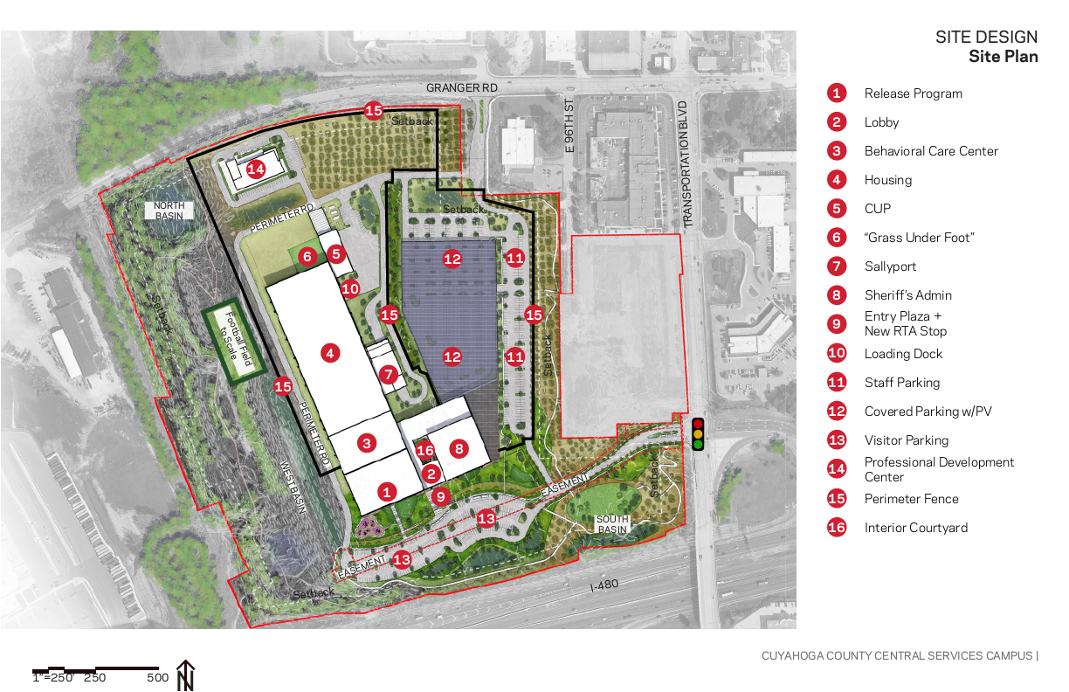
Project Scope– Site Layout
Utilizes an existing asset
Training room/teaching/testing facilities (isolates noisy activity)
Off hour use including other law enforcement agencies
Cost savings

Slide 9
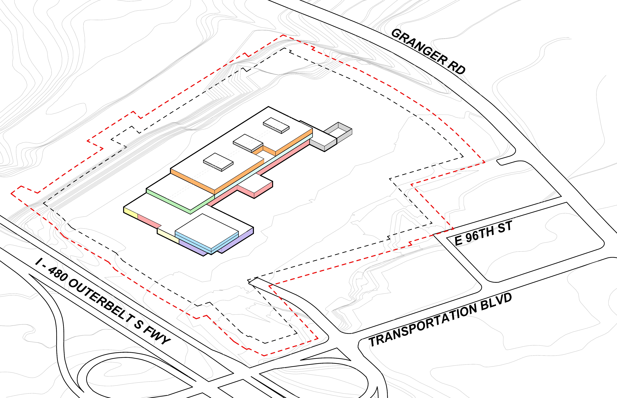
Project Scope– Site Layout- Massing Model
Main Campus Building 3 Story Structure

Slide 10
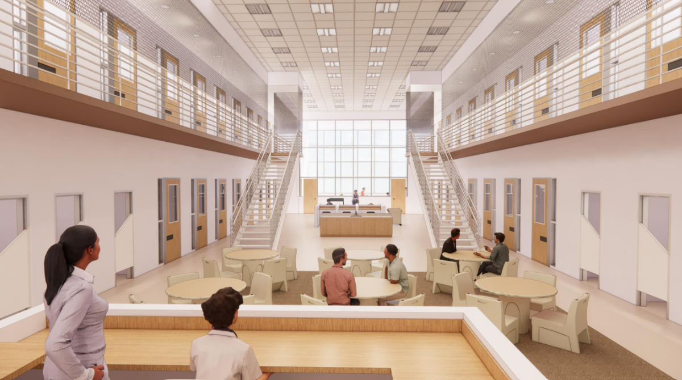
Project Scope– Housing Units
Translation of concepts previously shared:

Slide 11
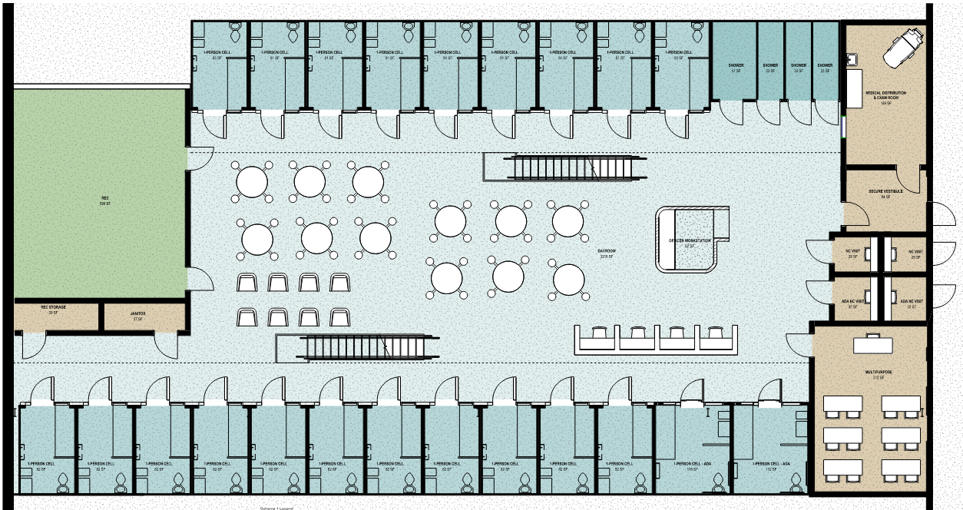
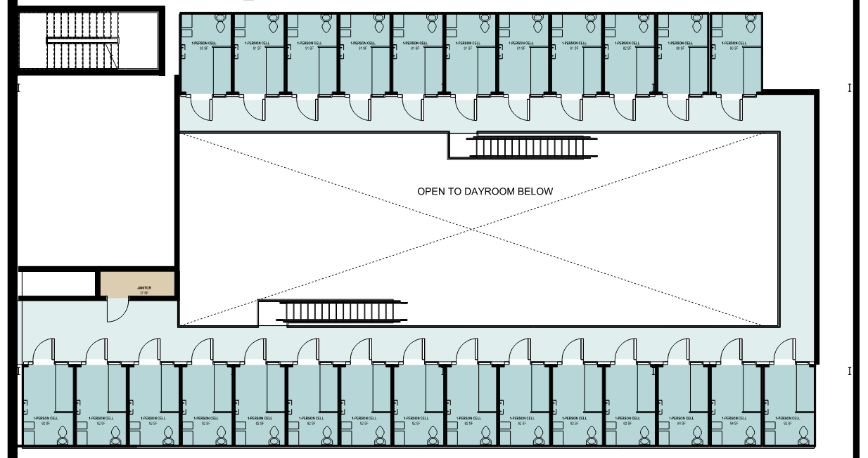
Project Scope– Housing Units
Translation of concepts previously shared:
Rec Yard
Medical Exam and Medicine Pass
Secure Vestibule
Non-Contact Visitation
Multi-Purpose
Example: Single Cell /48 Bed/ First Floor
Upper Tier

Slide 12
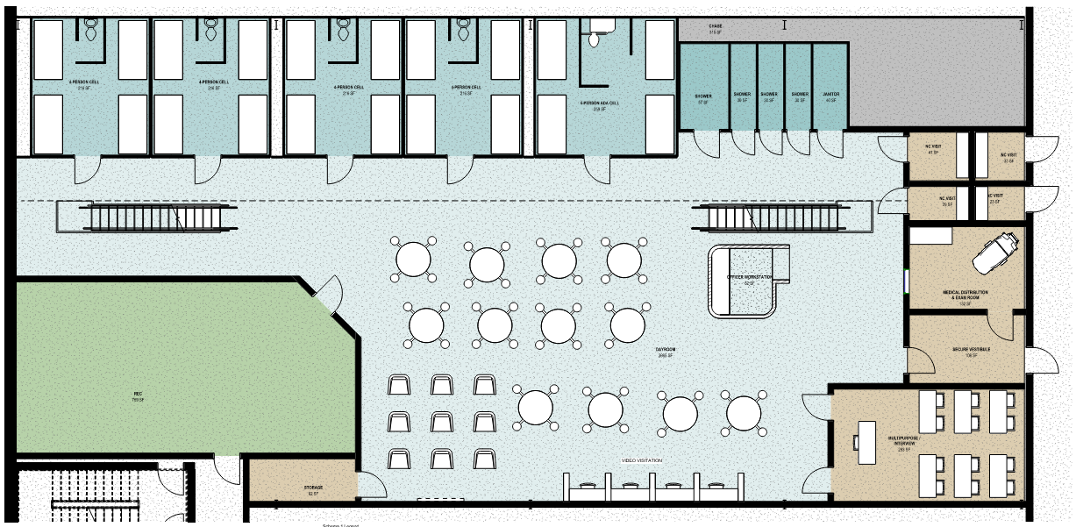
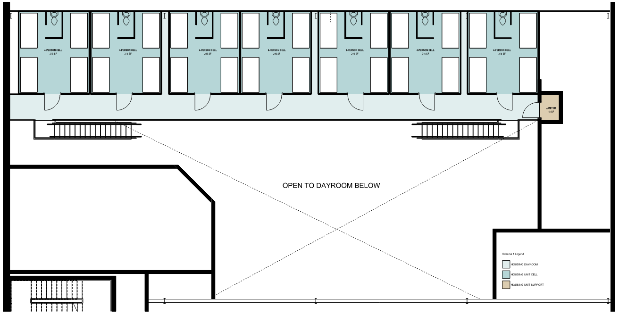
Project Scope– Housing Units
Translation of concepts previously shared:
Non-contact Visitation
Medical Exam and Medicine Pass
Secure Vestibule
Multi-Purpose
Rec Yard
Example: 4 Bed Cell /48 Bed/ First Floor
Upper Tier

Slide 13
Project Budget

Slide 14
Project Budget: What is the Cost?
DESIGN- BUILDER COSTS $785,150,000
Estimate include:
Trade Costs (Labor/Materials/Equipment)
Design-Builder Contingency
General Conditions (including Staff)
Insurance
Payment and Performance Bond
Architect / Engineer of Record Fees
DB Fee
COUNTY COSTS $104,521,000
Estimate include:
Permits
Design Architect Fees
FF&E/OS&E Costs
Precon Service Fees
Misc. Consultant Fees (Testing, PMC, Geotech, Survey, Commissioning, etc)
Insurance
Operational Costs such as Utility Service and Utility Consumption Costs
County Hard/Soft Cost Contingencies
TOTAL DEVELOPMENT BUDGET $889,671,000

Slide 15
Project Schedule

Slide 16
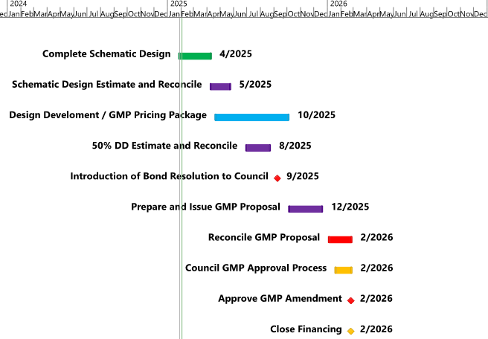
Project Schedule: What is the Timeline?
Milestones to GMP and Financial Close

Slide 17
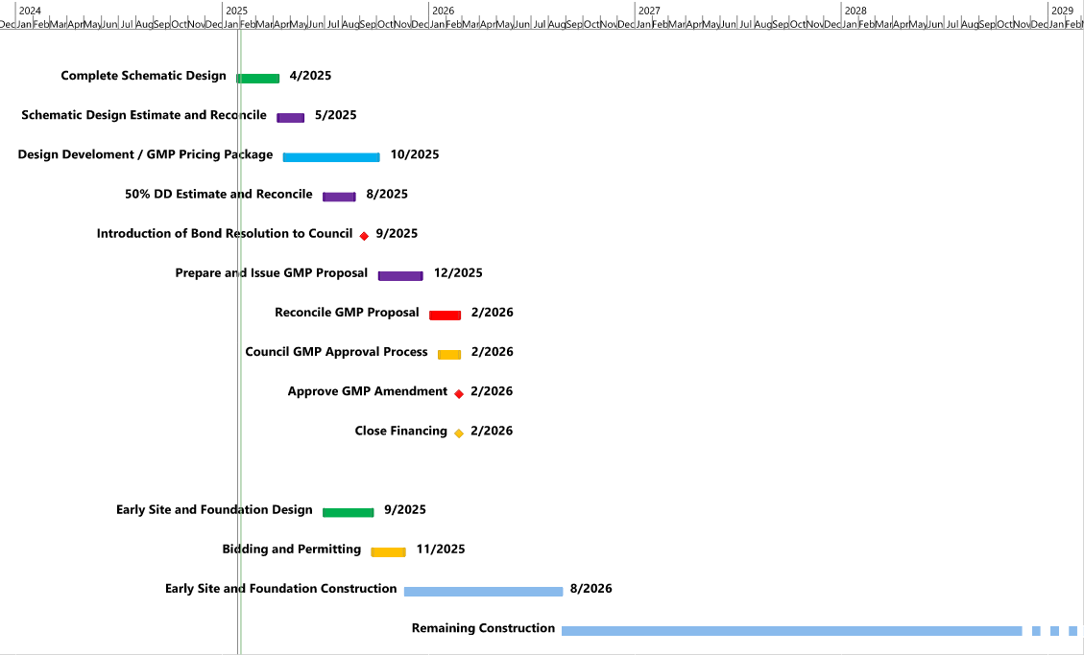
Project Schedule: What is the Timeline?
Design and Construction

Slide 18
Questions?

